Slide 1
DEEP DIVE – ACES & Trauma
Presenting on Complex Trauma, Adverse Childhood Experiences, and What We Can Do About It!

Slide 2
Our Agenda
October 27, 2021
Time | Topic
8:30am | Welcome and Debrief
9:00am | Your Presentation Background, Horror Stories and Needs Today
9:30am | Key Slide Review & Identification of Key Slides for Your Agency
10:00am | Activity Review, Thought Process & Discussion – Make it Personal
10:45am | Responding to Unaddressed Group Identified Needs

Slide 3
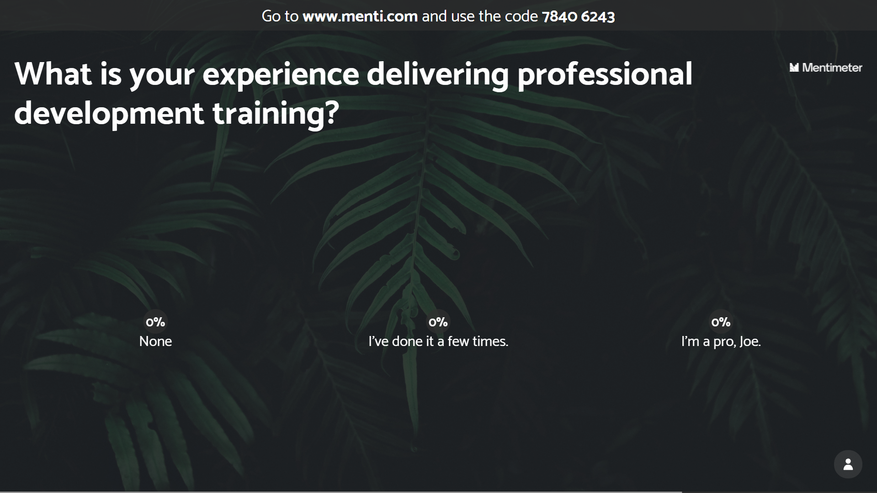

Slide 4
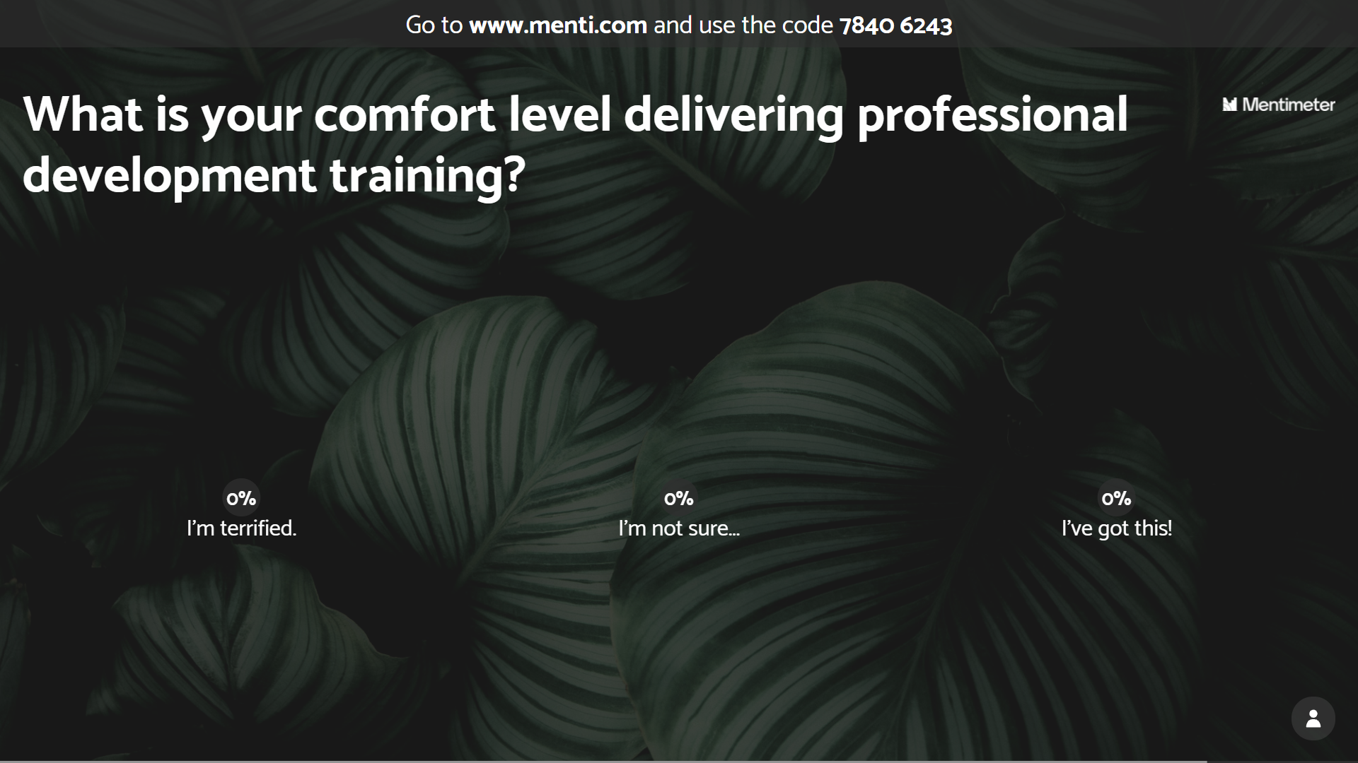

Slide 6
In your breakout room, please discuss what your needs are today. You will be asked to report your needs upon return.
Notes:
Notes: Although there are ongoing discussions about whether or not the ACE survey should be administered to presentation participants, and I understand concerns about retraumatization, this is the most important component of personalizing the presentation.
The survey is private and totally voluntary. I ask people to keep track of their score on their fingers or in their minds. I acknowledge up front that I will not ask for people to disclose their ACE score, except for one group, and only if they feel comfortable: Those with an ACE score of Zero.
Please do read the ACE questions aloud.
Directions: Keep track of your total number of yes answers. This is your ace score.

Slide 9
Adverse Childhood Experiences Study (ACES)
ACES began as study in the late 1980’s and 1990’s at a diet and nutrition center managed by Kaiser-Permanente in San Diego, California. It became the largest study ever to examine social determinants of health.
Over 17,000 people participated in the study, which found a causal connection between traumatic childhood experiences and health.
The study considers the long-term impact of three common forms of household abuse and dysfunction.
ACES Participants were mostly:
Middle class, average age of 57
80% White, 10% Black, 10% Asian
74% Some college
44% Graduated college
49.5% Men
Since the original ACE study, new research demonstrates that ACEs are more prevalent for those belonging to non-dominant cultures and living in poverty...
Notes:
Notes: This is a brief summary of the ACE Study origins and demographics. The text on this slide is all you need; however, I find that adding salient details about Felitti or Anda’s experience increasing engagement. Check out these video interviews, or just google ACES origins to find what resonates with you:
Politics and Profit Interview: https://vimeo.com/349164603/b152fa1e61
Indian Congress Lecture: https://www.youtube.com/watch?v=-ns8ko9-ljU

Slide 10
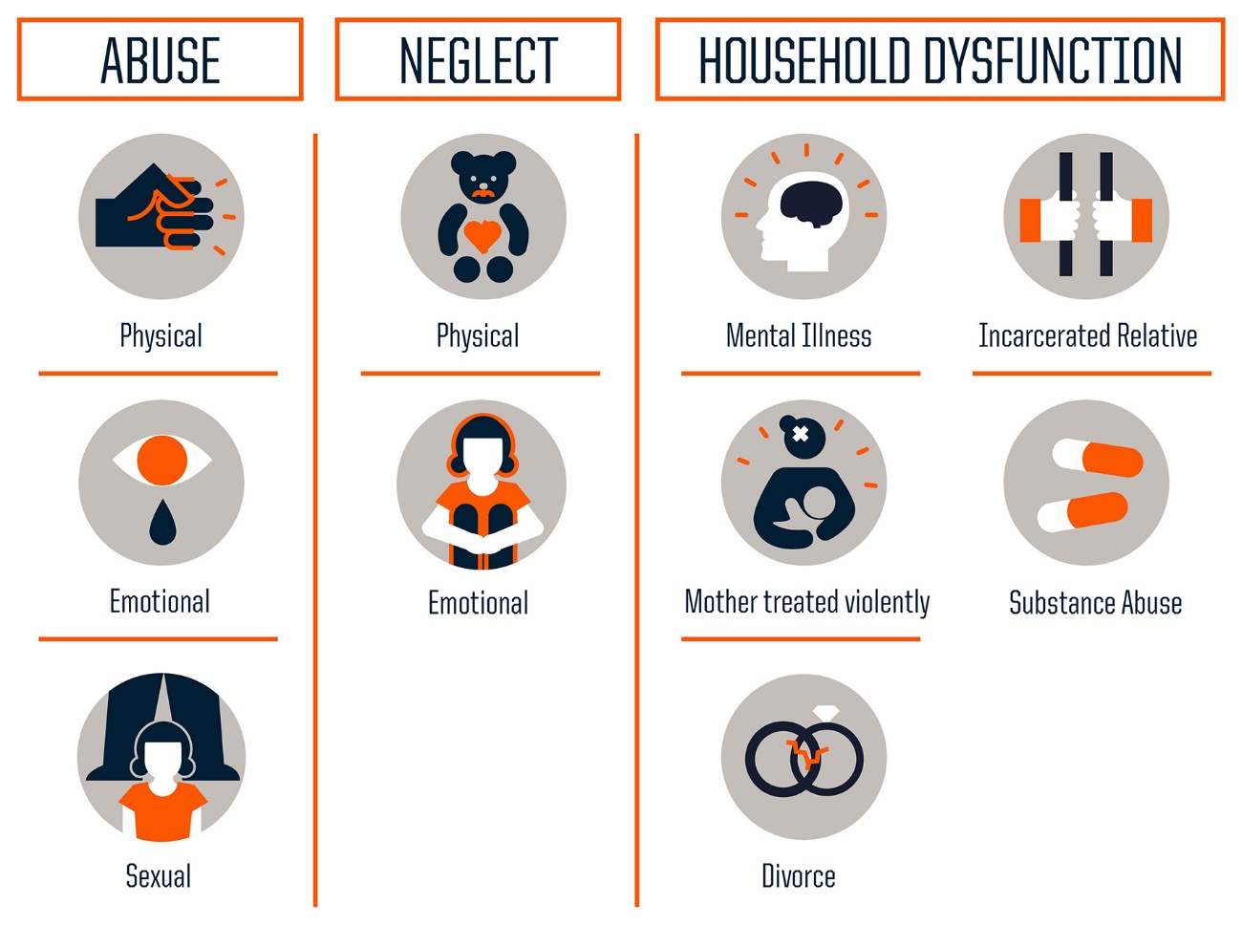
THREE
TYPES OF ACEs
MEASURED
The original ACE study measured three types of ACEs through a 10 question assessment:
But, there’s actually more than just these…
Notes:
Adverse Childhood Experiences are any exposure to one of 10 forms of household abuse and dysfunction prior to your 18th birthday. There are now more known domains of exposure, but for today, we will focus on the 10 original ACES.
Source: Centers for Disease Control and Prevention
Credit: Robert Wood Johnson Foundation
https://www.npr.org/sections/health-shots/2015/03/02/387007941/take-the-ace-quiz-and-learn-what-it-does-and-doesnt-mean

Slide 11
ACEs and Intersectionality
People from non-dominant cultures are significantly underrepresented in the ACEs research.
When they are included in the data, Black, Hispanic and LGBT children are consistently shown to be exposed to more adversities than white children.
Similarly, those living in economically distressed communities are more likely to experience ACEs.
This has led to an ongoing reexamination of the ACEs that predict long-term negative health and opportunity outcomes.
Racial disparities in Childhood Trauma: https://scholar.harvard.edu/files/davidrwilliams/files/child_adversity.pdf

Slide 12
RACE, ETHNICITY AND INCOME INFLUENCE EXPOSURE
ACE Exposure by Race/Ethnicity and Income Level
N=84,837
Poor and near poor children are more likely to be exposed to ACES if their parents lack a high school education.
They are more than twice as likely to have three or more categories of trauma exposure compared to children not impacted by poverty.
BIPOC are disproportionately exposed to trauma when income is not a factor.
https://scholar.harvard.edu/files/davidrwilliams/files/child_adversity.pdf
Notes:
https://www.ncbi.nlm.nih.gov/pmc/articles/PMC4815563/
https://scholar.harvard.edu/files/davidrwilliams/files/child_adversity.pdf

Slide 13
Since the original ACE study, exposure to additional early life stressors are being studied.
Passing of a loved one or pet
End of a relationship
Acute Trauma: is caused by a single traumatic event that triggers extreme emotional or physical stress.
Natural Disaster
Homelessness, Foster Care
Poverty
Complex Trauma: is caused by exposure to multiple traumatic events. The long-term impact of this exposure is severe and pervasive.
Community Violence
Deportation or Migration
Historical Trauma: is a complex and collective trauma experienced over time and across generations by a group of people who share an identity, affiliation, or circumstance.
Bullying
Discrimination, Racism
Medical Trauma
Notes:
Note: Additional known trauma domains with links to long-term negative health and opportunity outcomes.

Slide 14
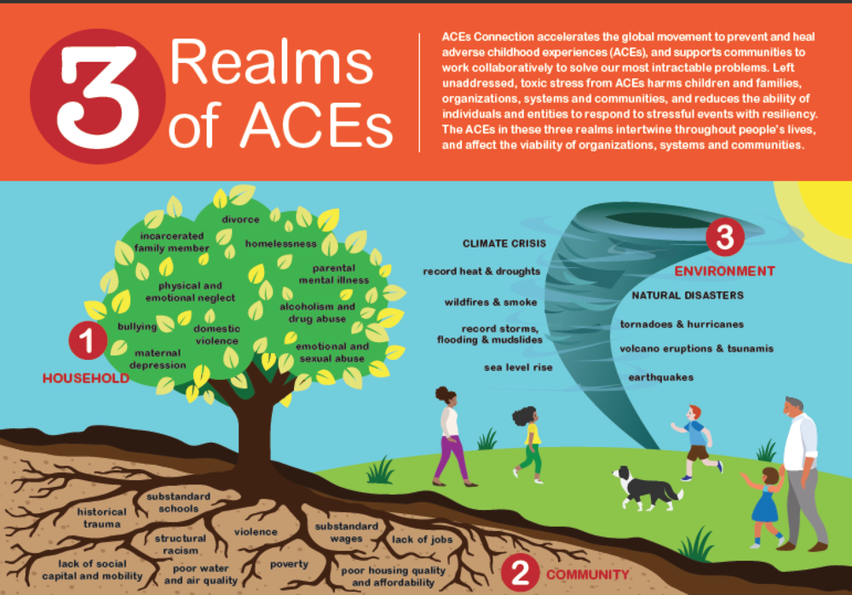

Slide 15
The Brain Science
A person’s environment and experience shapes their behavior and health.
Our brain is designed to prioritize survival.
Hormones like Cortisol are released when our “Fight, Flight, or Freeze” response is triggered.
Notes:
Notes: There are many local expert presenters and presentations that can unpack the neurology of ACES. This is not that presentation. In fact, all I want to acknowledge here is that audiences already possess enough intuitive understanding of how the brain works that we only need to review what we already know. You may read the brain science slides as-is, or supplement with any salient details you wish to include, as long as they are based in evidence.

Slide 16
Toxic Stress
Prolonged exposure to Cortisol and other stress hormones is toxic, and makes permanent changes to the brain.
This means you may encounter clients who are perfectly adapted to survive in their home environment, but who cannot turn-off their behavioral and stress response adaptations in your organization, community or other “normal” situations.
Notes:
Notes: This slide may be read as presented.

Slide 17
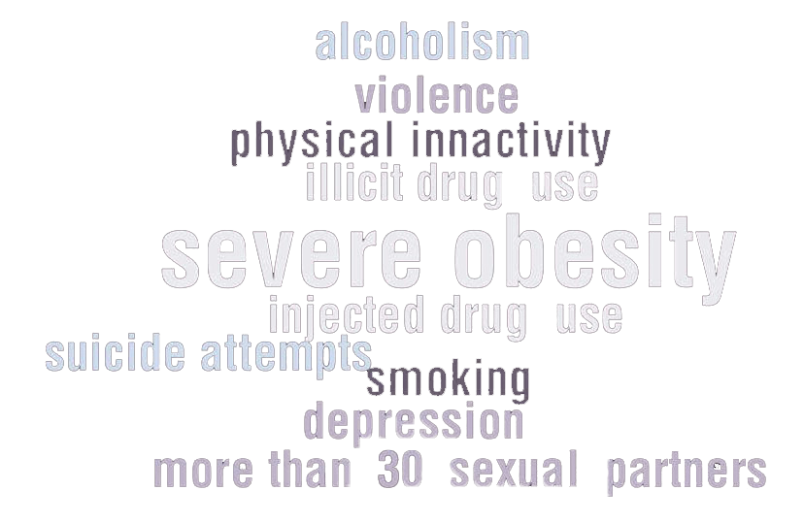
ACES LEAD TO THE 10 MOST COMMON CAUSES OF EARLY DEATH
Notes:
Notes: Read this slide as is. Again, these are the findings from the original ACES study which is our focus today.

Slide 18
REFRAMING OUR POINT OF VIEW
With an ACE score of 0, the majority of adults have few, if any, risk factors for the most common diseases leading to early death.
With an ACE score of 4 or more, the majority of adults have multiple risk factors for these diseases or the diseases themselves.
Much of what we see as problem behaviors should actually be viewed as a
personal solution to an unrecognized prior adversity.
Notes:
Notes: This is a critical slide. It is the paradigm shift we are asking all participants to embrace. If the behaviors our clients are experiencing bring them benefit – if they are solutions to an unrecognized prior adversity – how does that shift the nature of our work and approach?

Slide 19
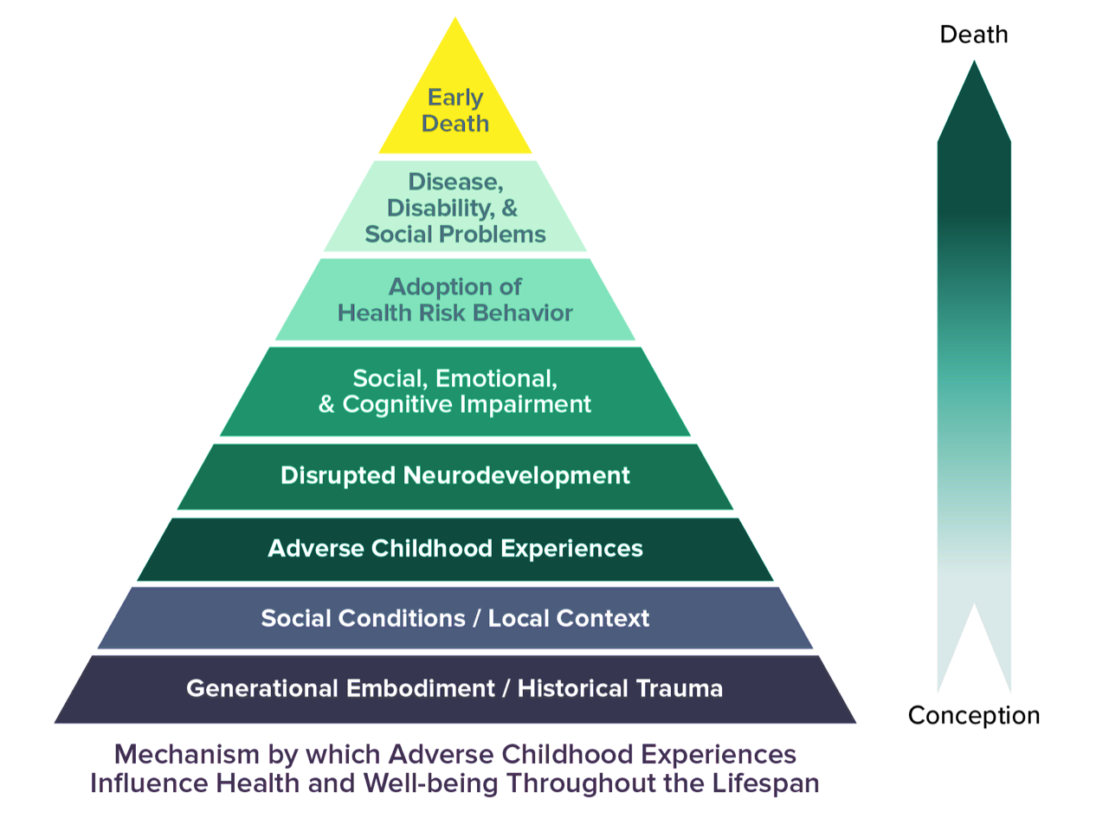
The ACE Pyramid
Without accounting for individual levels of resiliency, this pyramid depicts how impacts to health and well-being can occur over a lifetime as a result of exposure to Adverse Childhood Experiences.
“Personal Solution”
what is predictable, is preventable
The ACE study found links between ACEs and adult health risks, often leading to chronic health conditions.
Those with 4 or more ACEs were found to be:
12.2x as likely to have attempted suicide
7.4x as likely to consider themselves to be an alcoholic
4.7x as likely to have ever used illicit drugs
4.6x as likely to have had 2 or more weeks of depressed mood in the past year
3.2x as likely to have had 50 or more intercourse partners, and
2.3x as likely to smoke
Notes:
Notes: So this is the framework by which we understand the progression of trauma into risk. If we start with a foundation of adversity, we expect brain development to be disrupted just as we saw in the Harvard video. That disruption leads to social, emotional or processing impairment and to compensate, the adoption of health risk behaviors as a personal solution to the challenge we are experiencing (after all, we’re all wired to want to feel better). But we know those personal solutions lead to disease, disability and social problems, and ultimately to early death. That is not hyperbole.
Fortunately, the model also allows for intervention points that allow us to interrupt the ACES trajectory. This is where your work is so important.

Slide 20
Let’s Talk about Kernels
Kernels are low or no-cost to evidence-based strategies recognized as fundamental units of behavioral influence.
This means we can unleash access to strategies that support safety, relationship and skill building essential to our client’s readiness to grow and learn.
Kernels give us a way to implement simple but effective practices that interrupt the ACES trajectory, move us from intuition to intention, and improve outcomes.
Notes:
Notes: The following slides may be read as presented. Kernels were first identified in a metastudy conducted by Dennis Embry and Tony Biglan: “Evidence-based Kernels: Fundamental Units of Behavioral Influence.”
https://www.ncbi.nlm.nih.gov/pmc/articles/PMC2526125/

Slide 21
What else can we do?
Be clear, consistent, predictable, and follow through
Maintain high expectations and assume positive intent, build on success rather than establishing limits
Provide guided opportunities to participate through voice and choice
Focus on the feeling of safety, building trust, and reliability of relationships
Notes:
As service providers we can also:
Deescalate situations
Check assumptions – observe and ask questions
Deeply listen, recognize strengths and successes

Slide 22
In your breakout room, please discuss the slides your remember as being most relevant for your agency and audience.
Notes:
Notes: Although there are ongoing discussions about whether or not the ACE survey should be administered to presentation participants, and I understand concerns about retraumatization, this is the most important component of personalizing the presentation.
The survey is private and totally voluntary. I ask people to keep track of their score on their fingers or in their minds. I acknowledge up front that I will not ask for people to disclose their ACE score, except for one group, and only if they feel comfortable: Those with an ACE score of Zero.
Please do read the ACE questions aloud.
Directions: Keep track of your total number of yes answers. This is your ace score.

Slide 24
Would we like to see how to set up a Mentimeter slide?
We will be using the annotate features on Zoom. Let’s practice now.
Please open your web browser on your phone or second screen and go to: www.menti.com
We will be sharing anonymously with each other throughout the presentation.
I will give you the participation code on the next slide.

Slide 25
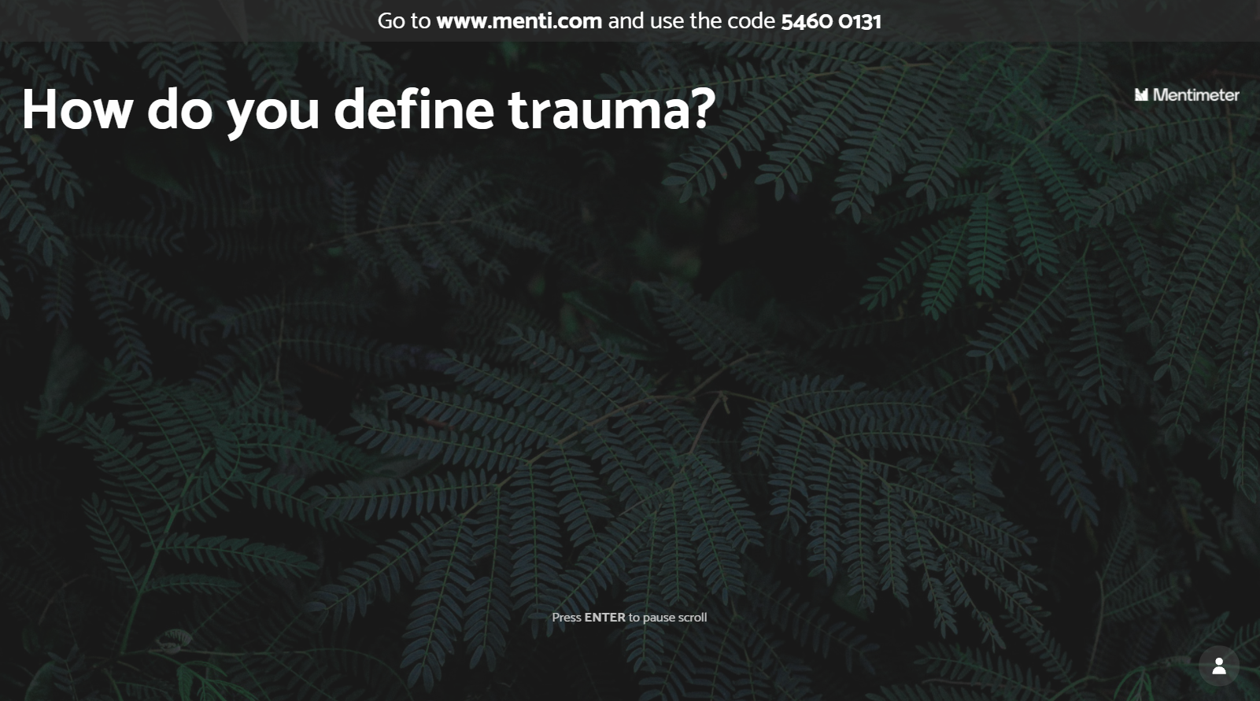

Slide 26
CLIENT OF CONCERN
Think about a client for whom you have concern. Share the following:
What worries do you have for this person?
What challenging behaviors does this person exhibit?
Notes:
Notes: Our goal is to immediately make this training personal by inviting participants to consider how they are impacted by client/student behavior in their places of work. We will expand on these questions as we move through the presentation. Ultimately, we will ask participants to consider what role trauma may have in influencing these behaviors, whether or not these behaviors bring benefits to the client, and why they would stop engaging in these behaviors without a replacement behavior.

Slide 28
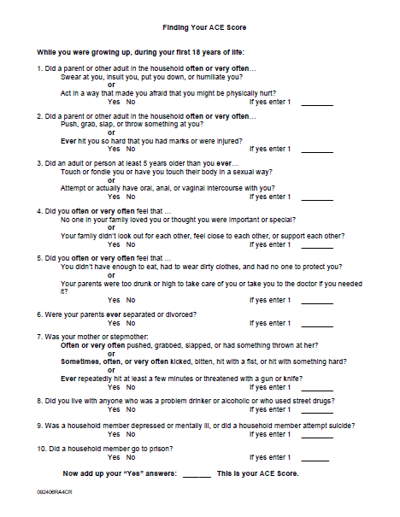
ACE SCORE CALCULATOR - Discussion
Notes:
Notes: Although there are ongoing discussions about whether or not the ACE survey should be administered to presentation participants, and I understand concerns about retraumatization, this is the most important component of personalizing the presentation.
The survey is private and totally voluntary. I ask people to keep track of their score on their fingers or in their minds. I acknowledge up front that I will not ask for people to disclose their ACE score, except for one group, and only if they feel comfortable: Those with an ACE score of Zero.
Please do read the ACE questions aloud.
Directions: Keep track of your total number of yes answers. This is your ace score.

Slide 29
Annotate: What is Maja’s
ACE SCORE?
0
1-3
4+
Notes:
Notes: The point here is that we can’t fully know our client’s trauma history. So, what’s the safer perspective? That they’re behaving badly to annoy you, or that there may be some underlying issue that would benefit from a trauma-informed approach?

Slide 31
Annotate: Client of Concern Question #3
Think about YOUR client of concern. Do you suspect this person has been exposed to trauma?
No
Yes
Notes:
Notes: The point here is that we can’t fully know our client’s trauma history. So, what’s the safer perspective? That they’re behaving badly to annoy you, or that there may be some underlying issue that would benefit from a trauma-informed approach?

Slide 32
CLIENT OF CONCERN
Think about a client for whom you have concern. Write down the following:
What worries do you have for this client?
What challenging behaviors does this client exhibit, if any?
Do you suspect this client has exposure to ACES?
All behavior has a function. If we consider this client’s behavior as a personal solution instead of a problem, what purpose might the behavior serve? How does the behavior help them to get their needs met?
Notes:
Notes: Now we are back to turn and talk. In dyads or triads, participants should discuss the “benefits” that engaging in the noted problem behavior brings to their client. What is the function of the behavior. Encourage speculation based on what they’ve learned today. This will be a challenging exercise for some participants transitioning from understanding their client’s behavior as “bad.”
We want participants to understand that all behavior has a purpose. Generally to gain something or escape something. This understanding is key to finding a prosocial replacement behavior.

Slide 34
Assessing for a Trauma-Informed Approach
Instructions to prepare for breakout session:
Strength: Please note one question that you strongly feel your organization is doing well on.
Challenge: Please note one question that you strongly feel your organization is challenged by.
Adopted from the National Center on Family Homelessness Trauma-Informed Organizational Self-Assessment and “Creating Cultures of Trauma- Informed Care: A Self Assessment and Planning Protocol” article by Roger D. Fallot, Ph.D. & Maxine Harris, Ph.D.
Notes:
Please mark down one question
https://www.air.org/sites/default/files/downloads/report/Trauma-Informed_Organizational_Toolkit_0.pdf
http://www.traumainformedcareproject.org/resources/Trauam%20Informed%20Organizational%20Survey_9_13.pdf

Slide 35
Building resiliency & relationships with staff & clients based on respect and inclusion. Creating secure, physically & psychologically safe environments. | Organizational operations and decisions are made with transparency and lots of information sharing in order to strengthen relationships with staff and clients. | Connecting clients with peers whose stories and lived experience can promote recovery, healing and hope. | Placing importance on partnership that levels the power differences between staff and clients. Sharing power in decision-making by recognizing everyone has a role to play in your organization. | Staff and client strengths and experience is recognized and built upon. Staff are “facilitators” of recovery and decision-making rather than “controllers.” | Your organization moves past stereotypes and biases to create policies, procedures and offer services responsive to the unique needs and strengths of the culture to which your clients belong.

Slide 36
In your breakout room, please discuss your approach to activities and interaction. Have you seen other activities that help to internalize this information?
Notes:
Notes: Although there are ongoing discussions about whether or not the ACE survey should be administered to presentation participants, and I understand concerns about retraumatization, this is the most important component of personalizing the presentation.
The survey is private and totally voluntary. I ask people to keep track of their score on their fingers or in their minds. I acknowledge up front that I will not ask for people to disclose their ACE score, except for one group, and only if they feel comfortable: Those with an ACE score of Zero.
Please do read the ACE questions aloud.
Directions: Keep track of your total number of yes answers. This is your ace score.

Slide 37
In your breakout room, please discuss your approach to teaching about ACES, Trauma and Trauma-informed strategies in your organization.
Notes:
Notes: Although there are ongoing discussions about whether or not the ACE survey should be administered to presentation participants, and I understand concerns about retraumatization, this is the most important component of personalizing the presentation.
The survey is private and totally voluntary. I ask people to keep track of their score on their fingers or in their minds. I acknowledge up front that I will not ask for people to disclose their ACE score, except for one group, and only if they feel comfortable: Those with an ACE score of Zero.
Please do read the ACE questions aloud.
Directions: Keep track of your total number of yes answers. This is your ace score.

