Slide 1
As we gather…..
Please make sure your screen name includes your first name and pronouns
Go to the 3 dots in the upper right hand corner of your image/frame and choose “rename”

Slide 2
Welcome to the Snohomish County CARE Train the Trainer Meet & Greet 2021
Restorative Practice
Mary Cline-Stively
Thank You for your participation and partnership!
Notes:
Intro self

Slide 3
Land Acknowledgment
We acknowledge that we are each residing on tribal lands of those who have lived on this land time immemorial. We pay respect to their elders past and present. Please take a moment to consider the many legacies of violence, displacement, migration, and settlement that bring us together today. We recognize the resilience of those past and present who work to build a strong and sovereign nation where Tribal members live their values and culture.
We are on the lands of the Tulalip, the Snohomish, the Stillaguamish, and Sauk Suiattle Tribes.
Notes:
2 min

Slide 4
Hopes for our time together
Describe the key concept of Restorative Practice
Reflect on how Restorative Practice can help us be more Trauma Informed in our approach
Apply some Restorative Practice tools into your work
Notes:
Anything else we want added? 2 min

Slide 5
Group Agreements
Address impact over intent
Embrace the power of humble, respectful listening
Create trusting and safe spaces – where a little bit of discomfort is okay.
Learning leaves – Stories stay
Speak from your own experience instead of generalizing
Participate to the fullest of your ability – community growth depends on the inclusion of every individual voice
We encourage you to lean in, be brave and vulnerable
Notes:
Anything else we want added? Let’s talk about CARE
2 min

Slide 6
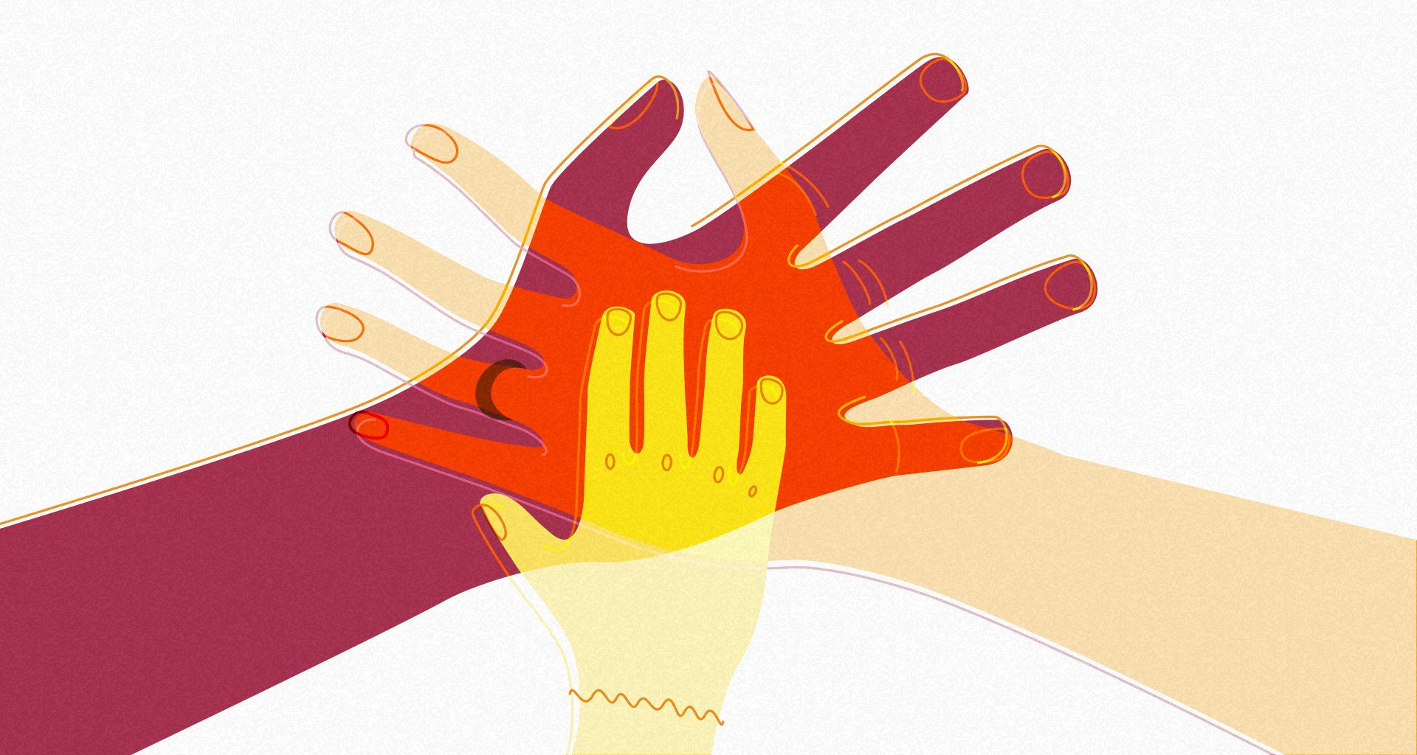
Introduction Round
Share: first name and 1 word that describes how you are coming into the space today.

Slide 7
Restorative Practice
A way of thinking and being focused on creating safe spaces for real conversations that deepen relationships and build stronger more connected communities. ~Mark Vander Vennen
Restorative Practices is an emerging social science that studies how to strengthen relationships between individuals as well as social connections within communities.
The fundamental hypothesis of restorative practice is that human beings are happier more cooperative and productive and more likely to make positive changes in their behavior when those in positions of authority do things with them rather than to or for them.
~International Institute of Restorative Practice
Notes:
2 min

Slide 8
Healthy Relationships
What do healthy, positive, appropriate relationships look like? Feel like? Sound like?
Notes:
Use white board to annotate
Need to be explicit – building trust
When we focus on getting clearer and “why” behind what we do, and can focus on the real conversation that needs to be had (vs. the conversation you “should” be having) and we provide clarity around roles, responsibilities, etc. it helps us to focus on what is happening vs. what’s wrong. It the first building block to bring trust into the relationship.

Slide 9
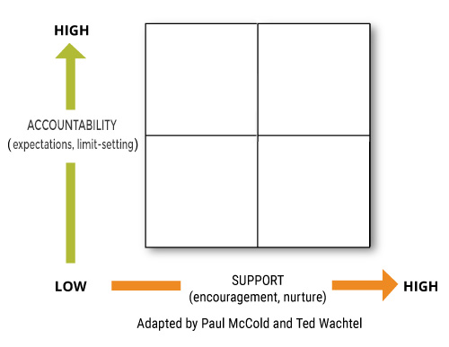
Social Discipline Window
Notes:
Think about someone in your life who provide lots of support but no accountability. Put the word you would use to describe them in the chat box

Slide 10
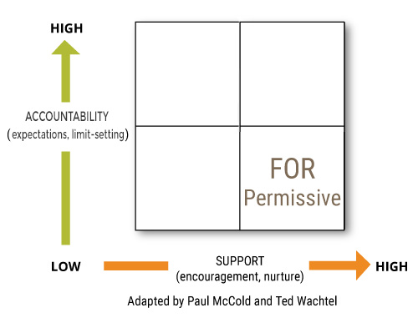
Social Discipline Window
Notes:
Now think of someone who provided lots of accountability/control but no support. Put in the chat box the word you would use to describe them

Slide 11
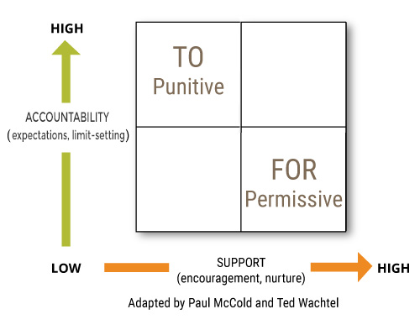
Social Discipline Window
Notes:
Now thinking of someone who provided no support or accountability. Put a word in the chat box that best describes them

Slide 12
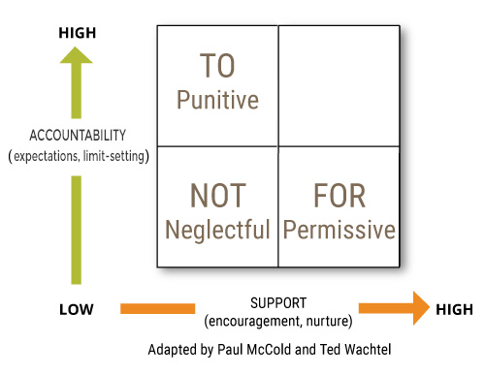
Social Discipline Window
Notes:
We are all one of these 3 styles when we are stressed and not well regulated. Take a minute to think about your go-to style. Talk about why it is important to be self-aware
Think about the person in your life who had the greatest impact on you – the one you respected the most – likely someone who was able to provide both accountability and support? What is the one word that you would use to describe what was special about that person?

Slide 13
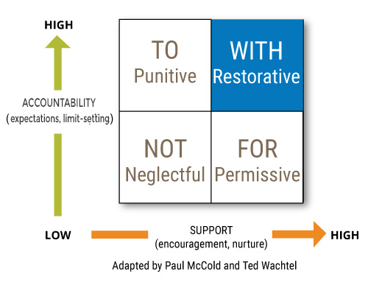
Social Discipline Window
Notes:
80% of them time

Slide 14
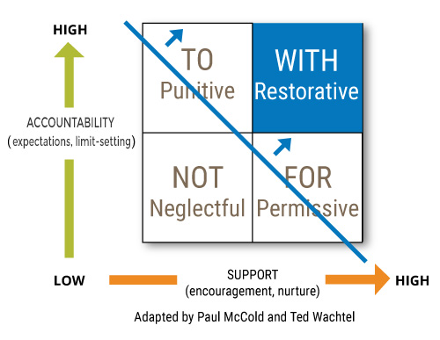
Social Discipline Window
Notes:
Movement toward. Most kind and loving thing to meet with high support and move or meet with high accountability and bring in support

Slide 15
Social Discipline Window Exercise
We are going to break into 8 groups. Each group will be assigned one of the quadrants: To, For, Not and With
Groups #1 and #5 NOT
Groups #2 and #6 TO
Groups #3 and #7 WITH
Groups #4 and #8 FOR
Where, within your organization, do you see this style? What do those behaviors look like? What is the outcome?
When we come back please have one person who can report out on your work
Notes:
Break into groups of 8. Each group is assigned one of the quadrants.
Bring everyone back together and review the work, quadrant by quadrant – sharing examples of what it might look like when we are in this area.

Slide 16
What being “With” looks like
Engaging Interactions
Clear Objectives and Goals
Collaboration
Being included in decisions that impact you
Seeing the “Whole” person
Possibility vs. Problem conversation's
Equity, diversity, and inclusion brought into every conversation

Slide 17
What being “With” feels like
Sense of hope
Safety – emotional and physical
Assets are recognized and used
Lack of “us” vs. “them” language
Validation
Human over task

Slide 18
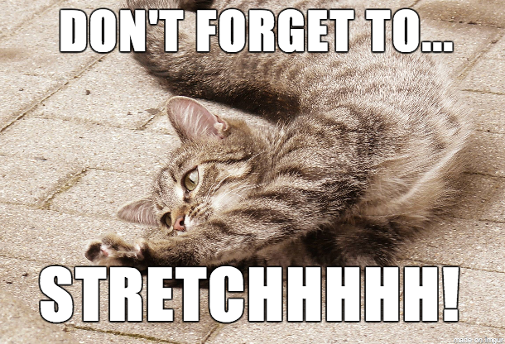
Break!!
10 minutes
To take care of yourself….
Stretch
Hydrate/Snacks
Get Fresh Air
Close your eyes

Slide 19
Let’s do a survey!
Notes:
Add survey for different scenarios for social discipline window or use white board to annotate.

Slide 20
Restorative Questions
What happened?
What were you thinking at the time? or What impact did it have?
Who has been affected and in what way?
What has been the hardest part for you?
What do you think you need to make it right?

Slide 21
Restorative Questions
Open-ended questions to help elicit emotion
Allow individuals space to explore issues in a non-threatening way.
Address past, present and future.
Proactively used to explore positive changes in behavior.
Responsively used to explore harm and how that harm impacts others.
Notes:
One of the great tools RP has to offer is the restorative questions – These can be used proactively and responsively.

Slide 22
Exercise
In pairs
Think about a time when you were harmed or created harm for another person. Take turns asking the other person the questions in regard to their situation.
The goal is to ask the questions and listen generously. This is NOT a time to engage in conversation.
I will be asking for a few people to share their highlights or experience with the questions.

Slide 23
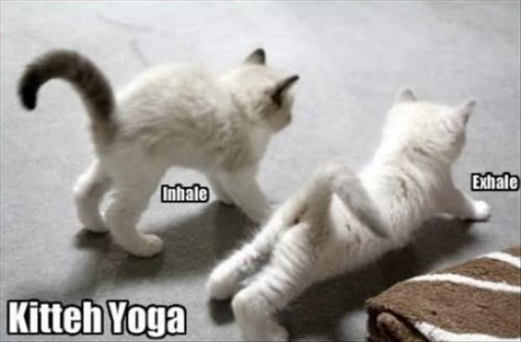
Break!!
10 minutes
To take care of yourself….
Stretch
Hydrate/Snacks
Get Fresh Air
Close your eyes

Slide 24
Circles and community
“There can be no vulnerability without risk; there can be no community without vulnerability; there can be no peace, and ultimately no life, without community.”
(M. Scott Peck, Psychiatrist and Best-Selling Author)
“Circles create soothing space, where even reticent people can realize that their voice is welcome.” (Margaret J. Wheatley)
“If people stand in a circle long enough, they’ll eventually begin to dance.”
(George Carlin, Comedian)
© International Institute for Restorative Practices
Notes:
Ask for volunteers to read a quote…
As a group – and using chat – share which one is most striking and why….

Slide 25
Circle and Community
“You have noticed that everything an Indian does is in a circle, and that is because the Power of the World always works in circles, and everything tries to be round...The sky is round, and I have heard that the earth is round like a ball, and so are all the stars. The wind, in its greatest power, whirls. Birds make their nest in circles, for theirs is the same religion as ours…
Even the seasons form a great circle in their changing, and always come back again to where they were. The life of a man is a circle from childhood to childhood, and so it is in everything where power moves.”
(Black Elk)
© International Institute for Restorative Practices
Notes:
Ask group to read the statements
In pairs – which statement appeals to them most? Group share
Key points: people are often disconnected from community. The way we are in community with others has shifted in the past decades: Connection vs. Contact – knowing people causality vs being in community.
Circles are not new – there are traditions cross most cultures that include circle in some way. Circles in our context are about making connections, building community and allowing space for all to be heard. They can be used proactively (to get to know each other) as well as responsively (in response to some level of harm).
Practice circle: use talking piece and explain its purpose. We will be going around, okay to pass, but know that I will come back to you. Question: think about your favorite childhood meal or food
After go- around debrief: what did you notice: question everyone could answer, keeping track of those that pass. Was what we were doing explicit?

Slide 26
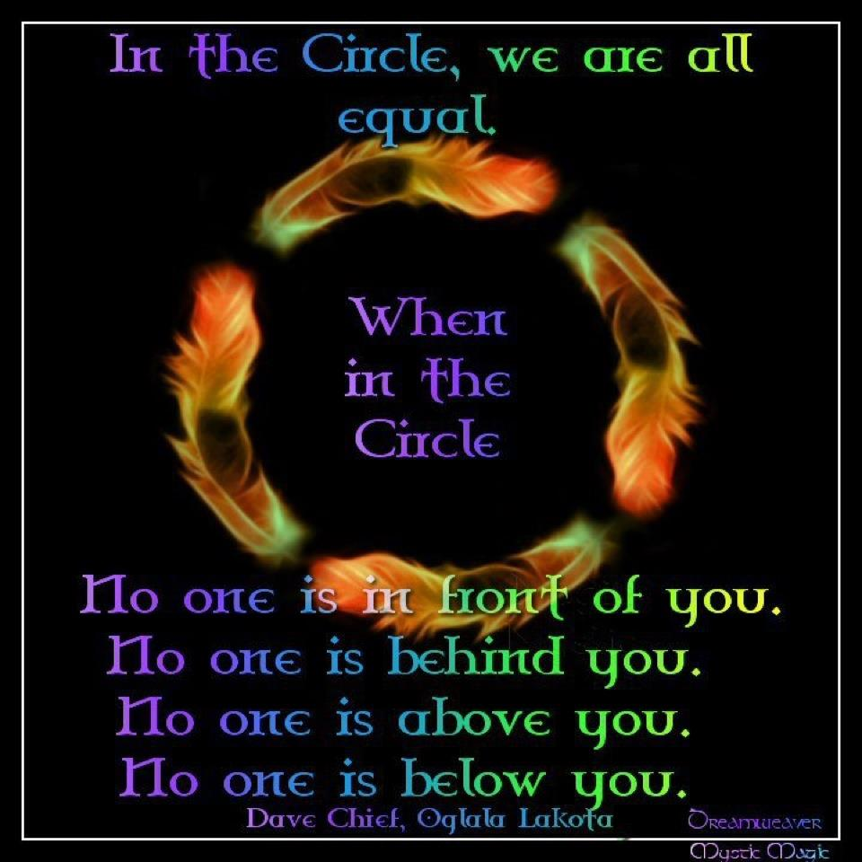
Why Circles?
Notes:
Acknowledge ancient cultures
Equality – everyone has equal seating
Equity – everyone has the same opportunity for speaking and having their voice heard
Safety and trust – you can see everyone else in the circle
Responsibility – everyone plays a role
Reminds you to facilitate VS. lecture
Building connections – everyone hears everyone's response
Ownership – shared sense of ownership felt by all
What does it look like virtually…. Check in and check out, ask to hear from everyone
Using a talking piece, passing, being explicit from the being .

Slide 27
Types of Circles
Proactive
Responsive
Sequential
Non-sequential
Notes:
Circles help us create space for everyone’s voice to be heard. Safety and trust are created – open up vulnerabilities – which you need to be aware of when thinking of trauma – may not be the starting place. Creates responsibility in the group – everyone plays a role and owns the space. Builds connections. 80% of the circles you do should focus on building community.
Circles also force us to facilitate with more intention.
Quick and easy circles: check in and check out.

Slide 28
Secrets to Success
Remember to facilitate
Clear topic and goal
Set a positive tone
Keep the focus
Get some allies
Use silence
Active listening
Pay attention to body language
Come into the circle well regulated
Notes:
Being explicit and clear
Clear understanding of why and what is expected of the participants
Role model the response if you are looking for something specific (like 1-2 word answer…)
Listening when in circle – listening to hear the story vs to respond

Slide 29
Circle Planning
Consider how you can start using circles in your daily work as well as you imagine brining the CARE training back to your organization.
What ideas do you have? What questions do you have?
Consider the following as you plan circles:
What is the goal?
What type of circle?
What questions would you use? Do the questions include past – present – future?

Slide 30
Circle Practice
In Groups of 4-5 folks:
Everyone introduce yourself
Go around everyone answer this question:
Are you getting what you came here for?
What would make this better?
As others are speaking, everyone else LISTEN, do not respond
Be prepared to share themes that emerged
You will have 15 minutes

Slide 31
Next Steps and Wrap Up
Reflection:
How does what you learned about Restorative Practice impact how you plan to approach bringing Trauma Informed Care to your organization?
Circle go around:
I learned, I realized or I was surprised by…..
Notes:
10 m

Slide 32
Thank You
Mary Cline-Stively, MA
Chief Executive Officer
Mary.cline-Stively@childstrive.org
206-619-2475

