Slide 1
Equity and the Intersection of Trauma Informed Practices
Presented By: Tami L Farber

Slide 2
Land Acknowledgment
We acknowledge that we are each residing on tribal lands of those who have lived on this land time immemorial. We pay respect to their elders past and present. Please take a moment to consider the many legacies of violence, displacement, migration, and settlement that bring us together today. We recognize the resilience of those past and present who work to build a strong and sovereign nation where Tribal members live their values and culture.
We are on the lands of the Tulalip, the Snohomish, the Stillaguamish, and Sauk Suiattle Tribes.
COMPASSION, APPRECIATION, RESILIENCE & EMPOWERMENT
Notes:
9:35-9:37
2 min

Slide 3
Why We Acknowledge The land
Offer recognition and respect
Acknowledge sovereignty of local tribes
Remind us historical contexts still affect current realities and future outcomes
Native Americans have lived in North America since time immemorial
COMPASSION, APPRECIATION, RESILIENCE & EMPOWERMENT
Notes:
9:37-9:39
2 min

Slide 4
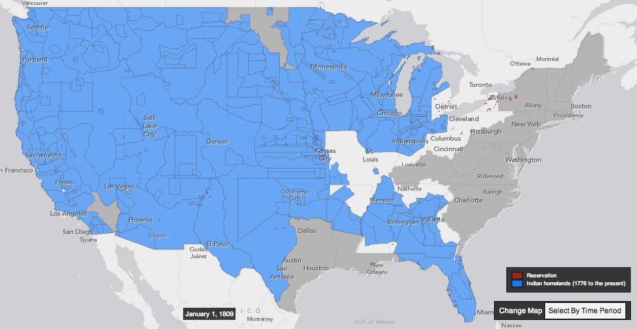
Theft of Indigenous homelands, 1776-present
COMPASSION, APPRECIATION, RESILIENCE & EMPOWERMENT
Notes:
9:39-9:44

Slide 5
Theft of Indigenous homelands, 1776-present
COMPASSION, APPRECIATION, RESILIENCE & EMPOWERMENT
Notes:
9:44-9:45

Slide 6
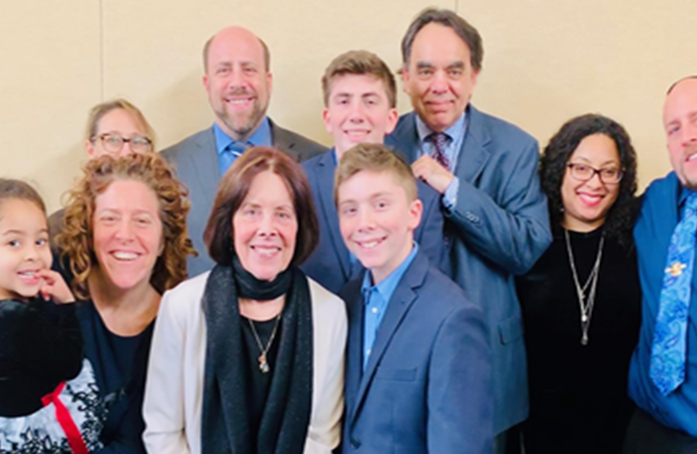
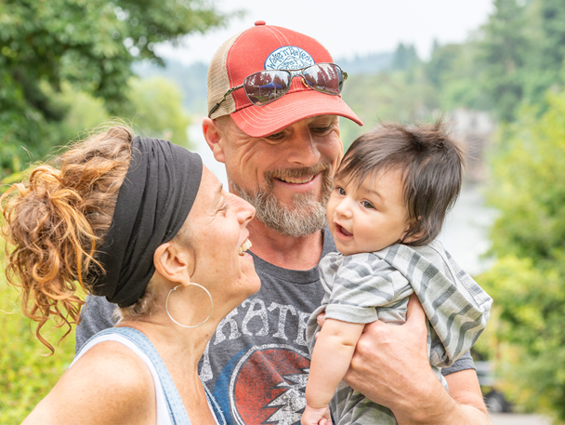
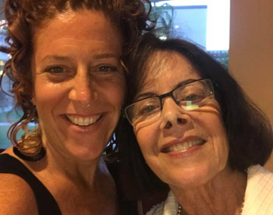
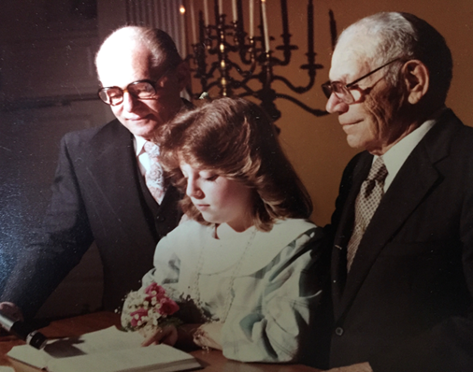
Notes:
9:45-9:48
3 min

Slide 7
Overview
As we approach our work to be Trauma Informed practitioners and organizations it is important to understand the complex cultural, social, economic and political forces that impact the lives of our children, families and communities as a way to identify the root cause of Trauma.
COMPASSION, APPRECIATION, RESILIENCE & EMPOWERMENT
Notes:
9:48-9:59
2 min

Slide 8
Belief/Rationale
A significant contributing factor to ACEs stems from the inequities and forms of oppression and marginalization we see in this country due to ones social identity, lack of access to resources, threats of harm and injury, humiliating and shaming events, and the ongoing experiencing of and witnessing of discrimination.
COMPASSION, APPRECIATION, RESILIENCE & EMPOWERMENT
Notes:
9:59-10:00
1 min

Slide 9
But all our phrasing—race relations, racial chasm, racial justice, racial pro- filing, white privilege, even white supremacy—serves to obscure that racism is a visceral experience, that it dislodges brains, blocks airways, rips muscle, extracts organs, cracks bones, breaks teeth. You must never look away from this. You must always remember that the sociology, the history, the eco- nomics, the graphs, the charts, the regressions all land, with great violence, upon the body.”
- Ta-Nehisi Coates
COMPASSION, APPRECIATION, RESILIENCE & EMPOWERMENT
Notes:
10:00-10:03
3 min

Slide 10
“Our bodies have a form of knowledge that is different from our cognitive brains. This knowledge is typically experienced as a felt sense of constriction or expansion, pain or ease, energy or numbness. Often this knowledge is stored in our bodies as wordless stories about what is safe and what is dangerous. The body is where we fear, hope and react; where we constrict and release; and where we reflexively fight, flee or freeze. If we are to upend the status quo of white-body supremacy, we must begin with our bodies.”
- Resmaa Menakem, Author My Grandmother’s Hands
COMPASSION, APPRECIATION, RESILIENCE & EMPOWERMENT
Notes:
10:03-10:06
3 min

Slide 11
Learning Outcomes
Build and strengthen relationships of CARE Team to create a sustainable network with a shared equity analysis
Build a common vocabulary for equity
Explore the relationship between social identity and historical and multi-generational trauma
Define and discuss the utilization of an equity analysis to inform policies, practices, procedures
Cross-pollinate ideas on the intersection between working towards equitable outcomes and being Trauma Informed
COMPASSION, APPRECIATION, RESILIENCE & EMPOWERMENT
Notes:
10:06-10:10:09
3 min

Slide 12
Group Agreements
Address impact over intent
Embrace the power of humble, respectful listening
Create trusting and safe spaces – where a little bit of discomfort is okay.
Learning leaves – Stories stay
Speak from your own experience instead of generalizing
Participate to the fullest of your ability – community growth depends on the inclusion of every individual voice
We encourage you to lean in, be brave and vulnerable
COMPASSION, APPRECIATION, RESILIENCE & EMPOWERMENT
Notes:
10:09-10:10
1 min review

Slide 13
Mix and Mingle
If you walk into a room what would be your theme song?
How have dimensions of your identity shaped/informed your lived experiences?
Name at least one way you feel you have experienced a form of trauma due to a dimension of your identity?
COMPASSION, APPRECIATION, RESILIENCE & EMPOWERMENT
Notes:
10:10-10:15
15 min
Starting with an exercise such as a Mix and Mingle is foundational and essential to building relationships to form a courageous and gracious space! Where we can learn in public and invite the stranger in!
Breakouts 3-4
15 minutes

Slide 14
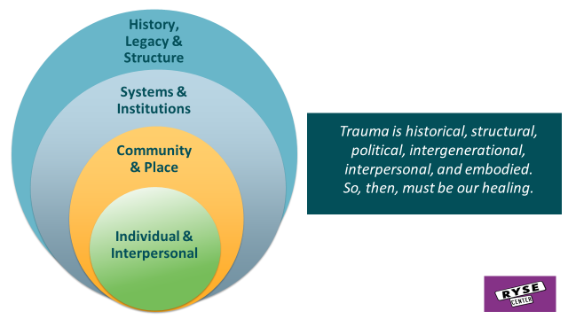
Equity Framework
COMPASSION, APPRECIATION, RESILIENCE & EMPOWERMENT
Notes:
10:15-10:20
5 minutes
It is critical that any organization or institution seeking to bring about greater equity and infuse equity principles and practices into all areas of the organization there must be a shared framework that is understood by all

Slide 15
Our ”Lasik” PROP
Power The ability or official authority to decide what is best for others. The ability to decide who will have access to resources. The capacity to exercise control over others.
Race A historical, political, and social construction created to concentrate power with White people and legitimize dominance, marginalization, and oppression over non-White people.
Oppression A pattern or system of inequality that gives power and privileges to members of one group of people at the expense of another.
Privilege A special advantage or right that a person is born into or acquires during their lifetime. It is not available to everyone in society. It is closely related to power: It often gives a person or group power over others.
Notes:
10:20-10:25
5 min

Slide 16
Leadership Reflection
How has Power Race Oppression and Privilege contributed to the individual and collective trauma we see in our communities?
COMPASSION, APPRECIATION, RESILIENCE & EMPOWERMENT
Notes:
10:25-10:50
25 min
2 min tee up
3 min solo think time
8 min breakouts in pairs
12 min large group share outs

Slide 17
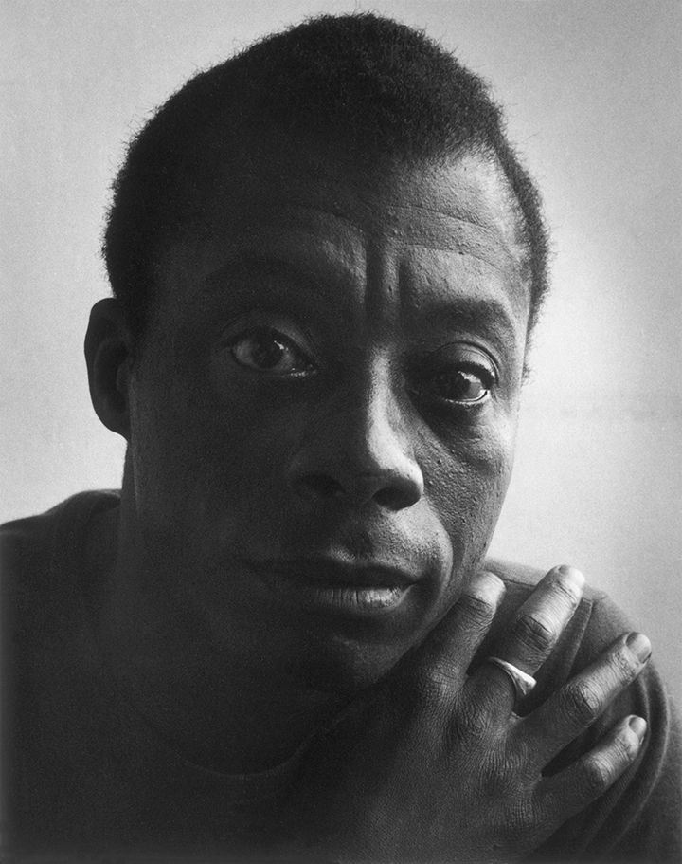
“History is not the past, it is the present. We carry our history with us. We are our history”
- James Baldwin
COMPASSION, APPRECIATION, RESILIENCE & EMPOWERMENT
Notes:
10:50-10:52
2 min

Slide 18
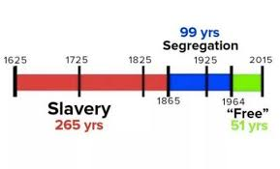
History|Legacy|Structure
COMPASSION, APPRECIATION, RESILIENCE & EMPOWERMENT
Notes:
10:52-10:54
2 min

Slide 19
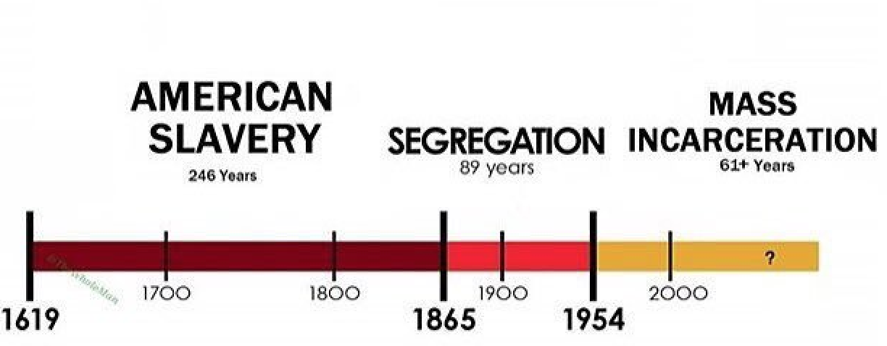
Somatic History Era
COMPASSION, APPRECIATION, RESILIENCE & EMPOWERMENT
Notes:
10:54-10:57
3 min

Slide 20
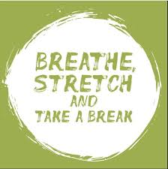
5 Minute Break
Notes:
10:57-11:02
Get a snack, stretch, whatever you need to come back to being present. (10:00)

Slide 21
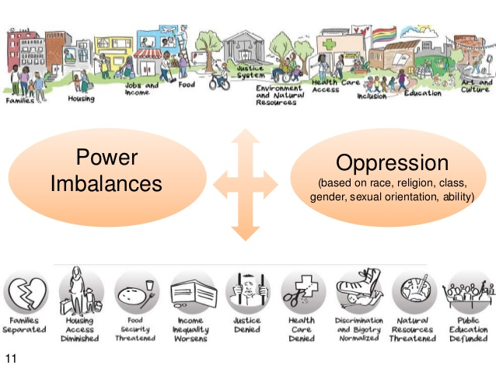
Root Causes of Inequities
Laws and Policies that created all types of systems of unbalanced power and privilege
Caused by historical practice of exclusion & discrimination across life course
Led to geographic concentration of poverty and hyper-segregation
COMPASSION, APPRECIATION, RESILIENCE & EMPOWERMENT
Notes:
11:02-11:05
3 min

Slide 22
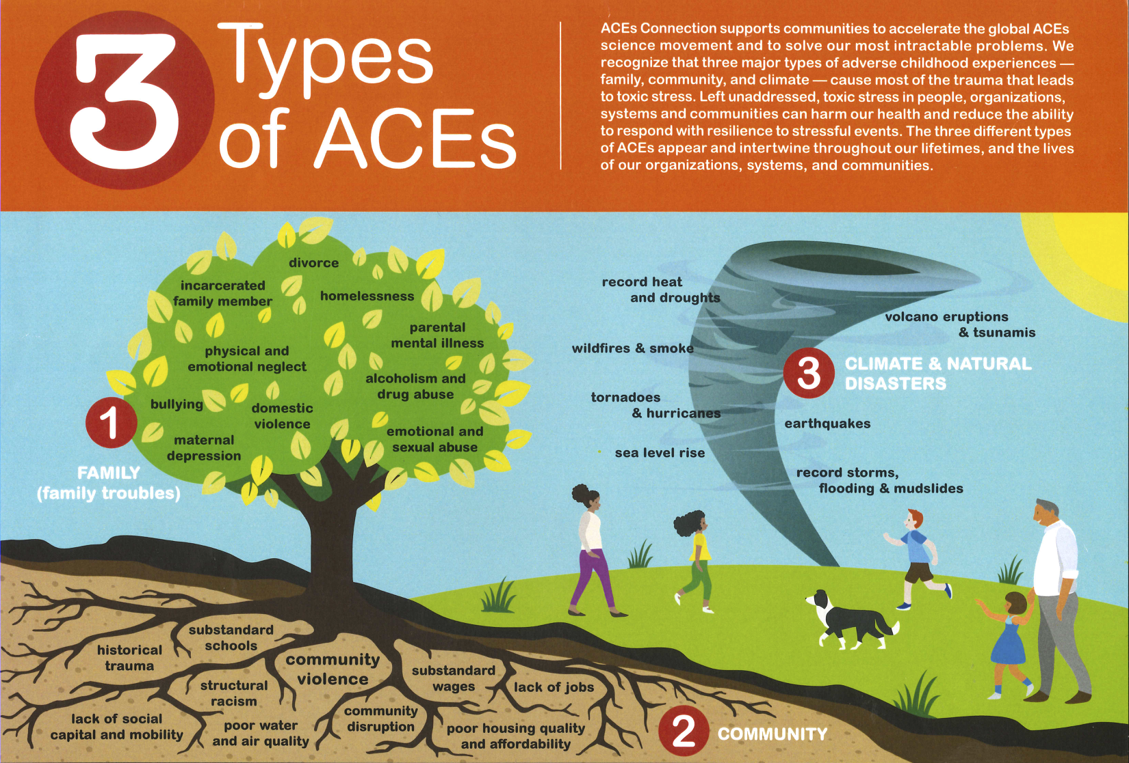
POWER
OPPRESSION
PRIVILEGE
Notes:
11:05 -11:07
2 min

Slide 23
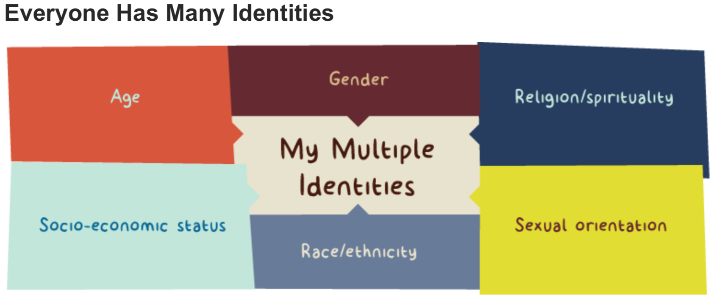
COMPASSION, APPRECIATION, RESILIENCE & EMPOWERMENT
Notes:
11:07-11:09
2 min

Slide 24
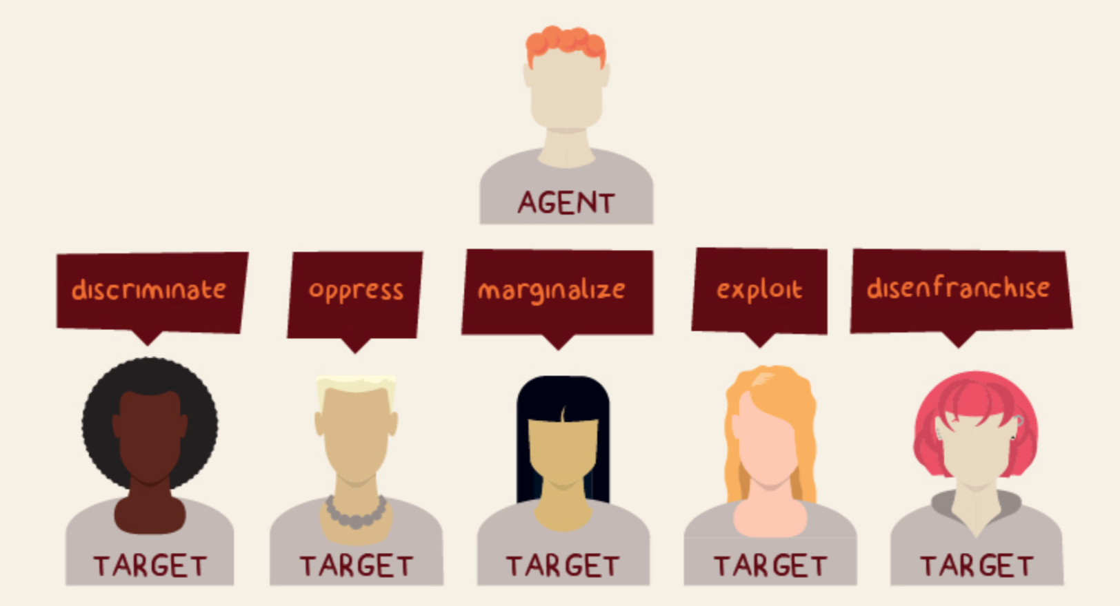
COMPASSION, APPRECIATION, RESILIENCE & EMPOWERMENT
Scholar Leticia Nieto
Notes:
11:09-11:12
3 min

Slide 25
Dominant Group | Marginalized Group | Oppression
White | People of Color | Racism
Colonizer | Native/Indigenous | Colonialism
Cisgender Men | Women, Transgender, non-binary genderfluid, gender neutral | Sexism
Able-bodied, Able-minded | People with a disability | Ableism
Christian | Other religions or spiritual practices | Christian Hegemony
Heterosexual | Lesbian, Gay, Bi, Queer | Heterosexism
Adult | Youth/Elder | Ageism
Wealthy & Middle class | Poor and working class | Classism
Citizen | Non-citizen | Nationalism
Formally educated | Non-formally educated | Elitism
English speaking | Non-English Speaking, English with an accent or dialect | Linguicism
Notes:
11:12-11:20
8 min
“This Template describes how society categorizes Identities. Scholar; Leticia Nieto describes Society’s Agent and Target groups.

Slide 26
Leadership Reflection
As Trauma Informed Care Leaders how can you use this power analysis to inform how you engage in your leadership professional practices?
COMPASSION, APPRECIATION, RESILIENCE & EMPOWERMENT
Notes:
11:20-11:50
2 min tee up
3 min solo think time
13 min breakouts 3-4
12 min large group shareouts

Slide 27
Types of Trauma
Individual/Collective
Acute
Chronic
Complex
Trans
generational
COMPASSION, APPRECIATION, RESILIENCE & EMPOWERMENT
Notes:
11:50-11:52
2 min

Slide 28
Intergenerational Trauma
COMPASSION, APPRECIATION, RESILIENCE & EMPOWERMENT
Notes:
11:52-11:58
6 min

Slide 29
Types of Trauma
What did you See, hear, feel?
How is historical /multigenerational trauma connected to equity at the personal level and at the institutional level?
COMPASSION, APPRECIATION, RESILIENCE & EMPOWERMENT
Notes:
11:58-12:30
2 min tee up
3 min solo think time
13 min breakouts 3-4
12 min large group shareouts

Slide 30
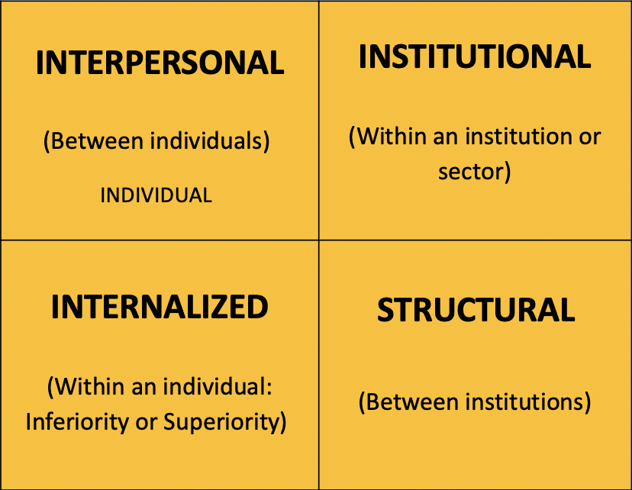
Levels of Oppression
COMPASSION, APPRECIATION, RESILIENCE & EMPOWERMENT
Notes:
12:30-12:40
10 min

Slide 31
Provide examples of how you see trauma playing out at each of these levels within your organization/institution and beyond?
COMPASSION, APPRECIATION, RESILIENCE & EMPOWERMENT
Notes:
12:40-1:10
2 min tee up
3 min solo think time
13 min breakouts 3-4
12 min large group shareouts

Slide 32
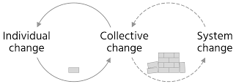
Intersection TIC and Equity
COMPASSION, APPRECIATION, RESILIENCE & EMPOWERMENT
Notes:
1:10-1:11
1 min

Slide 33
No Equity Informed Lasik
No Equity Informed Lasik
NO TRAUMA INFORMED CARE LENS
POWER OVER
YOU CAN’T CHANGE
PEOPLE NEED FIXING FIRST
OPERATE FROM THE DOMINANT CULTURE
PEOPLE ARE OUT TO GET YOU
THERE’S ONLY RIGHT OR WRONG
HELPING
“YOU’RE CRAZY!”
COMPLIANCE/OBEDIENCE
INFO IS SHARED ON A NEED TO KNOW BASIS
PRESENTING ISSUE
“US AND THEM”
LABELS, PATHOLOGY
FEAR BASED
I’M HERE TO FIX YOU
INSTRUCTIVE
PEOPLE MAKE BAD CHOICES
BEHAVIOR VIEWED AS PROBLEM
WHAT’S WRONG WITH YOU?
BLAME/SHAME
GOAL IS TO GO THINGS THE “RIGHT” WAY
PRESCRIPTIVE
TRAUMA INFORMED CARE LENS
POWER WITH
NEUROPLASTICITY CAN CHANGE
PEOPLE NEED SAFETY FIRST
CULTURE HUMILITY
PEOPLE CAN LIVE UP TO THE TRUST YOU GIVE THEM
THERE’S MULTIPLE VIEWPOINTS
LEARNING
“IT MAKES SENSE”
EMPOWERMENT/COLLARBORATION
TRANSPARENCY AND PREDICTABILITY
WHOLE PERSON AND HISTORY
“WE’RE ALL IN THIS TOGETHER”
BEHAVIOR AS COMMUNICATION
EMPATHY BASED
SUPPORT THE HEALING
PARTICIPATORY
PEOPLE WHO FEEL UNSAFE DO UNSAFE THINGS
BEHAVIOR VIEWED AS A PERSONAL SOLUTION
WHAT HAPPENED TO YOU?
RESPECT
GOAL IS TO CONNECT
CHOICE
Notes:
1:11-1:12
1 min

Slide 34
National Effective Practice
Normalize - A shared analysis and definitions
- Urgency/prioritize
- Healing and TIC
Organize - Internal infrastructure
- Partnerships
- Healing and TIC
Operationalize - Racial equity tools
- Data to develop strategies and drive Results
- Healing and TIC
Assess
Assess
Visualize
Assess
Framework Credit: Government Alliance on Race and Equity
Notes:
1:12-1:22
10 min

Slide 35
Racial Equity Tools for Policies Practices and Procedures
A simple set of questions:
1. Proposal: What is the policy, program, practice or budget decision under consideration? What are the desired results and outcomes?
2. Data: What’s the data? What does the data tell us?
3. Community engagement: How have communities been engaged? Are there opportunities to expand engagement?
4. Analysis and strategies: Who will benefit from or be burdened by your proposal? What are your strategies for advancing racial equity or mitigating unintended consequences?
5. Implementation: What is your plan for implementation?
6. Accountability and communication: How will you ensure accountability, communicate, and evaluate results?
Government Alliance on Race and Equity
Notes:
1:22-1:24

Slide 36
Trauma Informed Care is Enhanced with an Equity Framework by:
Realize Trauma is deeply rooted in a multi-generational, dehumanizing process of systems of inequities
REALIZE
Respond to Trauma in a culturally responsive way and hold healing as the restoration of identity and ensure your responses are happening at all levels: individual, community and institutional
RESPOND
RECOGNIZE
the ways in which Power Race Oppression and Privilege influence/impact individuals and communities lived experiences and recognize your own biases
RESIST
Resist perpetuating/maintaining dominant cultural norms through your policies and practices when engaging in TIC
COMPASSION, APPRECIATION, RESILIENCE & EMPOWERMENT
Notes:
1:24-1:26
2 min

Slide 37
Closing
I came in today feeling ______ …and I am leaving feeling ______
COMPASSION, APPRECIATION, RESILIENCE & EMPOWERMENT

