Slide 1
As we gather…..
Please make sure your screen name includes your first name and pronouns
Go to the 3 dots in the upper right hand corner of your image/frame and choose “rename”

Slide 2
Welcome to the Snohomish County CARE Train the Trainer Meet & Greet 2021
Implementation Science and
Adult Learning
Mary Cline-Stively
Thank You for your participation and partnership!
Notes:
Intro self

Slide 3
Land Acknowledgment
We acknowledge that we are each residing on tribal lands of those who have lived on this land time immemorial. We pay respect to their elders past and present. Please take a moment to consider the many legacies of violence, displacement, migration, and settlement that bring us together today. We recognize the resilience of those past and present who work to build a strong and sovereign nation where Tribal members live their values and culture.
We are on the lands of the Tulalip, the Snohomish, the Stillaguamish, and Sauk Suiattle Tribes.
Notes:
2 min

Slide 4
Hopes for our time together
Begin to think about implementation at your organization.
Reflect on what tools and supports you may need as you plan for training and implementation.
Leave with the start to a plan for implementation.
Notes:
Anything else we want added? 2 min

Slide 5
Group Agreements
Address impact over intent
Embrace the power of humble, respectful listening
Create trusting and safe spaces – where a little bit of discomfort is okay.
Learning leaves – Stories stay
Speak from your own experience instead of generalizing
Participate to the fullest of your ability – community growth depends on the inclusion of every individual voice
We encourage you to lean in, be brave and vulnerable
Notes:
Anything else we want added? Let’s talk about CARE
2 min

Slide 6
Ice Breaker
In groups of 3-4, share how your vision is starting to form for your organization as you being your CARE community journey.
10 minutes
Brief share out to the whole group

Slide 7
Implementation Science / Practice
Seek to identify specific activities, contexts and other factors that increase the likelihood of successful implementation and lead to improved outcomes.
Notes:
2 min

Slide 8
Principles
Be Empathetic: Approach facilitation and change processes with regard for others as legitimate, respected, and valuable contributors. Seek mutual-understanding and growth promotion within relationships.
Be Curious: Ask questions, demonstrate authentic interest, engage in different ways.
Be Committed: Bring patience, resilience and willingness to challenge the status quo. Demonstrate flexibility and agility as you encounter set backs.
Advance Equity: Integrate strong equity components, including explicit attention to the languages, cultures, values, assets, etc.
Use Critical Thinking: Explore the diverse elements of a situation, examine your own and others assumptions.
Embrace Cross-Disciplinary Approaches: Appreciate and use different perspectives to bring mutual and transformative learning.
Notes:
These are the Foundational attitudes with which those leading implementation of should consider as you approach your work

Slide 9
Reflection…
In pairs – 5 minutes
Consider the principles –
Where are your strengths?
Where are your growing edges?
What questions do you have?

Slide 10
Core Competencies
Co-Creation and Engagement Domain
Co-Learning: create opportunities for folks to learn together, agree to outcomes and how things are implemented.
Brokering: bridge connection between folks, departments, partners
Address power differentials: acknowledge it, seek shared understanding, create spaces that allow for free speech.
Co-Design: support co-design of implementation strategies when possible, consider including those with lived experience.
Tailoring Support: determine frequency, duration and intensity based on the needs of the group.
Notes:
Core Competencies: Knowledge, resources and skills to support the implementation/change
Co-Creation and Engagement: practices that match the values, needs, skills and resources of the organization
Co-learning – engagement in training, creating shared language. TILT team formation – identifying outcomes, methods, etc.

Slide 11
Reflection…
In pairs – 5 minutes
Consider the co-creation and engagement domain –
Where are your strengths?
Where are your growing edges?
What questions do you have?

Slide 12
Core Competencies
Ongoing Improvement Domain
Assess needs and assets: create opportunities that fit the needs of the organization.
Understanding context: Implementation is influenced by the service system and the context of your community.
Appling and integrating frameworks, strategies and approaches: develop a unique package that meets your needs.
Facilitation: support everyone to do their best thinking.
Communication: consider information exchange as well as creating shared understandings.
Conducting Improvement Cycles: create space for reflection, feedback and adjustments
Notes:
On-going improvement: dedicating time for reflection, shared learning and improvements along the way – GROWTH MINDSET

Slide 13
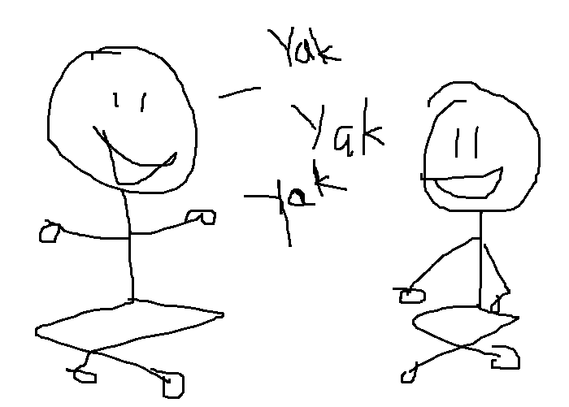
Reflection…
In pairs – 5 minutes
Consider the on-going improvement domain –
Where are your strengths?
Where are your growing edges?
What questions do you have?

Slide 14
Core Competencies
Sustaining Change Domain
Growing and Sustaining Relationships: implementation takes place through trusting relationships.
Developing Teams: Ensure the meetings are structured, effective and build the competency of those attending. Explicitly support team development and the opportunity to contribute.
Building Capacity: Individual and organizational level.
Cultivating Leaders and Champions: create opportunities for distributed leadership.
Notes:
Sustaining Change: develop a shared vision and mutual accountability by facilitating existing relationships, problem solving and resource sharing while identifying and addressing the dynamic changes that occur over time
Relationships: build trust through honest listening, using feedback, demonstrating commitment, providing credible information, showing vulnerability and staying in difficult situations. When trusting relationships exist, information is more readily exchanged – that is where the magic happens!
Leadership: display knowledge, support and engagement (NOT EXPERTISE). Role model being accountable and committed and create opportunities at all levels in the organization.

Slide 15
Reflection…
In pairs – 5 minutes
Consider the sustaining change domain–
Where are your strengths?
Where are your growing edges?
What questions do you have?

Slide 16
Reflection and Engagement
In break out rooms by organization:
When considering the principles and core competencies what ideas do you have as you think about creating an implementation plan? What are you most concerned about? What are the easy wins?
15 minutes
Brief share out when you return

Slide 17
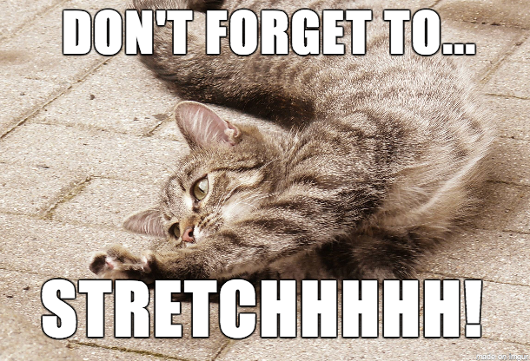
Break!!
10minutes
To take care of yourself….
Stretch
Hydrate/Snacks
Get Fresh Air
Close your eyes
5 Minute Countdown | Big Timer - Fullscreen countdown timer

Slide 18
Developing a culture of safety
Implementation really relies on collaborative learning, taking risks (and being willing to fail).
The center of creating this type of environment is vulnerability, trust and psychological safety.
Elements include:
Leadership commitment and development
Training, development and on-going support
Environment of continuous learning
Staff engagement and idea sharing

Slide 19
Psychological Safety
The belief that you can speak up, take risk and put forward ideas, questions or challenges without facing ridicule or retaliation.
~Amy Edmundson
Notes:
Invest time and space for the creation of safe spaces -
Psychological safety is the #1 variable across the most productive teams in a project conducted by Google
Creating safe spaces, especially at the beginning of a change initiative is an investment in both the short term and long term outcomes

Slide 20
Safe Spaces
As you consider how you can create and cultivate safe, gracious spaces, apply the equity and justice lens.
Consider:
How does this fit with the anti-racism work the organization is doing?
Consider the systemic and general trauma that may be present?
Notes:
Story about “brave spaces” Sonia Renee Taylor – soft spaces

Slide 21
Equity Reflection
Consider reflective questions as a way to set the foundation for safety:
Am I focused and ready to give 100% of my attention?
Am I prepared to listen to different perspectives?
Am I aware of the implicit and explicit biases I may bring to the meeting?
Am I aware of how my power and privilege – race, gender, age, position – may impact the conversation?
Am I prepared to be open to different people’s expertise and knowledge?

Slide 22
Creating a “gracious space”
Start with a check in, introduction type exercises with minimal self-disclosure – building toward creating brave spaces to share throughout the time together.
Community or group agreements: use as a way to gain engagement early on.
Clear learning objectives: so everyone is clear why they are in the room, ask if there are other things folks were hoping for.
Use a circle process to ensure all voices are heard.
Ensure everyone has logistical info – restrooms, breaks, how to use technology, etc.
Be explicit on expectations (“would like to hear from everyone”, feel free to pass, “popcorn” style, etc.)
End with some sort of check out, reflection - how they experienced the time, exercise
Notes:
Creating a space where all feel welcome and their voice is important

Slide 23
Leadership
Leaders are anyone who has the courage to develop the potential in people and processes
Who we are is how we lead….
Do your own work so that you can show up and be present
Get comfortable being uncomfortable
You don’t need to be the expert
Model the behaviors you want see – acknowledge, ask for help, reflection, learning….
Notes:
That means you all are LEADERS – no matter your title.

Slide 24
Being Curious
Use reflective, open ended questions.
Provide feedback using a strengths based approach: “that might work, another options might be to try XXXX” or “yes and XXXX”.
Ask questions to better understand verses jumping to the conclusion – “can you say more about…” or “can you give me an example of when you had that experience”.
Check in with the group: is the pace working, do folks need a break, etc.
Model being curious, vulnerable, brave and centered (take a deep breath).
Stay neutral – acknowledge a contribution to the conversation without judgement.
Notes:
Additional ways to model behaviors – and set the stage as the trainer/leader

Slide 25
Opportunities for engagement
If material is being read out load, ask for volunteers.
Use “pair-share” exercises, even if only a few minutes to turn to partner, then group hi-lights.
Ask “what questions do you have” vs. “any questions?”.
Provide real-life experiences and examples. Ask for examples from the group.
Use language like “what was your take away”, “a-ha moment”, “experience” when trying to encourage sharing.
Use small group interactions whenever possible.
Use silence – it may mean that folks are absorbing material. It is okay to pause and give a minute for reflection.
Provide content and then provide some sort of opportunity for engagement around the material like a few minutes of self-reflection, pair-share, small group, etc. The important part is integration, experience and/or practice of material to help make it their own.
Use self-assessment type of tools or questions as a way to mitigate the gap of experience and the new information.
Provide a variety of different ways to access the material - Visual; auditory; kinesthetic; etc.
Notes:
think about ways to practice being “with” the participants

Slide 26
Reflection and Engagement
In break out rooms by organization:
When considering the safe/gracious spaces and engagement what ideas do you have as you think about creating an implementation plan? What are you most concerned about? What are the easy wins?
15 minutes
Brief share out when you return

Slide 27
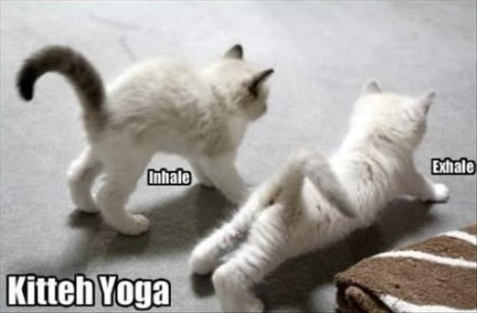
Break!!
10 minutes
To take care of yourself….
Stretch
Hydrate/Snacks
Get Fresh Air
Close your eyes
5 Minute Countdown | Big Timer - Fullscreen countdown timer

Slide 28
Characteristics of Adult Learners (adapted from Malcolm Shepherd Knowles)
Self-Concept: as we become adults we become self-directed human beings. Therefore we want to be able to take some ownership of our learning and be an active participant.
Adult Learner Experience: As adults we are building experiences that become a great resource for learning. Therefore, we want to be able to incorporate our experiences into our learning.
Readiness to Learn: Change is hard for everyone. We may access learning situations where the material is different than how we have experienced previously. Adults tend to prefer being part of a “facilitated co-learning experience” verses being taught by the “teacher/expert”.
Orientation to learning: As adults we tend to want our learning to be closely related to our life or work. We want to be able to attach the learning to real life experiences and we want the learning to help us “solve problems” or to make things different.
Motivation to Learn: Generally most adult’s motivation is internal. Adults want to understand how the material will impact their life.

Slide 29
Four Quadrants of Change
 | Subjective | Objective
Individual | Quadrant 1 Personal Meaning & Engagement | Quadrant 2 Skills & Behaviors
Collective | Quadrant 3 Culture & Shared Values | Quadrant 4 Systems & Structure
https://goatesconsultinggroup.com/Documents/IsChangePossible-EricKlein.pdf
Notes:
The 4 quadrants of change help us look at change as a “whole organization” It give equal weight to both the inner/subjective aspects and the outer/objective aspects while focusing both on the individual and the collective. This is a great tool to assess areas of strength as well as challenge with any change initiative. Each quadrant is interrelated and can also support or hinder advancement or sustainability of a change - all quadrants are of equal importance and need consideration for success - these can be supports or obstacles
Q1: Personal Meaning. It is about inter development. Explaining the why of the strategy (i.e. the why should I do this and how does it relate to my role or values), co-creation, those closest to the work being involved.
Q2: Skills: this is about building technical and interpersonal skills. making sure that staff receive the training and support to develop the skills and behaviors and that those skills and behaviors receive positive reinforcement, Does everyone have the information who needs it? are we using common language?
Q3: Culture: building shared meaning and paying attention to power dynamics. making sure communication and the strategy is aligned with the desired culture and that negative culture behaviors are disincentivize - walking the talk…. if we say we are about connection but do not ever provide opportunities for connection, it is a bit of a misfit
Q4: Systems and structure: organizational design, technology, workflow, policies and procedures. making sure there is a system and structure in place to support the change, such as having the time built into the agenda to address, having clear communication channels, making sure there is a good feedback process and monitoring
Ask group to identify or name any strategies to accomplish any of the examples-

Slide 30
Implementation Plan
Consider these elements
Why is this important for the organization? What is your vision for what you are hoping to accomplish?
What tasks need to occur?
How will this be best accomplished?
When – what is the order of priority?
Who can be involved?

Slide 31
Reflection and Engagement
In break out rooms by organization:
Start to think about your why, what, how, when and who.
What are you most nervous about? What questions do you have? What do think will be the easy wins?
15 minutes
Brief share out when you return

Slide 32
Next Steps and Wrap Up
Reflection:
How does what you learned about implementation science and adult learning impact how you plan to approach bringing Trauma Informed Care to your organization?
Circle go around:
I learned, I realized or I was surprised by…..
Notes:
10 m

Slide 33
Thank You
Mary Cline-Stively, MA
Chief Executive Officer
Mary.cline-Stively@childstrive.org
206-619-2475

