Slide 1
Welcome to the Snohomish County CARE Trauma Informed Care Train the Trainer Training
Safety
Empowerment and Choice
Cultural, Historical and Gender Issues
Trustworthiness & Transparency
Collaboration & Mutuality
Peer Support
Notes:
2 min

Slide 2
Land Acknowledgment
We acknowledge that we are each residing on tribal lands of those who have lived on this land time immemorial. We pay respect to their elders past and present. Please take a moment to consider the many legacies of violence, displacement, migration, and settlement that bring us together today. We recognize the resilience of those past and present who work to build a strong and sovereign nation where Tribal members live their values and culture.
We are on the lands of the Tulalip, the Snohomish, the Stillaguamish, and Sauk Suiattle Tribes.
COMPASSION, APPRECIATION, RESILIENCE & EMPOWERMENT
Notes:
2 min

Slide 3
Group Agreements
Address impact over intent
Embrace the power of humble, respectful listening
Create trusting and safe spaces – where a little bit of discomfort is okay.
Learning leaves – Stories stay
Speak from your own experience instead of generalizing
Participate to the fullest of your ability – community growth depends on the inclusion of every individual voice
We encourage you to lean in, be brave and vulnerable
COMPASSION, APPRECIATION, RESILIENCE & EMPOWERMENT
Notes:
2 min

Slide 4
Turning to One Another
There is no power greater than a community discovering what it cares about. Ask “What’s possible?” not “What’s wrong?” Keep asking. Notice what you care about. Assume that many others share your dreams. Be brave enough to start a conversation that matters. Talk to people you know. Talk to people you don’t know. Talk to people you never talk to. Be intrigued by the differences you hear. Expect to be surprised. Treasure curiosity more than certainty. Invite in everybody who cares to work on what’s possible. Acknowledge that everyone is an expert about something. Know that creative solutions come from new connections. Remember, you don’t fear people whose story you know. Real listening always brings people closer together. Trust that meaningful conversations can change your world. Rely on human goodness. Stay together. —
Margaret Wheatley, 2002
COMPASSION, APPRECIATION, RESILIENCE & EMPOWERMENT
Notes:
2 min

Slide 5
Reflections from the ACEs deep dive
What are you hopes and needs today?
https://www.menti.com/2a23hg5wcn
Or Menti.com The voting code 7557 8181
COMPASSION, APPRECIATION, RESILIENCE & EMPOWERMENT
Notes:
15 min Menti
Aha moments, thoughts to provide and make sure there is closure from last training session

Slide 6
Agenda Today
Trauma Informed Leadership Teams
Institutions and their Systems of Trauma
Learning Collaboratives Structure of the CARE
Assessment Tools
Notes:
Liza

Slide 7
TILT
Learning Collaboratives, Structure of the CARE

Slide 8
Trauma Informed Leadership Team (TILT)
COMPASSION, APPRECIATION, RESILIENCE & EMPOWERMENT

Slide 9
Trauma-Informed Leadership Team (TILT) Overview
The Trauma Informed Leadership Team (TILT) is a principal-driven, accountable group, working in the spirit of trauma-informed principles. The
goal of the TILT is to review, shape, and lead the paradigm shift to embed trauma informed principles into policies, procedures, and practices within
your organization. The TILT leads the identification, adoption and sustainability plans while building on the organization's strengths, aligning with
the organization culture and centering on equity. The CARE Community Trauma Informed Principles:
Safety –​
Building relationships with others based on mutual respect and inclusion of all individuals. The goal is to promote a secure, safe, physically and emotionally, environment by building positive relationships that build resiliency for all in each interaction.​
Trustworthiness & Transparency-​
Fostering positive relationships based on trust and honesty. Share as much information as possible, relational.​
​
Peer Support-​
Identifying common concerns within the community and engaging in collective problem solving. This means recognizing and actively working towards solving the needs of every individual.​
​
Collaboration and Mutuality-​
Recognizing the importance of all roles within the organization and developing equal opportunities for decision making. Best practice is to collaborate with community members, families, and organizations within Snohomish County to promote trauma informed principles and systems of care.
Empowerment, Voice, and Choice-​
Recognizing that every person’s experience is unique and requires an individualized approach. Create opportunities and systems that empower all individual’s voice and choice. Seek staff and consumers input.​
​
Resiliency-​
Building resiliency by modeling compassion and regulation with each interaction and by providing skills and protective factors. Providing the opportunity to promote recovery and the ability to bounce back from adverse conditions. ​
​
Cultural, Historical, Gender issues-​
Appreciating and celebrating the differences and each individual’s unique experiences by practicing cultural competency. Implementing a competency lens of cultural, historical and gender issues in your daily work.​
Notes:
5 min

Slide 10
Trauma-Informed Leadership Team (TILT) Overview
When organizations build a Trauma-Informed System, they are fostering opportunities to be compassionate, curious and less reactive to stress. Creating an environment where all those, both inside and outside of the organization feel valued, welcomed, respected, and build positive connections and relationships that promote wellbeing, resilience and healing.
Who: A diverse group of staff members representing all levels, divisions, departments and/or teams. Consider including a variety of perspectives, experience and roles. Examples include:
Executive
Administration
Service providers
Support staff – consumer facing staff
Human Resources
Marketing
Consumers
When: A consistent time and place that is protected within the organization
Recommend monthly but the most important aspect is that the meetings are consistent and reliable.
Notes:
5 min

Slide 11
Trauma-Informed Leadership Team (TILT) Overview
What: The team is responsible for assessing, implementing and co-creating a sustainability plan for the Trauma Informed policies, procedures and practices. In the spirit of collaboration, the team should put effort toward to value all voices, flatten the hierarchy and model the Trauma Informed Principles in their meetings. Examples include:
Co-creating norms, group agreements, intent/mission, vision for group
Create a compassionate, brave space
Set agendas
Co create meeting protocols: how agendas are set, minutes, in person vs. virtual norms, reviewing norms when a new person joins, etc.
Set roles (facilitator, data, note taker, timekeeper, etc.). Determine if those roles are set or rolling.
Consider how to include self-care into the meeting, such as food, ritual, poems, and meditations, check in, and check out, etc.
Commitment to participation: establish length of commitment, i.e., 1 year, consider how new people will join, guidelines when someone needs to step down (maybe ask them to help with recruitment and orientation for their replacement), etc. .
Let data drive the work – use organizational assessment tools annually to determine areas of focus.
Communicate with all staff – share the work, gain input, engage as many people as possible, including your Board of Directors.
Think of projects in small do-able steps, start with something that is highly visible to others.
Help support training plan for the first year, new staff, etc.
Notes:
5 min

Slide 12
Notes:
2 min
Talking about systemic trauma; What is sharable is bearable…relationship between healing and justice
Can you have one without the other?
This is a time where our institutions are shifting—public health and public safety..how do these institutions transform? From trauma-inducing to trauma-reducing or healing? What is our role? Our collective and organizational roles?
Slide: By Joe Neigel, Children’s Wellness Coalition member

Slide 13
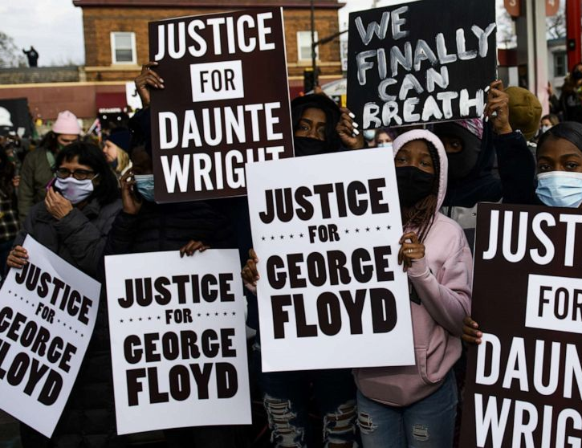
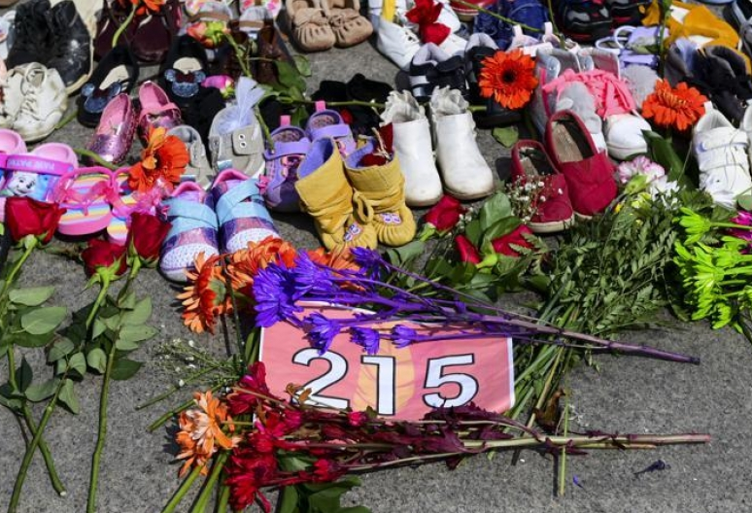
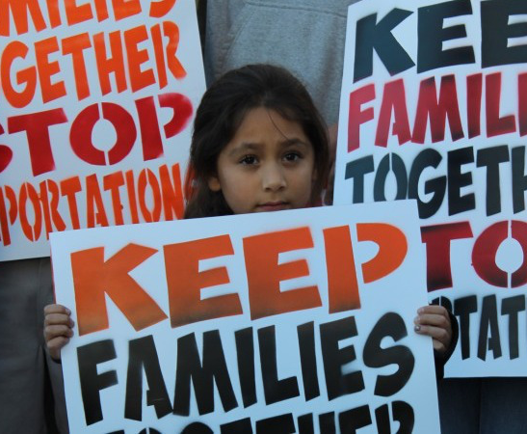
Systemic Oppression
18
Notes:
important for us to be disrupters and speak our truth
The intersection of TIC and DEI work means integrating and embedding our understanding of the impact of trauma, to include defining trauma to include harm caused by our systems—historical trauma, collective trauma, macroaggression, and microaggressions. The goal is building systems where one’s identity does not define your outcomes and inclusion is not just providing access to a service but having services provided in a way that the consumer feels valued, heard, and cared for in an authentic way.

Slide 14
Agenda: Focus Areas
Connecting
Learning
Processing
Breakout groups:
Focus on Understanding: Trauma-Informed Principles and Systems
Integrating:
Focus on Practice
Use your Organizational Assessments
Next Steps:
Closing Check Out
COMPASSION, APPRECIATION, RESILIENCE & EMPOWERMENT
Notes:
10 min

Slide 15
Check-in Examples
Make sure to rename yourself in zoom
Breakout rooms questions (5 mins): 2-3/room:
What resources or practices have you been drawing from to support yourself during this COVID time?
What brings you joy these days?
What are you most proud of during this time?
What interests you about having our organization become trauma informed ?
What is most challenging for you ?
How did you get in this line of work?
COMPASSION, APPRECIATION, RESILIENCE & EMPOWERMENT
Notes:
2 min

Slide 16
CARE Assessment Tools
Standards of Practice for Trauma Informed Care Organizations:
Self-assessment tool for TILT team
Specific to trauma informed principles and practices
Intended to provide benchmarks for planning and monitoring progress and as a means to highlight accomplishments
Trauma Informed CARE Continuum Assessment
Measures factors that support successful implementation: motivation, intervention specific capacity, general organization capacity
Results will be provided back to you by Snohomish County Human Services
For entire organization
COMPASSION, APPRECIATION, RESILIENCE & EMPOWERMENT
Notes:
2 min

Slide 17
Assessment Process
Decide:
When to administer once a year for the CARE Continuum
Standard of Practice Tool will be used for the TILT team
CARE Continuum Assessment will be used for the entire organization
Prepare:
Communication and supporting materials (email templates, FAQS)
Inform staff of the assessment (what it is, why it is being conducted, how results will be used, when they can participate) Use assessment guide.
Administer:
Encourage participation
Review and reflect:
Review results
Communicate results to staff and receive input
Act:
Decide where to focus
Identify and plan strategies based on results
Implement, monitor, and adjust
COMPASSION, APPRECIATION, RESILIENCE & EMPOWERMENT
Notes:
5 min

Slide 18
TILT Team Action Items
Next meeting:
In-between work:
COMPASSION, APPRECIATION, RESILIENCE & EMPOWERMENT
Notes:
5 min

Slide 19
In Menti Who should be on your TILT team How can you recruit them?
https://www.menti.com/2a23hg5wcn
Or Menti.com The voting code 7557 8181
COMPASSION, APPRECIATION, RESILIENCE & EMPOWERMENT
Notes:
10 min

Slide 20
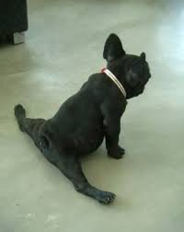
10 Minute Break
Take time to stretch,
get something to drink and breathe!
Notes:
10 min

Slide 21
Celica Quirarte from DSHS A CARE Champion talking about her TILT Experience
COMPASSION, APPRECIATION, RESILIENCE & EMPOWERMENT
Notes:
20 minutes

Slide 22
Any Questions?
COMPASSION, APPRECIATION, RESILIENCE & EMPOWERMENT
Notes:
10 minutes

Slide 23
Institutions and their Systems of Trauma Zsofia and Szabi Pasztor Farmer Frog
COMPASSION, APPRECIATION, RESILIENCE & EMPOWERMENT
Notes:
45 minutes-160 min
(105 min)

Slide 24
10 Minute Break
Take time to stretch
Get something to drink and breathe!
Notes:
10 min -180 min

Slide 25
Learning Collaboratives
COMPASSION, APPRECIATION, RESILIENCE & EMPOWERMENT

Slide 26
Learning collaboratives are a way to get support, resources, and to further your knowledge of Trauma Informed Care and grow the CARE community. As per the agreement you need to attend a minimum of 6 learning collaboratives; however, attending as many as possible is a great way to get support for the first year.
Cohort 4’s learning collaborative will be held on the 2nd week of the month. We will be sending a calendaring link with the zoom link attached after the training for you to decide which learning collaborative time to attend. The collaboratives will begin in December and run through November 2022. The learning collaboratives will take place on Zoom until further notice.
The sessions are scheduled for the second Wednesday of the month. In the mornings from 9:00 a.m. – 10:30 a.m. and the afternoons from 1:00 p.m. – 2:30 p.m.
Love to have your expertise to support all of us.
COMPASSION, APPRECIATION, RESILIENCE & EMPOWERMENT
Notes:
5 min-185
Learning collaboratives are great way to get support, resources, and to further your knowledge of Trauma Informed CARE and grow the CARE community. The theme of the learning collaboratives are to learn more, share more, practice more. To have manageable time and space we will have 2 learning collaborative times to choose from each month. Our learning collaboratives will be held the second week of the month and have both morning and afternoon times to hopefully meet everyone’s needs. You will receive an email invite with a zoom link to register after the training.

Slide 27
ZOOM Links will be provided following the training.
December 8, 2021 | March 9, 2022 | June 8, 2022 | September 14, 2022
January 12, 2022 | April 13, 2022 | July 13, 2022 | October 12, 2022
February 9, 2022 | May 11, 2022 | August 10, 2022 | November 9, 2022
COMPASSION, APPRECIATION, RESILIENCE & EMPOWERMENT
Notes:
2 min

Slide 28
Structure of CARE Designation
COMPASSION, APPRECIATION, RESILIENCE & EMPOWERMENT

Slide 29
What is the CARE Movement?
CARE stands for: Compassion, Appreciation, Resilience & Empowerment
Snohomish County is committed to building restorative trauma informed organizations. Over the last three years, we have trained over 45 organizations to become designated Restorative Trauma Informed CARE sites. The vision for this partnership is for all Snohomish County residents to thrive in an equitable, sustainable environment that cultivates relationships and a strong feeling of belonging.
We have engaged our local organizations from pre-school to older adults. The goal is to build community resiliency, increase collaboration across agency partners and strengthen the overall well-being of our community.
Notes:
5 min Liza
In the 4th year-started with schools -goal is to buffer adversity and increase resiliency in our community and make a positive impact on social determinants.
WE have a CARE HR Cohort and Executive Leadership Cohort.

Slide 30
COMPASSION, APPRECIATION, RESILIENCE & EMPOWERMENT
7
6
Continue to learn, grow practice, make connections, build community, & collaborate with partners
Recertification &
Ongoing Training
5
Create a sustainable implementation plan around the Standards of Practice and embed the TIC principles into your policies and procedures.
4
3
2
Attend at least 6 monthly
Learning Collaboratives yearly for two years
1
Create a monthly Trauma Informed Leadership
Team (TILT)
Attend the CARE Train the Trainer (TOT) training
Complete Core Trainings by
October 2022
Organizational commitment to being Restorative, Equitable & Trauma Informed (CARE Agreement)
Notes:
10 min
Agreements and Core Components:
The two representatives from each organization attends all 5 (five ) days
Each attendee participates in a minimum of six (6) additional mandatory learning collaboratives, each year, over two years.
Each organization identifies at least one practice area and work towards others as they see fit.
Each organization forms a TILT (Trauma Informed Leadership Team) that meets at least monthly.
The TOT-Trainers train their workplace to include all the components of Trauma Informed Practices––within the agreement timeframe. The core training will be completed by April 30th, 2021.
Attend all 5 days of the training
At least 2 people from each organization
Agree to be a champion to create and develop the TILT
Attend the monthly learning collaboratives
Communicate to the top up and down on what is happening with the TILT regularly
Include HR in TILT
Use the Standards of Practice to implement TIC practices in their organization
If you need help or technical assistance reach out to the CARE community
Communicate within the organization to all employee on how the work is going to move forward
Develop a training plan to obtain the decal within the 1 year time frame
Attend ongoing training and the recertification process to make your transition into trauma informed care sustainable

Slide 31
What’s Next
Phase One: Aware +Adopting a Trauma Informed System
Build TILT team, engage leadership, develop an ongoing communication plan and start to think about how to embed workplace principles into your entire organization, plan your CARE training and set training schedule. Move towards being able to explain and advocate for trauma informed care. Involve human resources, marketing and other departments in this work. Advocate and explain the why of trauma informed care.
Phase Two: Train, Coach and Align
Complete training, make data driven decisions using Standard of Practice and CARE Continuum Assessments, align trauma informed principles to your policies and practices. Engage, train and align leadership and board members to this committed change. Applying knowledge and skills. Trauma Informed Care is an organizational priority.
Phase Three: Integrate and Sustainability
Evaluate and measure impact, build capacity , implement sustainability for practice changes. Staff are modeling and embodying trauma informed care.
COMPASSION, APPRECIATION, RESILIENCE & EMPOWERMENT
Notes:
take 10 min as a team and talk about your immediate phase 1 next steps
5 min debrief
15 min (217)
To launch initiative

Slide 32
Standards of Practice Assessment:
The following Standards of Practice for Trauma Informed Care organizations in Snohomish County, WA are based on nationally recognized principles of trauma informed care and are in alignment with SAMHSA’s Concept of Trauma and Guidance for a Trauma Informed approach. These standards were integrated with Trauma Informed Oregon’s Standards of Practice and reviewed and adopted by Snohomish County’s Children’s Wellness Coalition to include family members, individuals with lived experiences, as well as providers from different fields of practice. These standards are intended to provide benchmarks for planning and monitoring progress and as a means to highlight accomplishments and to challenge each organization.
https://www.surveymonkey.com/r/VMJGNCS
COMPASSION, APPRECIATION, RESILIENCE & EMPOWERMENT
Notes:
5 min go into survey monkey

Slide 33
COMPASSION, APPRECIATION, RESILIENCE & EMPOWERMENT
Notes:
2 min what do you do with this? Once you have this how do you use this. Guide , then what?

Slide 34
CARE Continuum Assessment:
CARE Continuum Assessment General Guide This guide provides a brief overview and general guide for the CARE Continuum Assessment. Overview the CARE Continuum Assessment is a tool to evaluate supports for trauma informed care. It is for use by those who are guiding and implementing trauma informed principles and practices for their organization, such as the Trauma informed Leadership Team (TILT). Results highlight supports and areas that need attention to promote successful implementation of trauma informed practices.
The assessment uses an R=MC2 framework that measures factors related to the successful implementation and spread of an intervention, practice or program. Its measures include motivation, intervention-specific capacity, and general capacity as they contribute to the willingness and ability of an organization to implement a practice or program.
Continuum CARE Assessment Survey Monkey Link: https://www.surveymonkey.com/r/RVVFXN5
COMPASSION, APPRECIATION, RESILIENCE & EMPOWERMENT
Notes:
5 min- how often should they take this.
The early work of the TILT team –snapshot of where you are at and a baseline . TILT toolbox.

Slide 35
Once you complete your organizations training on the core competencies of trauma informed practices your organization is eligible for the CARE 4 x 8 decal/s. Please let us know when that is completed, and we will make sure you get the right number of decals needed. Please display your decal at your front entrance and any other prominent places. In addition, your organization will be added to the CARE interactive map. Please take a picture of staff in front of your logo and email it to liza.Patchen-Short@snoco.org and it will be loaded on the CWC photo gallery.
COMPASSION, APPRECIATION, RESILIENCE & EMPOWERMENT
Notes:
2 min-timing of when you get the logo

Slide 36
Website Acknowledgement
Website Acknowledgement of CARE Certification:
[Agency/Organization] is proud to be designated an official CARE Community site.
CARE – Compassion, Appreciation, Resilience, Empowerment
In partnership with the Snohomish County Children’s Wellness Coalition, Snohomish County Human Services and other organizations throughout Snohomish County, we are committed to implementing trauma informed practices and policies.
We are dedicated to staff professional development, participation in ongoing learning communities and operational change that focuses on the key foundations of Trauma Informed Care, Adverse Childhood Experiences, Brain Science, Resiliency, Restorative Practice, Equity, and Self-Care/Secondary Traumatic Stress.
COMPASSION, APPRECIATION, RESILIENCE & EMPOWERMENT
Notes:
2 min

Slide 37
Closing
In two words what values do you bring forth on your CARE team?
COMPASSION, APPRECIATION, RESILIENCE & EMPOWERMENT
Notes:
5 min your values are held your left pocket and right pocket that you carry with you

Slide 38
Welcome to the Snohomish County CARE Trauma Informed Care Train the Trainer Training
Safety
Empowerment and Choice
Cultural, Historical and Gender Issues
Trustworthiness & Transparency
Collaboration & Mutuality
Peer Support

Slide 39
CARE Panel
Deep Dive Trauma Informed CARE
Next Steps
Questions
Presented By: Liza Patchen-Short & Laura Mote
Notes:
2 min

Slide 40
Grounding Exercise
This short exercise give us the opportunity to fully arrive to this meeting.
Please close your eyes if you are comfortable doing so, or it's just fine to keep your eyes open and have a soft gaze downwards.
Bring attention to how you are sitting, and find a way to be relaxed and alert at the same time. (pause)
Bring attention to your breath, and notice how you are breathing. If you'd like, take some deeper, slower breaths. Let’s give ourselves permission to let go of our busy day and become present together.”
OK, to end this time, please bring a bit of movement into your body, perhaps move your hands and feet.
If you have your eyes closed, you can now slowly open our eyes when you’re ready.
Thank you for doing this. I hope this was a welcome little break. Maybe you can notice how you feel right now, and if you feel any different than you felt before we did this
COMPASSION, APPRECIATION, RESILIENCE & EMPOWERMENT
Notes:
2 min

Slide 41
Reflection of the previous day and Hopes for today
(Menti)
https://www.menti.com/ym1daetgxy
Or Menti.com The voting code 9623 1635
COMPASSION, APPRECIATION, RESILIENCE & EMPOWERMENT
Notes:
10 min (Menti)

Slide 42
Breakout Rooms – 10 minutes, broken out by organization Discuss any lingering questions you still might have about implementing CARE into your organization. Pick two questions to ask the panel of CARE Designated Organizations.
COMPASSION, APPRECIATION, RESILIENCE & EMPOWERMENT
Notes:
10 minutes (8:55)

Slide 43
Panel Discussion
COMPASSION, APPRECIATION, RESILIENCE & EMPOWERMENT
Notes:
60 min
(83 min)
Toni Gardner
Gabrielle Nonast
Anja Keys

Slide 44
10 Minute Break
Take time to stretch
Get something to drink and breathe!
Notes:
10 min

Slide 45
Deep Dive Starred Slides
Get Ready for the Deep Dive!
This will be an opportunity for you to start planning how you will deliver Trauma Informed Care training to your organization! This is exciting… and maybe a little bit scary. Our goals will be to:
Identify challenges or barriers to presenting information on Trauma Informed Care
Review key activities you may choose to use when training your organization
Review key concepts you will want to cover when training your organization
Review ways to highlight adult learning styles and opportunities for engagement within Trauma Informed Care training
What to expect:
You will spend a good portion of time in breakout rooms with others from your organization. This time will be spent planning what activities and slides are most relevant and how your team will deliver a meaningful Trauma Informed Care training to your organization.
There will be ample time for you to ask clarifying questions on concepts, how to facilitate activities, and anything else you are concerned about.
COMPASSION, APPRECIATION, RESILIENCE & EMPOWERMENT
Notes:
2 minutes

Slide 46
Under the Surface
COMPASSION, APPRECIATION, RESILIENCE & EMPOWERMENT
Notes:
2 min
This is a great depiction to understand this work. It about if you had the knowledge of other experiences what would be different? How would you respond? …. We will watch it and then come together as a group to talk about it what we noticed and learned.
We all have our own stories that we carry around every day. This is a good reminder to be curious, non-judgmental, and not make assumptions. We never know the whole story. Trauma does not discriminate. It is across all socio-economic barriers, including those we serve and those we work with.

Slide 47
Large Group Discussion
COMPASSION, APPRECIATION, RESILIENCE & EMPOWERMENT

Slide 48
19
Why Be Trauma Informed
Aligning these initiatives is vital to successful organization culture transformation
Trauma Informed
Care
Restorative Practices Relational Healing
Racial Equity and Justice
COMPASSION, APPRECIATION, RESILIENCE & EMPOWERMENT
Notes:
4 min
Snohomish County’s CARE model combines three best practices: TIC, RP ( the social science of improving and repairing relationships between people and communities)and DEI ( ensuring that processes are impartial, fair and provide equal outcomes for every individual. It is
our belief that inclusiveness, healing, building relationships and the impact of trauma are the building blocks for lasting healing systemic change.

Slide 49
22
What is Trauma Informed Care?
Trauma Informed Care is a strengths-based framework that is grounded in an understanding of and responsiveness to the impact of trauma…that emphasizes relationships, being curious, non-judgmental, and creates space for physical, psychological, and emotional safety for all. This paradigm shift builds and allows for opportunities to rebuild and keep a sense of empowerment and resiliency.
COMPASSION, APPRECIATION, RESILIENCE & EMPOWERMENT
Notes:
3 min
Trauma Informed Care is about building relationships, focusing on providing safety, connection especially when working with a person who may already feel disconnected, overwhelmed and not worthy. This work is a paradigm shift, not new work. It is how you do the work.
When we are curious and shift our thinking to what has happened to a person vs. what is wrong with them, that is a using a trauma informed lens that recognizes and honors that there are other factors driving behaviors.
According to Jennings, A trauma informed approach “would be experienced by all involved as a profound cultural shift in which consumers and their conditions and behaviors are viewed differently, staff respond differently, and the day-to day delivery of services is conducted differently” (Jennings, 2004, p. 21) Models for Developing Trauma Informed Behavioral Health Systems and Trauma –Specific Services.

Slide 50
23
What is a Trauma Informed System?
A trauma-informed system is a strengths-based framework that is grounded in an understanding of and responsiveness to the impact of trauma on those who have contact with the system, and service providers. The entire organization embeds and sustains trauma awareness, knowledge, and skills into their organizational cultures, practices, and policies. They act in collaboration with all those involved using the best available modalities to maximize physical and psychological safety, facilitate healing , and support their ability to thrive.
COMPASSION, APPRECIATION, RESILIENCE & EMPOWERMENT
Notes:
3 min
A Trauma Informed System embeds trauma informed principles into all the workplace policies and procedures and recognizes and responds to the impact of traumatic stress. This system supports a culture of staff wellness and creates an environment that is emotionally, physically, and socially safe for all.
In addition, A Trauma Informed Care system is about changing an organizational culture where policies and procedures that are reflective of these values in all aspects of the organization. This shift and intention is the very foundation in which we think, how we feel, how we communicate, and how we practice.
Ultimately this is changing a mental model of how we understand ourselves as well as other human beings. The fundamental question to reframe is from, “what’s wrong with you?” to “what happened to you? “It is a strengths-based perspective not a deficit based.

Slide 51
28
So Why Be a Trauma Informed Organization?
Why be a CARE Designated Organization?
Building relationships, a sense of belonging, trust and connection creates a workplace culture of healing.
The paradigm shift becomes not what is wrong with you but what has happened to you.
Trauma informed, restorative principles that are equitable aim at insuring environments and services are accessible welcoming, healing and provides a sense of belonging to all particularly those impacted by the inequities in our community.
COMPASSION, APPRECIATION, RESILIENCE & EMPOWERMENT
Notes:
3 min
Why Trauma Informed?
Trauma Informed Care is about
Building relationships, creating a sense of belonging, trust, and deep connection which ultimately creates a workplace culture of healing.
This paradigm shift and work focuses on not what is wrong with you, but what has happened to you? TIC acknowledges the whole person, and the knowledge of the impact of trauma.
Trauma Informed Care aims at insuring environments and services to be welcoming, not retraumatizing but healing, and provides a sense of emotional safety and belonging to all.
TIC is not a training; it is the way in which you do the work.

Slide 52
Notes:
2 min
Trauma Organized-Organizations impacted by stress, operating in silos, avoidant of issues and isolated in their practices or service delivery. These organizations can be trauma inducing
Trauma Informed -these are organizations that develop a shared language to define, normalize and address the impact of trauma on clients and workforce. They operate from a foundational understanding of the nature and impact of trauma.
Healing Organizations -Organizations where staff policies, procedures, services and treatment models apply an understanding of trauma embedded within them. Their approaches to providing services are trauma-shielding or trauma-reducing.

Slide 53
28
Key Elements of Trauma Informed Care
Building relationships, being curious , feeling a sense of belonging, trust, and connection
Building compassion in your daily interactions.
Asking, “not what is wrong with you but what has happened to you.” It’s about creating healing.
COMPASSION, APPRECIATION, RESILIENCE & EMPOWERMENT
Notes:
2 min
Why Trauma Informed?
Trauma Informed Care is about
Building relationships, creating a sense of belonging, trust, and deep connection which ultimately creates a workplace culture of healing.
This paradigm shift and work focuses on not what is wrong with you, but what has happened to you? TIC acknowledges the whole person, and the knowledge of the impact of trauma.
Trauma Informed Care aims at insuring environments and services to be welcoming, not retraumatizing but healing, and provides a sense of emotional safety and belonging to all.
TIC is not a training; it is the way in which you do the work.

Slide 54
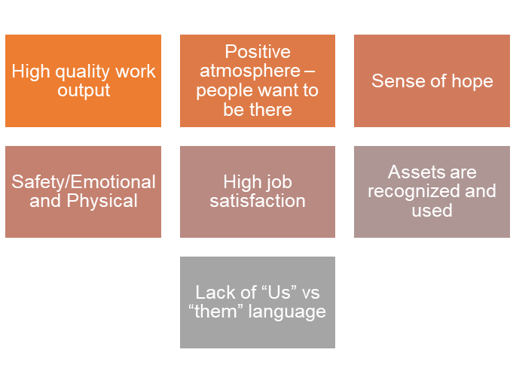
28
What being “With” Feels like
COMPASSION, APPRECIATION, RESILIENCE & EMPOWERMENT
Notes:
2 min

Slide 55
28
What being “With” looks like
Engaging Interactions
Clear objectives and goals
Collaboration
Being included in decisions that impact you
Seeing the Whole person
Possibility vs Problem conversation’s
COMPASSION, APPRECIATION, RESILIENCE & EMPOWERMENT
Notes:
2 min

Slide 56
41
NO Equitable & TRAUMA INFORMED CARE LENS
POWER OVER
YOU CAN’T CHANGE
PEOPLE NEED FIXING FIRST
OPERATE FROM THE DOMINANT CULTURE
PEOPLE ARE OUT TO GET YOU
THERE’S ONLY RIGHT OR WRONG
HELPING
“YOU’RE CRAZY!”
COMPLIANCE/OBEDIENCE
INFO IS SHARED ON A NEED TO KNOW BASIS
PRESENTING ISSUE
“US AND THEM”
LABELS, PATHOLOGY
FEAR BASED
I’M HERE TO FIX YOU
INSTRUCTIVE
PEOPLE MAKE BAD CHOICES
BEHAVIOR VIEWED AS PROBLEM
WHAT’S WRONG WITH YOU?
BLAME/SHAME
GOAL IS TO GO THINGS THE “RIGHT” WAY
PRESCRIPTIVE
Equitable & TRAUMA INFORMED CARE LENS
POWER WITH
NEUROPLASTICITY CAN CHANGE
PEOPLE NEED SAFETY FIRST
CULTURE HUMILITY
PEOPLE CAN LIVE UP TO THE TRUST YOU GIVE THEM
THERE’S MULTIPLE VIEWPOINTS
LEARNING
“IT MAKES SENSE”
EMPOWERMENT/COLLARBORATION
TRANSPARENCY AND PREDICTABILITY
WHOLE PERSON AND HISTORY
“WE’RE ALL IN THIS TOGETHER”
BEHAVIOR AS COMMUNICATION
EMPATHY BASED
SUPPORT THE HEALING
PARTICIPATORY
PEOPLE WHO FEEL UNSAFE DO UNSAFE THINGS
BEHAVIOR VIEWED AS A PERSONAL SOLUTION
WHAT HAPPENED TO YOU?
RESPECT
GOAL IS TO CONNECT
CHOICE
What Does the Cultural Shift of Trauma Informed Care Look Like
Notes:
2 min
Now lets take a look at what a community with a trauma informed lens looks like: Notice the differences? How about Power With rather than Power Over. Transparency and Predictability rather than Info shared on a need to know basis. You might ask why these trauma informed practices are so important?
When we use a Trauma Informed lens, we provide opportunities to connect, heal, and thrive.
Our lens shifts away from traditional practices built on punishment and blame, to practices that teach, empower and build on mutual collaboration.
By embracing a strengths-based approach we are able to blend accountability with empathy and curiosity.

Slide 57
29
The benefits and importance of this work
Staff become more regulated, flexible and resilient. A better sense of wellbeing for all
A trauma Informed workplace is calmer, and staff have deeper relationships
Staff and customers feel like they belong and are heard
We prioritize human over tasks
We find out the real story and do not make judgements or assumptions
Mental health days are supported instead of absenteeism
Increased productivity and retention
COMPASSION, APPRECIATION, RESILIENCE & EMPOWERMENT
Notes:
5 min
There are many benefits to embedding this work into an organization. Staff become more regulated and develop resilience, you have an organization that puts relationship over task which ultimately increases productivity, retention and decreases absenteeism by focusing on self-care, holistic workplace wellbeing, and validated employees. This is a culture shift that informs actions and healing. Trauma informed care focuses on the whole person, including past trauma, triggers, and how that affects a person’s behaviors and your work moving forward with them. Yet another benefit focuses on how we are in relationship with our colleagues, and how one functions as a whole organization. It is ultimately creating an environment that promotes thriving and resiliency for all.

Slide 58
Trauma Informed Guiding Principles
31
Safety: Prioritize physical, emotional and psychological safety in each interaction
Trust and Transparency: Share as much information as possible, relational
Collaboration and Mutuality: Allow time for social interaction – Consider allowing staff to use sharing platforms (Zoom Meetings) to stay in touch with family and team members
Voice and Choice: Seek staff and customer input
Cultural, Historical and Gender: Incorporating a competency lens of cultural, historical and gender issues in your daily work
Peer Support: Engage peer support to serve larger communities
Resiliency: Model compassion and regulation with each interaction
COMPASSION, APPRECIATION, RESILIENCE & EMPOWERMENT
Notes:
4 min
This is a roadmap for creating a workplace culture of resiliency and healing. Trauma-informed care interventions, policies and practices must be delivered within a framework of a trauma-informed system. The principles will be the guideposts for your work.
Safety –
Building relationships with others based on mutual respect and inclusion of all individuals. This is all about Prioritizing a safe, physically and emotionally, environment in each interaction. It is human, over task.
Trustworthiness & Transparency-
This principle focuses on Fostering positive relationships based on trust and honesty among community members (staff, schools, family members, police, ,). The goal is to be relational, share as much information as possible. Folks like to know what is going on and also what is coming up.
Peer Support-
Peer Support may be defined as the help and support that people with lived experience are able to give to one another.
It may be social, emotional or practical support but importantly this support is mutually offered and reciprocal, allowing peers to benefit from the support whether they are giving or receiving it.
This is about Identifying common concerns or issues of the community and engaging in collective problem solving. It’s recognizing and actively working towards solving the needs of every individual.
Collaboration and Mutuality-
This is about Recognizing the importance of all roles within the organization and developing how you involve and make opportunities for decision making.
This is also about Collaborating with community members, families, and agency’s within Snohomish County. More than ever before, it is critical to allow time for social interaction for staff for connection, pausing, checking in, and encouraging them to stay in touch with family and team members. This will help reduce isolation, fear, and anxiety allowing them to stay mentally well and present.

Slide 59
Exercise and Reflection Groups of 4-5, 15 minutes What guiding principle is a strength in your organization/community? What do you hear, see and feel? What guiding principle is an opportunity to strengthen? Be ready to share as a group
COMPASSION, APPRECIATION, RESILIENCE & EMPOWERMENT
Notes:
5 minutes

Slide 60
20
Notes:
1 min
https://www.youtube.com/watch?v=dF20FaQzYUI

Slide 61
Notes:
1 min
https://www.youtube.com/watch?v=rCvhOqThYJ4
Brene Brown
The Secret to Compassion

Slide 62
Josh Shipp Video
COMPASSION, APPRECIATION, RESILIENCE & EMPOWERMENT
Notes:
2 min
https://joshshipp.com/oca-lp/

Slide 63
42
How to build a thriving community through relationship and connection
Understanding
Trauma
Having community common language &
understanding
Building Healing Relationships
Compassion and human over tasks
“What has happened?”
NOT
“What is wrong?”
Community Building and Collaborating
Building Resiliency
Understanding Brain Science
Equity and Belonging
Science and evidence-based practices
Providing Care & Compassion
COMPASSION, APPRECIATION, RESILIENCE & EMPOWERMENT
Notes:
4 min
Now lets take a look at what a community with a trauma informed lens looks like: Notice the differences? How about Power With rather than Power Over. Transparency and Predictability rather than Info shared on a need to know basis. You might ask why these trauma informed practices are so important?
When we use a Trauma Informed lens, we provide opportunities to connect, heal, and thrive.
Our lens shifts away from traditional practices built on punishment and blame, to practices that teach, empower and build on mutual collaboration.
By embracing a strengths-based approach we are able to blend accountability with empathy and curiosity.

Slide 64
Know Your Why
COMPASSION, APPRECIATION, RESILIENCE & EMPOWERMENT
Notes:
2 min
This work should be done on individual, organizational and community levels. As individuals who are embarking on becoming a CARE champion and trainer for your organization in order to move this work forward you will want to know your why. This video is a really nice example of what can happen when you feel your why.
Laura will talk about her personal why
Liza commonalities – show up, advocates for kids, think about it from a strength’s perspective, look at it from a systems perspective. Build resiliency through coping skills, use humor, personally connected to the values and mission of our department. We value education and personal growth.

Slide 65
Breakout Rooms
Name
5 people per breakout room
20 minutes
Talk about your Why of being a champion of the trauma informed care movement.
COMPASSION, APPRECIATION, RESILIENCE & EMPOWERMENT

Slide 66
10 Minute Break
Take time to stretch,
get something to drink and breathe!
Notes:
10 min

Slide 67
Breakout Rooms -50 min, in groups by organization 1.) What key principles and strategies do you think fit best for you to train your staff about Trauma Informed Care? 2.) How do you create safety, and deepen relationships thru the process? 3.) Who would be the best person on your training team to train this section? 4.) What else do you need to know about Trauma Informed Care to implement your training? 5.) Knowing you have a year to complete your trainings, when can you imagine starting them? What supports do you still need? 6.)How will you communicate your strategy and intention to your entire staff? Debrief by group – 10 min (Menti)
https://www.menti.com/ym1daetgxy
Or Menti.com The voting code 9623 1635
COMPASSION, APPRECIATION, RESILIENCE & EMPOWERMENT
Notes:
60 min
Liza

Slide 68
A Hopi Elder Speaks “You have been telling the people that this is the Eleventh Hour now you must go back and tell the people that this is the Hour. And there are things to be considered… Where are you living? What are you doing? What are your relationships? Are you in right relation? Where is your water? Know your garden. It is time to speak your Truth. Create your community. Be good to each other. And do not look outside yourself for the leader.” Then he clasped his hands together, smiled and said, “This could be a good time!” “There is a river flowing now very fast. It is so great and swift that there are those who will be afraid. They will try to hold on to the shore. They will feel they are torn apart and will suffer greatly. “Know the river has its destination. The elders say we must let go of the shore, push off into the middle of the river, keep our eyes open, and our heads above water. And I say, see who is in there with you and celebrate. At this time in history, we are to take nothing personally, least of all ourselves. For the moment that we do, our spiritual growth and journey comes to a halt. “The time for the lone wolf is over. Gather yourselves! Banish the word struggle from your attitude and your vocabulary. All that we do now must be done in a sacred manner and in celebration. “We are the ones we’ve been waiting for.” ~attributed to an unnamed Hopi elder
Notes:
2 min (46 min) (236 minutes total)

Slide 69
Words of wisdom for each other and closing remarks
COMPASSION, APPRECIATION, RESILIENCE & EMPOWERMENT
Notes:
20 min
Words of wisdom to each other –in chat
Ask others to speak

