Slide 1
1
Welcome to the Snohomish County CARE Trauma Informed Care Train the Trainer Training
Safety
Empowerment and Choice
Cultural, Historical and Gender Issues
Trustworthiness & Transparency
Collaboration & Mutuality
Peer Support
Notes:
2 min Liza
Good Morning and Welcome to the 2021 CARE Train the Trainer Trauma Informed Care Training-….there are 23 organizations in this cohort for a total of almost 50 organizations working towards becoming TI.
This is the first of 10 trainings ..hopefully you have the manual and attended or watched the orientation workshop. If you have not watched the orientation, please email us and we will send you the link.
We wanted to acknowledge your commitment, dedication and for being a champion in this work. We are so excited to be partnering with you. Certainly, Zoom is not the preferred method and model for this work of deeply connecting, but we are committed to try our best. Please give us grace for this platform. I also want to acknowledge we wish we had more time to process and connect but will work to make that up in the learning collaboratives. If you have questions that arise for you in the training please feel free to put them in the chat box or raise your hand on the reaction prompt. If we do not get on the them, we will do our best to respond via email or contact you directly.

Slide 2
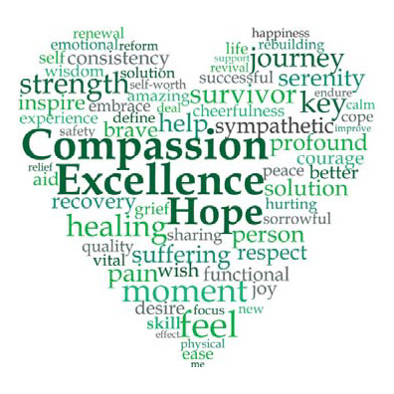
2
Building a Restorative Trauma Informed Community in Snohomish County
COMPASSION, APPRECIATION, RESILIENCE & EMPOWERMENT
Notes:
Liza
Read title

Slide 3
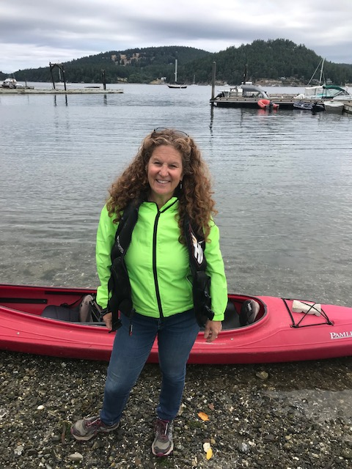
3
Liza Patchen-Short, MA, LMHCA, MHP, CMHS
Liza Patchen-Short works at Snohomish County in the Human Services Behavioral Health Division as the Children’s Mental Health Liaison. Liza has a Bachelor’s Degree in Social Work and Master’s Degree in Human Services with a focus on resiliency. Liza has over thirty years working in the non-profit sector advocating for youth and families. She is the co-chair of the Snohomish County Children’s Wellness Coalition and Youth Suicide Prevention Taskforce, and is leading the charge by supporting schools, community organizations and the community at large in building a Restorative Trauma Informed Community. Liza is co-facilitating the initial cohorts learning collaboratives to build a strong foundation for a trauma informed community. Liza is married and has two wonderful sons and three great stepsons.
COMPASSION, APPRECIATION, RESILIENCE & EMPOWERMENT
Notes:
Liza-1 min
Liza Title and work

Slide 4
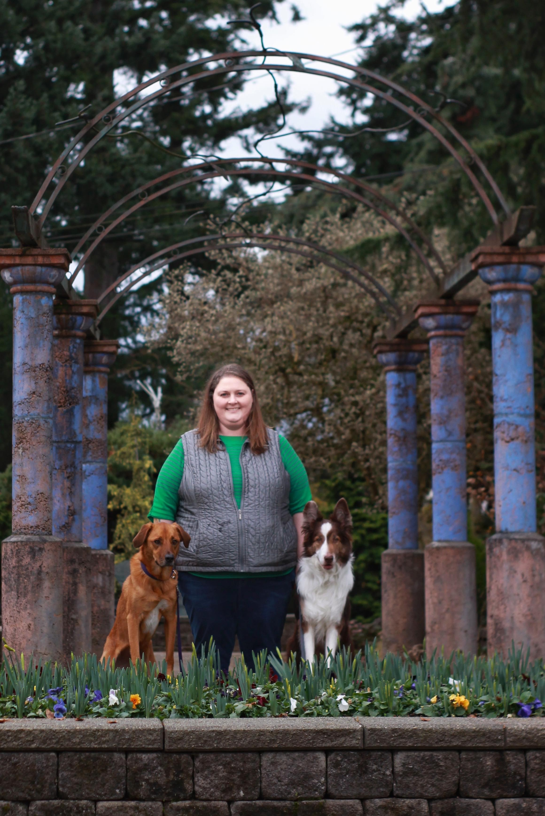
4
Laura Mote, LSWAIC, MHP
Laura Mote is the Mental Health Community Support Specialist with Snohomish County Behavioral Health for the Denney Juvenile Justice System. Laura holds a Master of Social Work Degree with a focus in adolescent trauma. Laura has worked with high-risk youth for over ten years. She is the co-chair of the Snohomish County Children’s Wellness Coalition. Laura is a dedicated leader in building a Restorative Trauma Informed Community. Laura is co-facilitating the initial cohorts learning collaboratives to build a strong foundation for a trauma informed community. Laura is devoted to her two dogs.
Together, Laura and Liza work diligently to bring Restorative Trauma Informed CARE in a way that organizations can systemically bring sustainable changes for the community at large.
COMPASSION, APPRECIATION, RESILIENCE & EMPOWERMENT
Notes:
Laura- 1 min
Laura title and work

Slide 5
5
We want everyone to acknowledge and see who is here at this training so if you could please use the chat box and put in:
Name
Organization and Role
One value you bring to the workplace
COMPASSION, APPRECIATION, RESILIENCE & EMPOWERMENT
Notes:
Laura 3 min
Each night we will send you a reflection opportunity for the training and the next training link

Slide 6
Hopes for the Entire Training
6
Understand your role as a CARE champion and the process of becoming a CARE organization
Understand how to apply and internalize Equity, Restorative Practices & Trauma Informed principles and frameworks in your organization and begin to use that lens in your daily work
Understand the impacts of Brain Science, Adverse Childhood Experiences (ACEs) and Trauma
Discuss the role and characteristics of Resiliency
Learn the basic tenets of Self-Care, Co-Care and Secondary Traumatic Stress and it’s relationship to Trauma Informed Practices
Understand the complex cultural, social, economic, and political forces that impact the lives of our children, families, and communities as a way to identify the root cause of trauma with a shared equity analysis.
COMPASSION, APPRECIATION, RESILIENCE & EMPOWERMENT
Notes:
Liza- 3 min
Read outloud

Slide 7
Hopes for today
7
Understand the foundation of trauma informed care and why it is important to you, your organization, and your community.
COMPASSION, APPRECIATION, RESILIENCE & EMPOWERMENT
Notes:
Liza- 3 min
Read outloud

Slide 8
The Ins and Outs of the CARE Training
8
How to get CEU credits?
At the end of each training unit you will receive a quiz and an evaluation that must be completed. The quiz score must be 70% or above.
Structure of the entire training
Same group agreements
Somatic grounding exercise at the beginning of each session
Same format – Daily agendas will provide break schedules
Reflection at the beginning of the day for the previous day’s trainings
Evaluations after each training section
Deep Dive Starred Slides
in each presentation we have starred slides. The star is in the top right corner, and we will point them out. Those are some of the core slides of this presentation that you will use during the deep dive portion of the training. We just want you to notice them for now.
COMPASSION, APPRECIATION, RESILIENCE & EMPOWERMENT
Notes:
Laura 3 min

Slide 9
CARE Training Days
9
Week 3:
Tuesday, October 19th
Restorative Practices
Mary Cline-Stively
Thursday, October 21st
Implementation Science & Adult Learning
Mary Cline-Stively
Week 4:
Tuesday, October 28th
Self-Care & Secondary Traumatic Stress Deep Dive
Lindsey Greene
Thursday, October 30th
Trauma 101 & Adverse Childhood Experiences (ACEs)
Joe Neigel
Week 5:
Tuesday, November 2nd
TILT, Learning Collaboratives, Structure of the CARE
Liza Patchen-Short & Laura Mote
Thursday, November 4th
Questions, TIC Why again, Panel, Next Steps
Liza Patchen-Short & Laura Mote
Week 1:
Tuesday, October 5th
Introduction to Trauma Informed Care
Liza Patchen-Short & Laura Mote
Thursday, October 7th
Equity and the Intersection of Trauma Informed Practices
Tami Farber
Week 2:
Tuesday, October 12th
Self-Care & Secondary Traumatic Stress (STS)
Lindsey Greene
Thursday, October 14th
Trauma 101 & Adverse Childhood Experiences
Joe Neigel
COMPASSION, APPRECIATION, RESILIENCE & EMPOWERMENT
Notes:
Laura 3 min

Slide 10
10
Grounding Exercise
Take a moment to ground yourself
Take a deep breath
(Inhale slow, Hold, Exhale slow)
Notice any sensations in your body
Try to name what you are feeling in the moment
Thank yourself for this moment and your strength
COMPASSION, APPRECIATION, RESILIENCE & EMPOWERMENT
Notes:
Laura 3 min

Slide 11
Zoom Tutorial & Norms
12
Remember to mute and unmute to reduce background noise-
Please keep camera, on for connection, if you can.
Can use chat to write comments or ? for discussion
Check name and rename if needed (name, pronouns and organization )
“Raise hand” to signal desire to speak
Patience with the technology
COMPASSION, APPRECIATION, RESILIENCE & EMPOWERMENT
Notes:
Laura- 2 min

Slide 12
Land Acknowledgment
11
We acknowledge that we are each residing on tribal lands of those who have lived on this land time immemorial. We pay respect to their elders past and present. Please take a moment to consider the many legacies of violence, displacement, migration, and settlement that bring us together today. We recognize the resilience of those past and present who work to build a strong and sovereign nation where Tribal members live their values and culture.
We are on the lands of the Tulalip, the Snohomish, the Stillaguamish, and Sauk Suiattle Tribes.
https://nativegov.org/a-guide-to-indigenous-land-acknowledgment/
COMPASSION, APPRECIATION, RESILIENCE & EMPOWERMENT
Notes:
Laura- 2 min

Slide 13
13
Group Agreements
Address impact over intent
Embrace the power of humble, respectful listening
Create trusting and safe spaces – where a little bit of discomfort is okay.
Learning leaves – Stories stay
Speak from your own experience instead of generalizing
Participate to the fullest of your ability – community growth depends on the inclusion of every individual voice
We encourage you to lean in, be brave and vulnerable
COMPASSION, APPRECIATION, RESILIENCE & EMPOWERMENT
Notes:
Liza- 3 min

Slide 14
14
Cohort 4 CARE ORGANIZATIONS
Volunteers of America
Providence Hospital
YMCA
Catholic Community Services
City of Mukilteo
Farmer Frog
Northwest Educational District 189
Hope Works
Greater Trinity Academy
Take the Next Step
Snohomish County Early Learning Head Start
Peoria Home
Fleet & Family Support Center Everett Naval Station
Recovery Café
Hand in Hand
ChildStrive
Housing Hope
Dawson Place
Verdant Health Commission
LINC NW
Homage
Everett Gospel Mission
Change the Narrative
Imagine Children’s Museum
COMPASSION, APPRECIATION, RESILIENCE & EMPOWERMENT
Notes:
1 min Liza

Slide 15
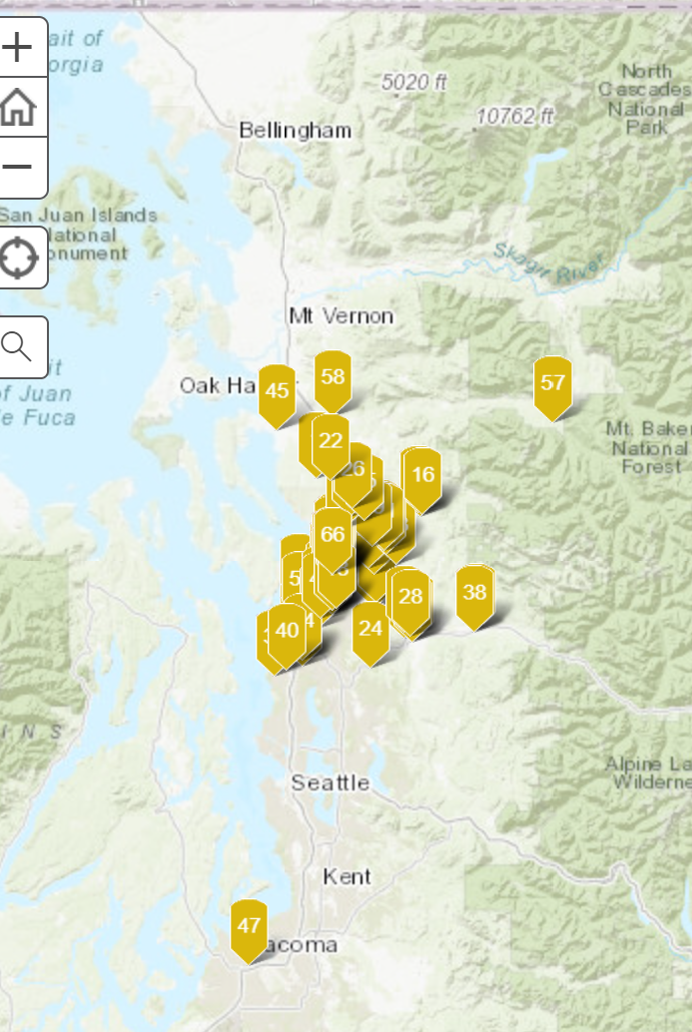
15
Interactive CARE Map
Notes:
Liza 5 min
https://arcg.is/01CSfW

Slide 16
16
What is the CARE Movement?
CARE stands for: Compassion, Appreciation, Resilience & Empowerment
Snohomish County is committed to building restorative trauma informed organizations. Over the last three years, we have trained over 45 organizations to become designated Restorative Trauma Informed CARE sites. The vision for this partnership is for all Snohomish County residents to thrive in an equitable, sustainable environment that cultivates relationships and a strong feeling of belonging.
We have engaged our local organizations from pre-school to older adults. The goal is to build community resiliency, increase collaboration across agency partners and strengthen the overall well-being of our community.
Notes:
10 min Liza
CARE Designated Organizations:
Community organizations that demonstrate that trauma-informed principles are embedded thought the organizations practices and policies. These organizations have participated in the Train the Trainer process and have formed Trauma Informed Leadership Teams
Train the Trainer Champions:
What that means is at least two staff from each organization have become trainers for their organization and have committed to train their entire organization on Trauma Informed Care , Adverse Childhood Experiences, Self-Care, Secondary Traumatic Stress, Resiliency, and Trauma 101 with a framework that embeds Restorative Practices and Equity.
Trauma Informed Leadership Team (TILT):
The Trauma Informed Leadership Team (TILT) is a principal-driven, accountable group, working in the spirit of trauma-informed principles. The goal of the TILT is to review, shape, and lead the paradigm shift to embed trauma informed principles into policies, procedures, and practices within your organization. The TILT leads the identification, adoption and sustainability plans while building on the organization’s strengths, aligning with the organization culture and centering on equity.
Learning Collaboratives:
Learning Collaborative are offered for each cohort of Train the Trainers (TOT). For the first year following training, it is important that the TOT’s attend at least six throughout the next year. These groups meet monthly to provide on-going support, learning and problem-solving. The goal is for organizations to participate on an on-going basis in order to maintain CARE certification as the learning process in continuous. These collaborative are led by Laura Mote and Liza Patchen-Short.
CARE TILT GPS (Growth, Practice and Strategy)
This is a learning series that uses a quality improvement and peer learning framework to provide established TILT teams with tools, resources, strategies and peer learning to advance trauma-informed, restorative work within their organization. TILTs commit to attending a total of 3 session that followed by an “action period” when TILTs apply concepts and tools to advance their trauma-informed, restorative practice or policy focus area of their choosing. During the learning series each TILT also received technical assistance and coaching to support their work. This is an optional opportunity for organizations wanting to work specifically on a project that will deepen their restorative, trauma informed work.

Slide 17
Ice Breaker: “Something in Common”
17
Something in Common
You will be randomly assigned to a room with 5 others
Each team has 10 minutes to:
Choose a person who will write down and report out on the following:
Find 5 UNIQUE things that your group has in common, within those 5 minutes
Choose 1 unique thing that you think your group will have in common with the other groups
When we re-join in the main room 1 person for their group will report out what 1 unique thing they think they will have in common with the other groups
Notes:
Liza 10 min

Slide 18
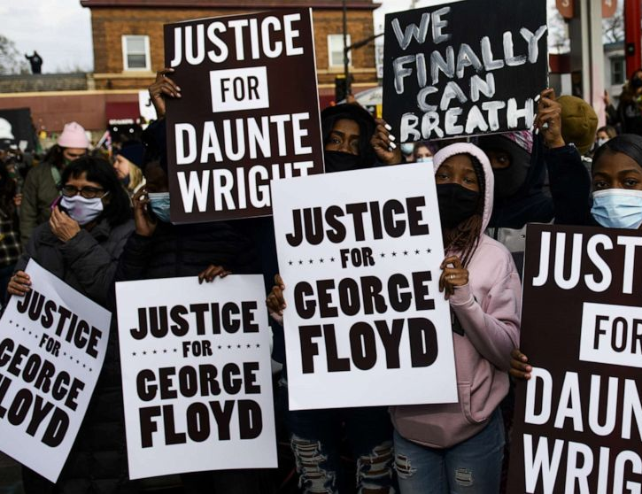
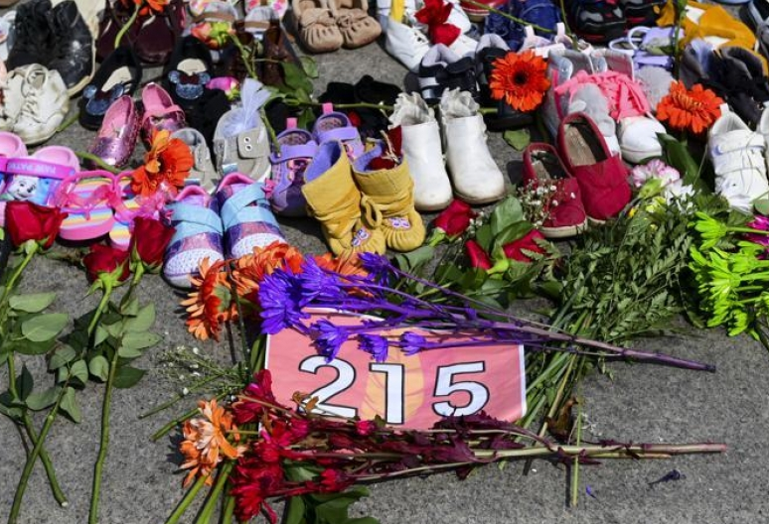
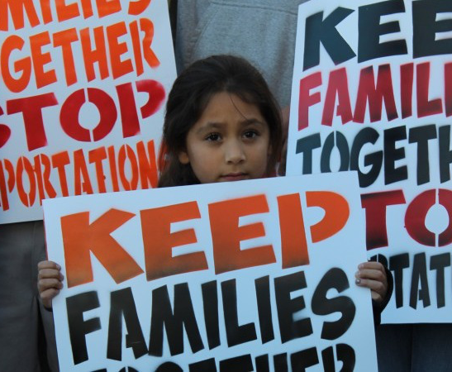
Systemic Oppression
18
Notes:
2 min Laura
The intersection of TIC and DEI work means integrating and embedding our understanding of the impact of trauma, to include defining trauma to include harm caused by our systems—historical trauma, collective trauma, macroaggression, and microaggressions. The goal is building systems where one’s identity does not define your outcomes and inclusion is not just providing access to a service but having services provided in a way that the consumer feels valued, heard, and cared for in an authentic way.

Slide 19
19
Why Be Trauma Informed
Aligning these initiatives is vital to successful organization culture transformation
Trauma Informed
Care
Restorative Practices Relational Healing
Racial Equity and Justice
COMPASSION, APPRECIATION, RESILIENCE & EMPOWERMENT
Notes:
Liza - 5 min
(61 min 9:30)
Snohomish County’s CARE model combines three best practices: TIC, RP ( the social science of improving and repairing relationships between people and communities)and DEI ( ensuring that processes are impartial, fair and provide equal outcomes for every individual. It is
our belief that inclusiveness, healing, building relationships and the impact of trauma are the building blocks for lasting healing systemic change.

Slide 20
20
Notes:
Liza 6 min
https://www.youtube.com/watch?v=dF20FaQzYUI

Slide 21
21
Identify any highlights?
COMPASSION, APPRECIATION, RESILIENCE & EMPOWERMENT
Notes:
Liza-7 min

Slide 22
22
What is Trauma Informed Care?
Trauma Informed Care is a strengths-based framework that is grounded in an understanding of and responsiveness to the impact of trauma…that emphasizes relationships, being curious, non-judgmental, and creates space for physical, psychological, and emotional safety for all. This paradigm shift builds and allows for opportunities to rebuild and keep a sense of empowerment and resiliency.
COMPASSION, APPRECIATION, RESILIENCE & EMPOWERMENT
Notes:
Liza-2 min
Trauma Informed Care is about building relationships, focusing on providing safety, connection especially when working with a person who may already feel disconnected, overwhelmed and not worthy. This work is a paradigm shift, not new work. It is how you do the work.
When we are curious and shift our thinking to what has happened to a person vs. what is wrong with them, that is a using a trauma informed lens that recognizes and honors that there are other factors driving behaviors.
According to Jennings, A trauma informed approach “would be experienced by all involved as a profound cultural shift in which consumers and their conditions and behaviors are viewed differently, staff respond differently, and the day-to day delivery of services is conducted differently” (Jennings, 2004, p. 21) Models for Developing Trauma Informed Behavioral Health Systems and Trauma –Specific Services.

Slide 23
23
What is a Trauma Informed System?
A trauma-informed system is a strengths-based framework that is grounded in an understanding of and responsiveness to the impact of trauma on those who have contact with the system, and service providers. The entire organization embeds and sustains trauma awareness, knowledge, and skills into their organizational cultures, practices, and policies. They act in collaboration with all those involved using the best available modalities to maximize physical and psychological safety, facilitate healing , and support their ability to thrive.
COMPASSION, APPRECIATION, RESILIENCE & EMPOWERMENT
Notes:
Liza- 2 min
A Trauma Informed System embeds trauma informed principles into all the workplace policies and procedures and recognizes and responds to the impact of traumatic stress. This system supports a culture of staff wellness and creates an environment that is emotionally, physically, and socially safe for all.
In addition, A Trauma Informed Care system is about changing an organizational culture where policies and procedures that are reflective of these values in all aspects of the organization. This shift and intention is the very foundation in which we think, how we feel, how we communicate, and how we practice.
Ultimately this is changing a mental model of how we understand ourselves as well as other human beings. The fundamental question to reframe is from, “what’s wrong with you?” to “what happened to you? “It is a strengths-based perspective not a deficit based.

Slide 24
24
Josh Shipp Video
COMPASSION, APPRECIATION, RESILIENCE & EMPOWERMENT
Notes:
Laura- 15 min to include group discussion
https://joshshipp.com/oca-lp/

Slide 25
Self- Reflection Question: 5 min When you think about trauma informed care or trauma informed systems what have you learned or surprised you? Breakout Rooms -10 min 2-3 in a group When you think of trauma informed care, how does it connect with your personal values? Any Questions?
25
COMPASSION, APPRECIATION, RESILIENCE & EMPOWERMENT
Notes:
15 min
Liza

Slide 26
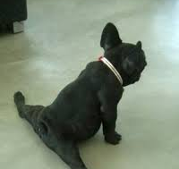
26
10 Minute Break
Take time to stretch
Get something to drink and breathe!
Notes:
10 min
(60 min)

Slide 27
27
Building an Equitable Restorative Trauma Informed Workplace:
A Culture of Connection and Belonging
COMPASSION, APPRECIATION, RESILIENCE & EMPOWERMENT
Notes:
1 min

Slide 28
28
So Why Be a Trauma Informed Organization?
Why be a CARE Designated Organization?
Building relationships, a sense of belonging, trust and connection creates a workplace culture of healing.
The paradigm shift becomes not what is wrong with you but what has happened to you.
Trauma informed, restorative principles that are equitable aim at insuring environments and services are accessible welcoming, healing and provides a sense of belonging to all particularly those impacted by the inequities in our community.
COMPASSION, APPRECIATION, RESILIENCE & EMPOWERMENT
Notes:
Liza- 5 min
Why Trauma Informed?
Trauma Informed Care is about
Building relationships, creating a sense of belonging, trust, and deep connection which ultimately creates a workplace culture of healing.
This paradigm shift and work focuses on not what is wrong with you, but what has happened to you? TIC acknowledges the whole person, and the knowledge of the impact of trauma.
Trauma Informed Care aims at insuring environments and services to be welcoming, not retraumatizing but healing, and provides a sense of emotional safety and belonging to all.
TIC is not a training; it is the way in which you do the work.

Slide 29
29
The benefits and importance of this work
Staff become more regulated, flexible and resilient. A better sense of wellbeing for all
A trauma Informed workplace is calmer, and staff have deeper relationships
Staff and customers feel like they belong and are heard
We prioritize human over tasks
We find out the real story and do not make judgements or assumptions
Mental health days are supported instead of absenteeism
Increased productivity and retention
COMPASSION, APPRECIATION, RESILIENCE & EMPOWERMENT
Notes:
Liza -5 min
There are many benefits to embedding this work into an organization. Staff become more regulated and develop resilience, you have an organization that puts relationship over task which ultimately increases productivity, retention and decreases absenteeism by focusing on self-care, holistic workplace wellbeing, and validated employees. This is a culture shift that informs actions and healing. Trauma informed care focuses on the whole person, including past trauma, triggers, and how that affects a person’s behaviors and your work moving forward with them. Yet another benefit focuses on how we are in relationship with our colleagues, and how one functions as a whole organization. It is ultimately creating an environment that promotes thriving and resiliency for all.

Slide 30
30
Notes:
3 min-Liza

Slide 31
What does a Trauma Informed Organization look like?
31
Workplace Principles
Safety –
Building relationships with others based on mutual respect and inclusion of all individuals. The goal is to promote a secure, safe, physically and emotionally, environment by building positive relationships that build resiliency for all in each interaction.
Trustworthiness & Transparency-
Fostering positive relationships based on trust and honesty. Share as much information as possible, relational.
Peer Support-
Identifying common concerns within the community and engaging in collective problem solving. This means recognizing and actively working towards solving the needs of every individual.
Collaboration and Mutuality-
Recognizing the importance of all roles within the organization and developing equal opportunities for decision making. Best practice is to collaborate with community members, families, and organizations within Snohomish County to promote trauma informed principles and systems of care. Allow time for social interaction for staff to stay in touch with family and team members during COVID times.
COMPASSION, APPRECIATION, RESILIENCE & EMPOWERMENT
Notes:
Liza-10 min
This is a roadmap for creating a workplace culture of resiliency and healing. Trauma-informed care interventions, policies and practices must be delivered within a framework of a trauma-informed system. The principles will be the guideposts for your work.
Safety –
Building relationships with others based on mutual respect and inclusion of all individuals. This is all about Prioritizing a safe, physically and emotionally, environment in each interaction. It is human, over task.
Trustworthiness & Transparency-
This principle focuses on Fostering positive relationships based on trust and honesty among community members (staff, schools, family members, police, ,). The goal is to be relational, share as much information as possible. Folks like to know what is going on and also what is coming up.
Peer Support-
Peer Support may be defined as the help and support that people with lived experience are able to give to one another.
It may be social, emotional or practical support but importantly this support is mutually offered and reciprocal, allowing peers to benefit from the support whether they are giving or receiving it.
This is about Identifying common concerns or issues of the community and engaging in collective problem solving. It’s recognizing and actively working towards solving the needs of every individual.
Collaboration and Mutuality-
This is about Recognizing the importance of all roles within the organization and developing how you involve and make opportunities for decision making.
This is also about Collaborating with community members, families, and agency’s within Snohomish County. More than ever before, it is critical to allow time for social interaction for staff for connection, pausing, checking in, and encouraging them to stay in touch with family and team members. This will help reduce isolation, fear, and anxiety allowing them to stay mentally well and present.

Slide 32
32
Empowerment, Voice, and Choice-
Recognizing that every person’s experience is unique and requires an individualized approach. Create opportunities and systems that empower all individual’s voice and choice. Seek staff and consumers input.
Resiliency-
Building resiliency by modeling compassion and regulation with each interaction and by providing skills and protective factors. Providing the opportunity to promote recovery and the ability to bounce back from adverse conditions.
Cultural, Historical, Race, Class, Gender issues-
Appreciating and celebrating the differences and each individual’s unique experiences by practicing cultural competency. Implementing a competency lens of cultural, historical and gender issues in your daily work.
COMPASSION, APPRECIATION, RESILIENCE & EMPOWERMENT
Notes:
Liza
Empowerment, Voice, and Choice-
Recognizing that every person’s experience is unique and requires an individualized approach. Opportunities to empower all individual’s voice and choice is provided. Listen deeply to all voices and use their input responsibly and honestly. Seek staff and customer input.
Resiliency-
Resiliency is defined as an opportunity to promote recovery, and the ability to bounce back from adverse conditions. The single most common factor for children who develop resilience is at least one stable and committed relationship with a supportive parent, caregiver, or other adult. These relationships provide the personalized responsiveness, scaffolding, and protection that buffer children from developmental disruption. Resilience is made up of five pillars: self-awareness, mindfulness, self-care, positive relationships & purpose. By strengthening these pillars, we in turn, become more resilient.
Cultural, Historical, Gender issues-
This is a critical principle. This is Incorporating a competency lens of cultural, historical, and gender issues in your daily work. It’s about being open minded, being an ally, and having a growth mind set for continued learning. This work is also about appreciating and getting to each person’s our values, and unique experiences.

Slide 33
33
COMPASSION, APPRECIATION, RESILIENCE & EMPOWERMENT
Notes:
Laura -10 min
Trauma Organized-Organizations impacted by stress, operating in silos, avoidant of issues and isolated in their practices or service delivery. These organizations can be trauma inducing
Trauma Informed -these are organizations that develop a shared language to define, normalize and address the impact of trauma on clients and workforce. They operate from a foundational understanding of the nature and impact of trauma.
Healing Organizations -Organizations where staff policies, procedures, services and treatment models apply an understanding of trauma embedded within them. Their approaches to providing services are trauma-shielding or trauma-reducing.

Slide 34
Organizational Stressors
34
Providers are unable to deliver quality care in an organizational culture defined by chronic stressors and collective traumas.
Technology and paperwork demands
Legislation, reforms, task focus
Feeling unsafe with
co-workers or clients
Client needs
vs. Regulations
Staff and budget cuts
Staff turnover, vacancies, understaffing
No time for collaboration or supervision
Direct and indirect trauma exposure
(Bloom & Farragher, 2013)
Notes:
Liza-5 min
Read each bubble slide and notes
There are work conditions that can lead to organizational level stress---Do any of these seem familiar to you?
These stresses may impact your organizations differently, but usually we can all relate to a few…..What do you see or notice? Feel free to add in the chat box.

Slide 35
35
Organizational Resilience
Capacity to Adapt to Changing Environment
Employee
Well-Being is Prioritized
Leadership Commitment to equity and organizational wellness
Succession Planning
Antiracist policies and practices
Targeted universalism
Centering relational practices
“A resilient organization is able to adapt and thrive in times of uncertainty, pressure and ambiguity.
Succeeding as an organization is much more likely when we build resilience into our strategy, culture and day-day practices. A resilient organization enables individual resilience.”
Sense of Humor
Staff
Committed to Organization’s Mission
(Bloom & Farragher, 2013)
Notes:
Liza 5 min
Targeted universalism means setting universal goals and using targeted processes to achieve those goals. Within a targeted universalism framework, an organization or system sets universal goals for all groups concerned.
Organizational resilience is set by these cultural structures that promotes these practices
Just like when we have organizational stressors, we also have organizational resiliencies.
Just like individuals, when organizations are up against enough stress, organizational buffers and resiliencies are forgotten or can be lost. It is important to have these practices in place to mitigate the adversity.

Slide 36
Challenges to Implementing Trauma Informed CARE
36
Getting buy in from the whole organization can be hard
Inconsistent understanding of what it means to be trauma informed
Most view this work as more work or just a training rather than a culture shift
Understanding this is complex system change work. It will take the whole organizations commitment, and dedication
Evaluating measures of trauma informed change is difficult
Workplaces not prioritizing the work
Building sustainable methods and systems
COMPASSION, APPRECIATION, RESILIENCE & EMPOWERMENT
Notes:
Liza- 5 min
It is important to remember that change will take time and that when you leave this training you do not have to be the “expert” of know everything. The learning collaboratives will help give you the support you need and help guide your work.
One strategy though for folks are your workplace that are a nay sayer is to keep them close, invite them to be a part of your TILT, help them understand the why…

Slide 37
37
“Trying to implement trauma-specific clinical practices without first implementing trauma-informed organizational culture change is like throwing seeds on dry land.”
Sandra Bloom, MD, Creator of the Sanctuary Model
COMPASSION, APPRECIATION, RESILIENCE & EMPOWERMENT
Notes:
1 min Liza
Read

Slide 38
Self- Reflection Question: 5 min Where in your life have you experienced a healing organization? What happened? Were you able to do your job better? Did you feel more connected or in sync with your colleagues? Did you feel a sense of reward? Breakout Room - 10 min 2-3 in a group Discuss your experiences from your reflection Any Questions?
38
COMPASSION, APPRECIATION, RESILIENCE & EMPOWERMENT
Notes:
15 min
Liza
(60 min 11:30)

Slide 39
39
10 Minute Break
Take time to stretch
Get something to drink and breathe!
Notes:
10 min

Slide 40
40
Key Ingredients for Creating a Trauma-Informed Approach to an Organization
Leading and communicating about the transformation process throughout entire agency
Engaging consumers in organizational planning
Training clinical as well as non-clinical staff members –common language and mission
Creating a safe environment
Preventing secondary traumatic stress in staff
Hiring a trauma-informed workforce
Involving consumers in the treatment process
Screening for trauma and ACEs
Training staff in trauma-specific treatment approaches
Engaging referral sources and partnering organizations
Use reflective supervision
Culturally competent staff
COMPASSION, APPRECIATION, RESILIENCE & EMPOWERMENT
Notes:
Laura- 5 min

Slide 41
41
NO Equitable & TRAUMA INFORMED CARE LENS
POWER OVER
YOU CAN’T CHANGE
PEOPLE NEED FIXING FIRST
OPERATE FROM THE DOMINANT CULTURE
PEOPLE ARE OUT TO GET YOU
THERE’S ONLY RIGHT OR WRONG
HELPING
“YOU’RE CRAZY!”
COMPLIANCE/OBEDIENCE
INFO IS SHARED ON A NEED TO KNOW BASIS
PRESENTING ISSUE
“US AND THEM”
LABELS, PATHOLOGY
FEAR BASED
I’M HERE TO FIX YOU
INSTRUCTIVE
PEOPLE MAKE BAD CHOICES
BEHAVIOR VIEWED AS PROBLEM
WHAT’S WRONG WITH YOU?
BLAME/SHAME
GOAL IS TO GO THINGS THE “RIGHT” WAY
PRESCRIPTIVE
Equitable & TRAUMA INFORMED CARE LENS
POWER WITH
NEUROPLASTICITY CAN CHANGE
PEOPLE NEED SAFETY FIRST
CULTURE HUMILITY
PEOPLE CAN LIVE UP TO THE TRUST YOU GIVE THEM
THERE’S MULTIPLE VIEWPOINTS
LEARNING
“IT MAKES SENSE”
EMPOWERMENT/COLLARBORATION
TRANSPARENCY AND PREDICTABILITY
WHOLE PERSON AND HISTORY
“WE’RE ALL IN THIS TOGETHER”
BEHAVIOR AS COMMUNICATION
EMPATHY BASED
SUPPORT THE HEALING
PARTICIPATORY
PEOPLE WHO FEEL UNSAFE DO UNSAFE THINGS
BEHAVIOR VIEWED AS A PERSONAL SOLUTION
WHAT HAPPENED TO YOU?
RESPECT
GOAL IS TO CONNECT
CHOICE
What Does the Cultural Shift of Trauma Informed Care Look Like
Notes:
Laura- 5 min
Now lets take a look at what a community with a trauma informed lens looks like: Notice the differences? How about Power With rather than Power Over. Transparency and Predictability rather than Info shared on a need to know basis. You might ask why these trauma informed practices are so important?
When we use a Trauma Informed lens, we provide opportunities to connect, heal, and thrive.
Our lens shifts away from traditional practices built on punishment and blame, to practices that teach, empower and build on mutual collaboration.
By embracing a strengths-based approach we are able to blend accountability with empathy and curiosity.

Slide 42
42
How to build a thriving community through relationship and connection
Understanding
Trauma
Having community common language &
understanding
Building Healing Relationships
Compassion and human over tasks
“What has happened?”
NOT
“What is wrong?”
Community Building and Collaborating
Building Resiliency
Understanding Brain Science
Equity and Belonging
Science and evidence-based practices
Providing Care & Compassion
COMPASSION, APPRECIATION, RESILIENCE & EMPOWERMENT
Notes:
Laura- 5 min
Now lets take a look at what a community with a trauma informed lens looks like: Notice the differences? How about Power With rather than Power Over. Transparency and Predictability rather than Info shared on a need to know basis. You might ask why these trauma informed practices are so important?
When we use a Trauma Informed lens, we provide opportunities to connect, heal, and thrive.
Our lens shifts away from traditional practices built on punishment and blame, to practices that teach, empower and build on mutual collaboration.
By embracing a strengths-based approach we are able to blend accountability with empathy and curiosity.

Slide 43
Self- Reflection Question: 5 min What is your hope with this work for yourself and your organization? Breakout Rooms -10 min 2-3 in a group What is something you misunderstood or had an incomplete understanding of trauma informed care that has become more complete or deep for you? Any Questions?
43
COMPASSION, APPRECIATION, RESILIENCE & EMPOWERMENT
Notes:
15 min
Liza

Slide 44
44
How Wolves Change Rivers
COMPASSION, APPRECIATION, RESILIENCE & EMPOWERMENT
Notes:
5 min Liza
https://www.youtube.com/watch?v=oSBL7Gk_9QU

Slide 45
45
In the chat: Write something you learned or appreciated about today’s session
COMPASSION, APPRECIATION, RESILIENCE & EMPOWERMENT
Notes:
Liza 3 min

Slide 46
46
Readings
Organizational Stress as a Barrier to Trauma-Informed Service Delivery, S. Bloom
The Future of Healing: Shifting from Trauma-Informed Care to Healing Centered Engagement, S. Ginwright
Organizational Prevention of Vicarious Trauma, H. Bell et al.
Strategies to Confronting Unconscious Bias, L. Nalty
Lessons Learned While Building a Trauma-Informed Public Health Behavioral Health System in the City of Philadelphia, Beidas, RS et al.
What Happened to you, B Perry, and O. Winfrey
The Body Keeps the Score, B van der Kolk
The Four Pivots, S Ginwright (release date 1/25/21)
COMPASSION, APPRECIATION, RESILIENCE & EMPOWERMENT
Notes:
2 min Liza

Slide 47
47
Thanks for being a Trauma Informed Care Champion!
COMPASSION, APPRECIATION, RESILIENCE & EMPOWERMENT
Notes:
1 min Liza

