Slide 1
Secondary Trauma and Self Care:
DEEP DIVE

Slide 2
Land Acknowledgment
We acknowledge that we are each residing on tribal lands of those who have lived on this land time immemorial. We pay respect to their elders past and present. Please take a moment to consider the many legacies of violence, displacement, migration, and settlement that bring us together today. We recognize the resilience of those past and present who work to build a strong and sovereign nation where Tribal members live their values and culture.
We are on the lands of the Tulalip, the Snohomish, the Stillaguamish, and Sauk Suiattle Tribes.
Native Land Map: https://native-land.ca/
COMPASSION, APPRECIATION, RESILIENCE & EMPOWERMENT

Slide 3
Group Agreements
Address impact over intent
Embrace the power of humble, respectful listening
Create trusting and safe spaces – where a little bit of discomfort is okay.
Learning leaves – Stories stay
Speak from your own experience instead of generalizing
Participate to the fullest of your ability – community growth depends on the inclusion of every individual voice
We encourage you to lean in, be brave and vulnerable
COMPASSION, APPRECIATION, RESILIENCE & EMPOWERMENT

Slide 4
Opening Check-in
???
Let’s breathe together: https://www.youtube.com/watch?v=uxayUBd6T7M
COMPASSION, APPRECIATION, RESILIENCE & EMPOWERMENT

Slide 5
Opportunities for engagement
If material is being read out load, ask for volunteers.
Use “pair-share” exercises, even if only a few minutes to turn to partner, then group hi-lights.
Ask “what questions do you have” vs. “any questions?”.
Provide real-life experiences and examples. Ask for examples from the group.
Use language like “what was your take away”, “a-ha moment”, “experience” when trying to encourage sharing.
Use small group interactions whenever possible.
Use silence – it may mean that folks are absorbing material. It is okay to pause and give a minute for reflection.
Provide content and then provide some sort of opportunity for engagement around the material like a few minutes of self-reflection, pair-share, small group, etc. The important part is integration, experience and/or practice of material to help make it their own.
Use self-assessment type of tools or questions as a way to mitigate the gap of experience and the new information.
Provide a variety of different ways to access the material - Visual; auditory; kinesthetic; etc.
COMPASSION, APPRECIATION, RESILIENCE & EMPOWERMENT
Notes:
Highlighted key opportunities for engagement that might be available in STS/Self Care

Slide 6
Quick Feedback
Launch Poll
COMPASSION, APPRECIATION, RESILIENCE & EMPOWERMENT

Slide 7
Breakout Rooms
What is your organization’s current culture and expectations around staff training?
What barriers or challenges do you think you’ll encounter in leading a training on Secondary Trauma and Self Care within your organization?
Report back: assign one person from your group to put your top 3 barriers or challenges up on the white board.
COMPASSION, APPRECIATION, RESILIENCE & EMPOWERMENT

Slide 8
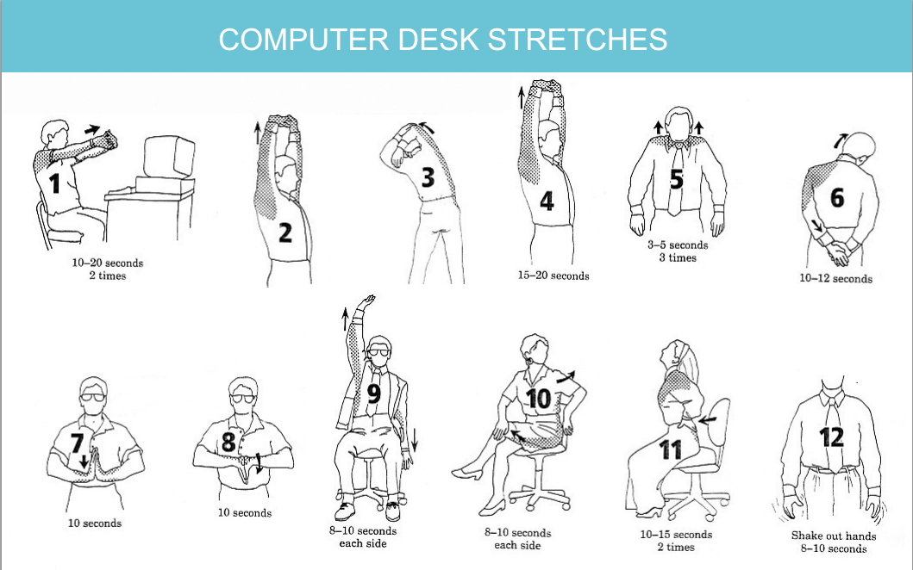
5 Minute Body Break

Slide 9
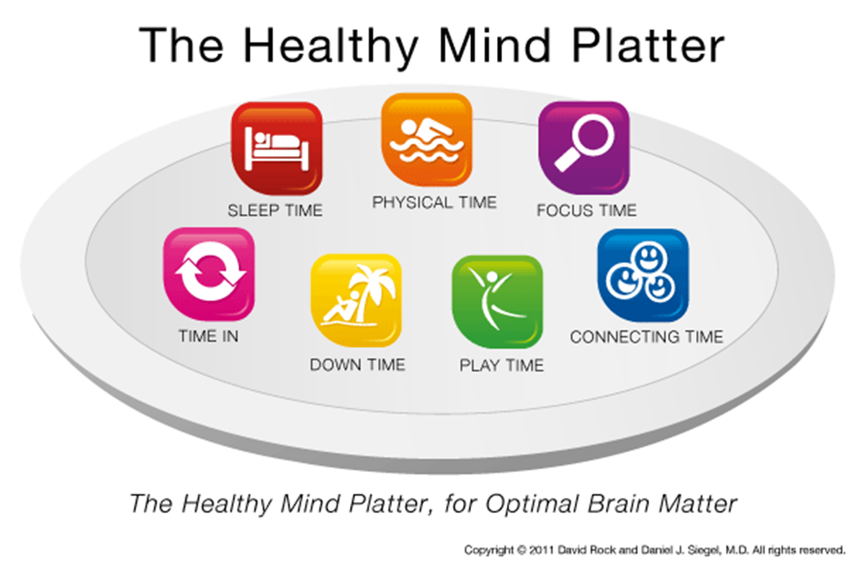
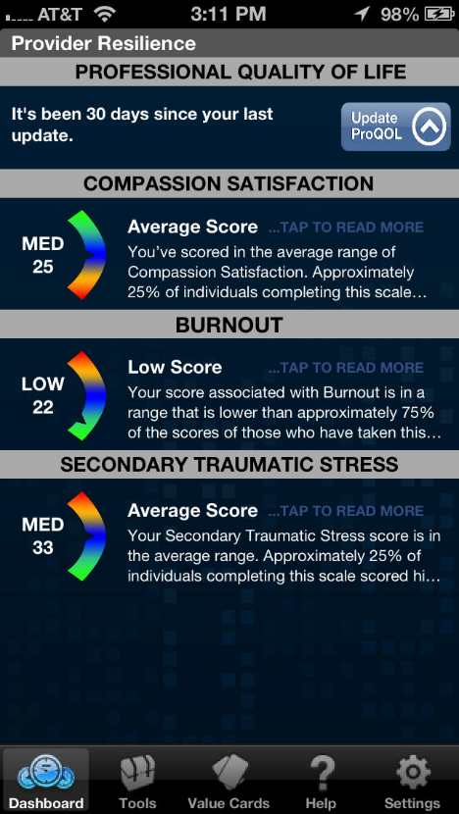
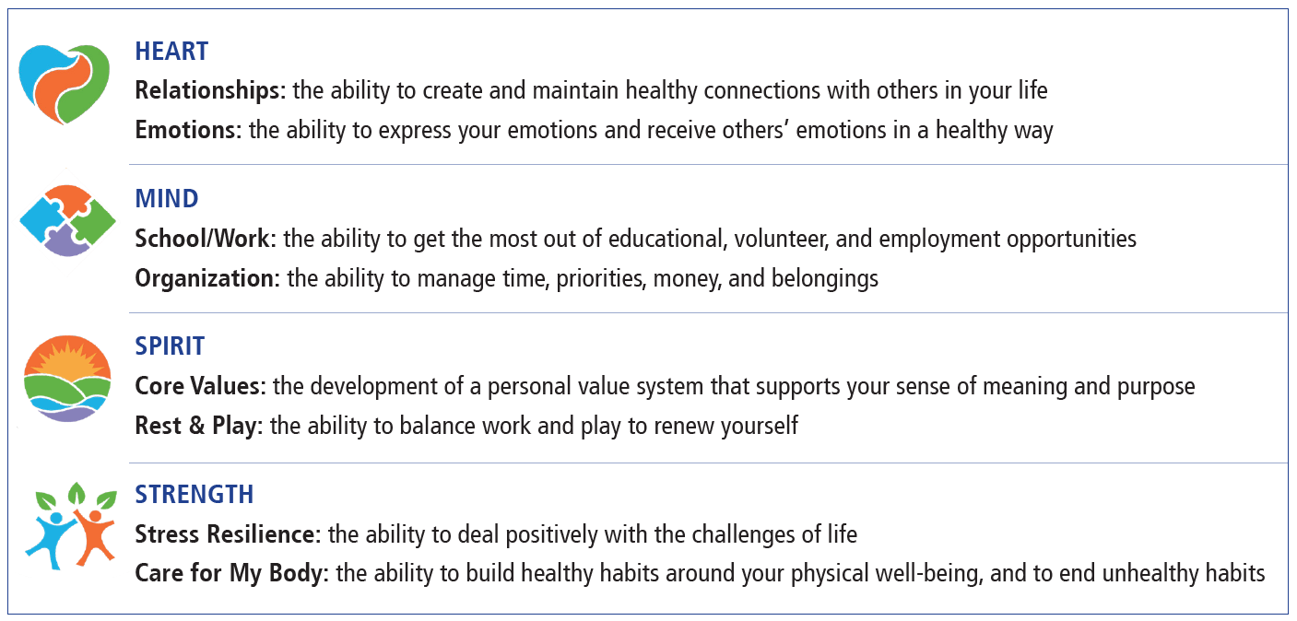
Reviewing Key Activities
Share a story of resilience
Healthy Mind Platter (annotate)
ProQOL (self reflection & small group)
TedTalk and small group
Wellness Compass (group brainstorm)
COMPASSION, APPRECIATION, RESILIENCE & EMPOWERMENT

Slide 10
Breakout Rooms
Of the 5, which activities do you think would be most valuable to your organization? Why?
Which ones do you plan on using?
Are there other activities you are thinking of doing instead?
Come back to the large group with the questions you have on successfully facilitating the activity.
COMPASSION, APPRECIATION, RESILIENCE & EMPOWERMENT

Slide 11
Ask me Anything
What questions do you have on facilitating activities?
COMPASSION, APPRECIATION, RESILIENCE & EMPOWERMENT

Slide 12
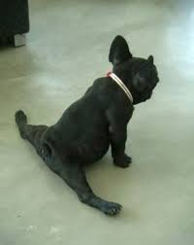
20 Minute Break

Slide 13
Starred Slides
The 5 starred slides are some of the heaviest content portions.
These are great places to add:
opportunities for participants to ask clarifying questions
prompts for brief interactions in the chat to assess knowledge
personal anecdotes to help content come to life
COMPASSION, APPRECIATION, RESILIENCE & EMPOWERMENT

Slide 14
COMPASSION, APPRECIATION, RESILIENCE & EMPOWERMENT
Notes:
We ALL have mental health, and we all can work toward our best state of mental wellness.
This may be a helpful visual to think about all the ways you are already doing things for your well-being.
Source: https://www.drdansiegel.com/resources/healthy_mind_platter/
Many of these seven essential elements needed to balance your mental health plate were built into the self care assessment you just completed. These may be a helpful visual to think about all the ways you are already doing things for your well-being. We ALL have mental health, and we all can work toward our best state of mental wellness.
Source: https://www.drdansiegel.com/resources/healthy_mind_platter/
Often called: the Seven Essential Activities for Optimum Mental Health-each one will be reviewed
Just as we can balance our diet to help our bodies perform better, we can also balance our time so that our mental health is better.
The Healthy Mind Platter has seven essential mental activities necessary for optimum mental health in daily life. These seven daily activities make up the full set of ‘mental nutrients' that your brain needs to function at it's best. By engaging every day in each of these servings, you enable your brain to coordinate and balance its activities, which strengthens your brain's internal connections and your connections with other people. Think of brain health as prevention for Compassion Fatigue. Remember balance is key.
Focus Time
When we closely focus on tasks in a goal-oriented way, we take on challenges that make deep connections in the brain.
Play Time
When we allow ourselves to be spontaneous or creative, playfully enjoying novel experiences, we help make new connections in the brain.
Connecting Time
When we connect with other people, ideally in person, and when we take time to appreciate our connection to the natural world around us, we activate and reinforce the brain's relational circuitry.
Physical Time
When we move our bodies, aerobically if medically possible, we strengthen the brain in many ways.
Time In
When we quietly reflect internally, focusing on sensations, images, feelings and thoughts, we help to better integrate the brain.
Down Time
When we are non-focused, without any specific goal, and let our mind wander or simply relax, we help the brain recharge.
Sleep Time
When we give the brain the rest it needs, we consolidate learning and recover from the experiences of the day.

Slide 15
Defining the Terms
Compassion Satisfaction (Positive aspects of working as a helper)
Compassion Fatigue (Negative aspects of working as a helper)
Burnout
Inefficacy and feeling overwhelmed
Work-related traumatic stress
Primary traumatic stress direct target of event
Secondary traumatic exposure to an event due to a relationship with the primary person
© Beth Hudnall Stamm, 2009. Professional Quality of Life Scale (ProQOL). www.proqol.org. This test may be freely copied as long as (a) author is credited, (b) no changes are made without author authorization, and (c) it is not sold.
COMPASSION, APPRECIATION, RESILIENCE & EMPOWERMENT
Notes:
Compassion Satisfaction
Refers to the positive feelings derived from competent performance as a trauma professionals. It is characterized by positive relationships with colleagues and the conviction that one’s work makes a meaningful contribution to clients and society.
Compassion Fatigue
This has 2 sub-categories, both burn out and work related traumatic stress contribute to CF.
Burnout
Characterized by emotional exhaustion, depersonalization and a reduced feeling of personal accomplishment.
While it is also work-related, burnout develops as a result of general occupational stress
the term is not used to describe the effects of indirect trauma exposure specifically.
STS defined: Trauma experienced as a result of exposure to another person’s trauma and trauma reactions.
Exposure can be through:
What someone tells you or says in your presence
The child’s play, drawings, written stories
Another persons reactions to trauma reminders
Media coverage, case reports, or other documents about the trauma
Compassion Fatigue Warning Signs:
Mental and physical exhaustion
Using alcohol, food, or other substances to combat stress and comfort yourself
Disturbed sleep
Feeling numb and distanced from life
Feeling less satisfied by work
Moodiness, irritability
Physical complaints—headaches, stomachaches

Slide 16
Exposure to secondary trauma may cause:
Avoidance
Withdrawal
Emotional numbing
Feeling disconnected from friends/family
Hyper arousal
Nervousness or jumpiness
Difficulty concentrating or taking in information
Re-experiencing
Intrusive images
Nightmares and insomnia
Thoughts & Feelings
Changes in your worldview
Feelings of hopelessness and helplessness
Anger
COMPASSION, APPRECIATION, RESILIENCE & EMPOWERMENT
Notes:
Group discussion with examples of exposure to trauma causing STS. Part of the conversation should include some normalizing, that this is something that is likely to occur in a professional setting.
These symptoms should also look familiar, they are symptoms we see in individuals who experience direct trauma.

Slide 17
Tools for Organizations
Using Benefits
Vacation/PTO
EAP
Relying on Relationships
Clinical supervision
Co-care
Personal Strategies
Self care plan
Counseling services
Organizational Strategies
- STS trainings
- Trauma case load balance
- Enhance physical safety
- Ongoing assessment (ex. ProQOL)
Stay connected
Workplace self-care group
Flextime scheduling if applicable
Recognize the connection between your client’s trauma and your own history
COMPASSION, APPRECIATION, RESILIENCE & EMPOWERMENT

Slide 18
Self Care Plan- Leaning In
Watch Out For:
Choosing strategies that SOLELY help you avoid strong feelings/others
Strategies that are not sustainable or achievable
Only focusing on one area of wellness
Look to Highlight:
Strategies that help you address the emotional pain that comes with your work
Your current strengths
Adding in a few achievable goals
All areas of wellness
COMPASSION, APPRECIATION, RESILIENCE & EMPOWERMENT

Slide 19
Breakout Rooms
Of the 5 starred slides, which ones do you think would be most valuable to your organization? Why?
Which ones do you plan on using?
Are there other key concepts that you need to incorporate into your organizational training?
What personal stories would you feel comfortable sharing during training to support learning?
Come back to the large group with the questions you have on successfully communicating this content.
COMPASSION, APPRECIATION, RESILIENCE & EMPOWERMENT

Slide 20
Ask me Anything
What questions do you have on communicating key content?
COMPASSION, APPRECIATION, RESILIENCE & EMPOWERMENT

Slide 21
5 Minute Body Break

Slide 22
Breakout Rooms
Start Planning!
Outline your team’s next steps to make training happen. What support do you need?
Who are the key champions who could lead Secondary Trauma/Self Care training in your organization? Who has natural gifts/strengths you can lean on?
How much time do you anticipate having in front of staff?
What’s your timeline? Is there a season when this content would be most relevant for staff?
How will you and your TILT continue to shift organizational culture toward embodying principles of TIC and self-care into the daily work?
COMPASSION, APPRECIATION, RESILIENCE & EMPOWERMENT

