Slide 1
Secondary Trauma and Self Care
Presented by: Lindsey Greene
Lindsey Greene is part of Coordinated Care’s Community Education team. Coordinated Care is the health plan for children and youth in foster care, adoption support, and alumni of foster care in Washington State. She started her career working in a residential treatment program for youth with behavioral health needs. She has experience working in the child welfare system in two states: Virginia and Washington. Lindsey has worked as a CPS investigator, foster care case manager, adoption worker, and as a supervisor. Lindsey obtained her MSW from the University of Washington in 2014. She joined Coordinated Care’s training team in 2015.

Slide 2
Land Acknowledgment
We acknowledge that we are each residing on tribal lands of those who have lived on this land time immemorial. We pay respect to their elders past and present. Please take a moment to consider the many legacies of violence, displacement, migration, and settlement that bring us together today. We recognize the resilience of those past and present who work to build a strong and sovereign nation where Tribal members live their values and culture.
We are on the lands of the Tulalip, the Snohomish, the Stillaguamish, and Sauk Suiattle Tribes.
Native Land Map: https://native-land.ca/
COMPASSION, APPRECIATION, RESILIENCE & EMPOWERMENT

Slide 3
Group Agreements
Address impact over intent
Embrace the power of humble, respectful listening
Create trusting and safe spaces – where a little bit of discomfort is okay.
Learning leaves – Stories stay
Speak from your own experience instead of generalizing
Participate to the fullest of your ability – community growth depends on the inclusion of every individual voice
We encourage you to lean in, be brave and vulnerable
COMPASSION, APPRECIATION, RESILIENCE & EMPOWERMENT

Slide 4
Opening Check-in
Share a Story of Resilience. Reflect on the past 1-2 weeks, what was a moment of resilience you experienced? It could be either:
- Personal or staff resilience
OR
- Resilience in a family/individual you work with.
How did you feel?
COMPASSION, APPRECIATION, RESILIENCE & EMPOWERMENT

Slide 5
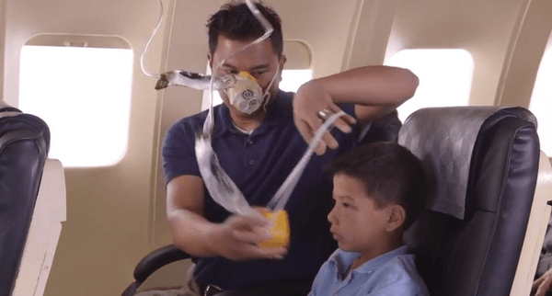
Secondary Traumatic Stress and Self Care
COMPASSION, APPRECIATION, RESILIENCE & EMPOWERMENT
Notes:
Talking Points:
Caring for yourself is NOT selfish, but rather it is imperative.
Think of the last time you were on a flight, you probably remember the flight attendants doing the safety announcements before take-off. Remember, they always say, “in the event of an emergency, please put on your own oxygen mask first before assisting those around you.” If we can’t breath, we aren’t going to be able to serve others in our community or family.
Supplemental Handouts for this section are:
PROQOL
Self Care ideas
Self Care templates
Self Care assessment
When PTSD Is Contagious article

Slide 6
Secondary Traumatic Stress and Self Care
Agenda:
Balancing your plate
Define the terms (CS, CF Burnout, STS)
Effects of secondary trauma
Organizational trauma
Understanding self care
COMPASSION, APPRECIATION, RESILIENCE & EMPOWERMENT
Notes:
Basic agenda for today.
Notice, throughout the deck, you’ll see some slides with plants/tress/flowers. That’s a cue to remind yourself it’s okay to look out the window, notice your surroundings, stretch a little, or do what you need while we’re talking and learning.

Slide 7
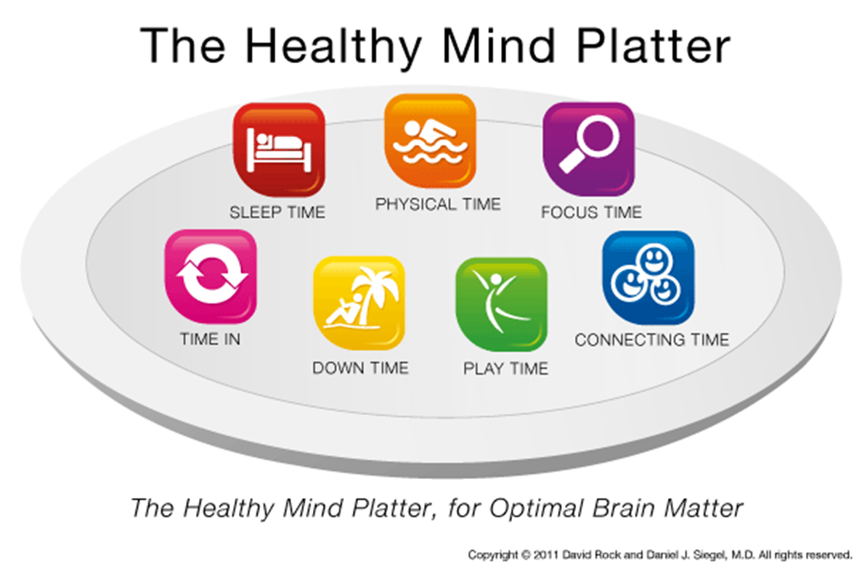
COMPASSION, APPRECIATION, RESILIENCE & EMPOWERMENT
Notes:
We ALL have mental health, and we all can work toward our best state of mental wellness.
This may be a helpful visual to think about all the ways you are already doing things for your well-being.
Source: https://www.drdansiegel.com/resources/healthy_mind_platter/
Many of these seven essential elements needed to balance your mental health plate were built into the self care assessment you just completed. These may be a helpful visual to think about all the ways you are already doing things for your well-being. We ALL have mental health, and we all can work toward our best state of mental wellness.
Source: https://www.drdansiegel.com/resources/healthy_mind_platter/
Often called: the Seven Essential Activities for Optimum Mental Health-each one will be reviewed
Just as we can balance our diet to help our bodies perform better, we can also balance our time so that our mental health is better.
The Healthy Mind Platter has seven essential mental activities necessary for optimum mental health in daily life. These seven daily activities make up the full set of ‘mental nutrients' that your brain needs to function at it's best. By engaging every day in each of these servings, you enable your brain to coordinate and balance its activities, which strengthens your brain's internal connections and your connections with other people. Think of brain health as prevention for Compassion Fatigue. Remember balance is key.
Focus Time
When we closely focus on tasks in a goal-oriented way, we take on challenges that make deep connections in the brain.
Play Time
When we allow ourselves to be spontaneous or creative, playfully enjoying novel experiences, we help make new connections in the brain.
Connecting Time
When we connect with other people, ideally in person, and when we take time to appreciate our connection to the natural world around us, we activate and reinforce the brain's relational circuitry.
Physical Time
When we move our bodies, aerobically if medically possible, we strengthen the brain in many ways.
Time In
When we quietly reflect internally, focusing on sensations, images, feelings and thoughts, we help to better integrate the brain.
Down Time
When we are non-focused, without any specific goal, and let our mind wander or simply relax, we help the brain recharge.
Sleep Time
When we give the brain the rest it needs, we consolidate learning and recover from the experiences of the day.

Slide 8
Group Reflection
Use annotate to put a stamp on the nutrients you feel like you’re getting enough of, and a stamp on the nutrients you feel like you could use more of.
Sleep
Physical
Focus
Time in
Down time
Play
Connecting
Answer in the chat: How does your organization and your work relationships help you prioritize these brain health activities, and how do they make it a challenge?
COMPASSION, APPRECIATION, RESILIENCE & EMPOWERMENT
Notes:
Talking Points: first ensure that participants know how to use annotate feature.
Encourage discussion around how this is NOT a list of things to add to your to do list, or that you should feel guilty if one doesn’t have time to accomplish all of these. Rather use it as a reflection tool to make sense of how our environment effects our well-being. (Ex. While caring for a parent, child, etc., we may go through phases of life where we don’t get as much sleep as needed to be our best selves and we notice more impatience/irritability/tiredness. Rather than negative self talk, we can use this framework to make sense of what’s going on and use it to help us think through how we can support others).
Also, how can organizations shift to allow more space to have needs met during the day? As organizations, are we encouraging connection, play, time in, and focus?

Slide 9
Secondary Traumatic Stress and Self Care
Agenda:
Balancing your plate
Define the terms (CS, CF Burnout, STS)
Effects of secondary trauma
Organizational trauma
Understanding self care
COMPASSION, APPRECIATION, RESILIENCE & EMPOWERMENT
Notes:
Basic agenda for today.
Notice, throughout the deck, you’ll see some slides with plants/tress/flowers. That’s a cue to remind yourself it’s okay to look out the window, notice your surroundings, stretch a little, or do what you need while we’re talking and learning.

Slide 10
Defining the Terms
Compassion Satisfaction (Positive aspects of working as a helper)
Compassion Fatigue (Negative aspects of working as a helper)
Burnout
Inefficacy and feeling overwhelmed
Work-related traumatic stress
Primary traumatic stress direct target of event
Secondary traumatic exposure to an event due to a relationship with the primary person
© Beth Hudnall Stamm, 2009. Professional Quality of Life Scale (ProQOL). www.proqol.org. This test may be freely copied as long as (a) author is credited, (b) no changes are made without author authorization, and (c) it is not sold.
COMPASSION, APPRECIATION, RESILIENCE & EMPOWERMENT
Notes:
Compassion Satisfaction
Refers to the positive feelings derived from competent performance as a trauma professionals. It is characterized by positive relationships with colleagues and the conviction that one’s work makes a meaningful contribution to clients and society.
Compassion Fatigue
This has 2 sub-categories, both burn out and work related traumatic stress contribute to CF.
Burnout
Characterized by emotional exhaustion, depersonalization and a reduced feeling of personal accomplishment.
While it is also work-related, burnout develops as a result of general occupational stress
the term is not used to describe the effects of indirect trauma exposure specifically.
STS defined: Trauma experienced as a result of exposure to another person’s trauma and trauma reactions.
Exposure can be through:
What someone tells you or says in your presence
The child’s play, drawings, written stories
Another persons reactions to trauma reminders
Media coverage, case reports, or other documents about the trauma
Compassion Fatigue Warning Signs:
Mental and physical exhaustion
Using alcohol, food, or other substances to combat stress and comfort yourself
Disturbed sleep
Feeling numb and distanced from life
Feeling less satisfied by work
Moodiness, irritability
Physical complaints—headaches, stomachaches

Slide 11
Check-in
What clarifying questions do you have?
What reactions are you having to the terms compassion satisfaction/compassion fatigue/burnout/secondary traumatic stress?
COMPASSION, APPRECIATION, RESILIENCE & EMPOWERMENT

Slide 12
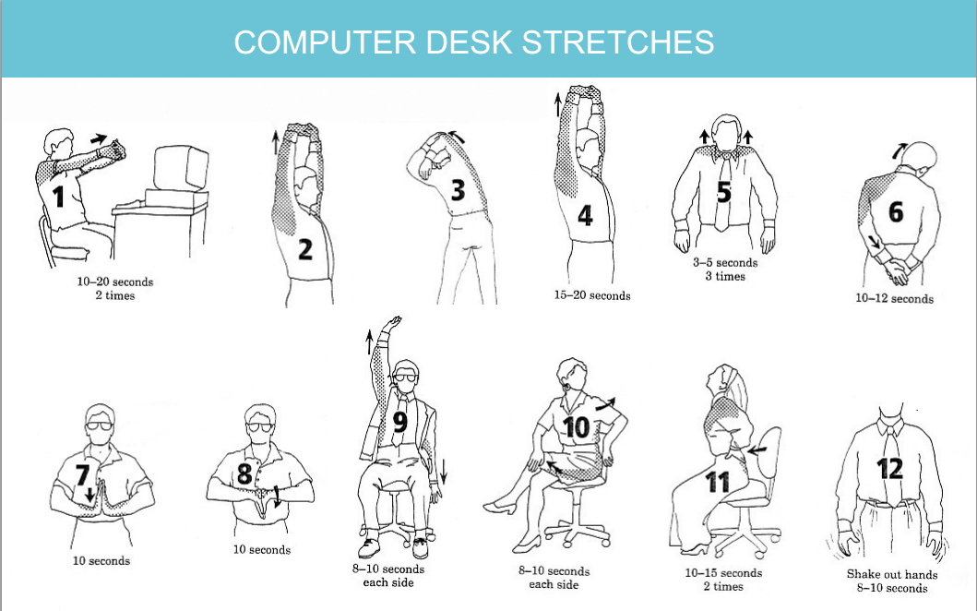
5 Minute Body Break

Slide 13
Measuring CF & CS: The Professional Quality of Life Scale (ProQOL)
A 30 item self report measure of the positive and negative aspects of caring
ProQOL measures CS and CF
CF has two subscales
1. Burnout
2. Secondary Trauma
The ProQOL is the most widely used measure of the positive and negative aspects of helping in the world
The ProQOL has proven to be a valid measure of compassion satisfaction and fatigue
© Beth Hudnall Stamm, 2009. Professional Quality of Life Scale (ProQOL). www.proqol.org. This test may be freely copied as long as (a) author is credited, (b) no changes are made without author authorization, and (c) it is not sold.
COMPASSION, APPRECIATION, RESILIENCE & EMPOWERMENT

Slide 14
Resiliency Planning
Individual, personally
- The ProQOL can help you plan where to put your energy to increase our resilience
Organizational planning
- Can help organizations find ways to maximize the positive aspects and reduce the negative aspects of helping
Supportive Supervision
- The ProQOL can be used as information for discussions
© Beth Hudnall Stamm, 2009. Professional Quality of Life Scale (ProQOL). www.proqol.org. This test may be freely copied as long as (a) author is credited, (b) no changes are made without author authorization, and (c) it is not sold.
COMPASSION, APPRECIATION, RESILIENCE & EMPOWERMENT

Slide 15
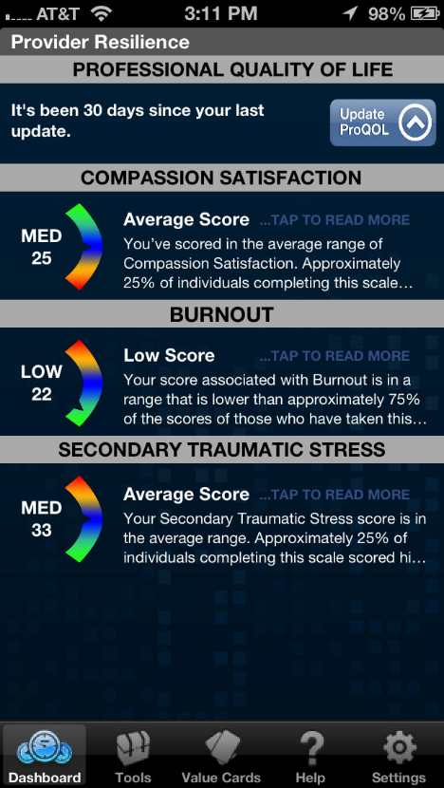
Activity: Take the ProQOL
Complete the ProQOL assessment.
Answer the poll.
Break out room discussion.
Large group debrief.
Two Ways to Access the ProQOL:
1. Download the free Provider Resilience App
OR
2. Grab pen/paper then use this link ProQOL Self Score
COMPASSION, APPRECIATION, RESILIENCE & EMPOWERMENT

Slide 16
Breakout Room Discussion
Did anything surprise you?
Do you think your scores are similar to others in your organization?
How would this tool help within your work at the individual, supervision, or organizational level?
COMPASSION, APPRECIATION, RESILIENCE & EMPOWERMENT

Slide 17
Breakout Room Share Back
Select one person from your breakout room to share back with the larger group a theme that emerged in your group discussion.
COMPASSION, APPRECIATION, RESILIENCE & EMPOWERMENT

Slide 18
20 Minute Break

Slide 19
Secondary Traumatic Stress and Self Care
Agenda:
Balancing your plate
Define the terms (CS, CF Burnout, STS)
Effects of secondary trauma
Organizational trauma
Understanding self care
COMPASSION, APPRECIATION, RESILIENCE & EMPOWERMENT
Notes:
Basic agenda for today.
Notice, throughout the deck, you’ll see some slides with plants/tress/flowers. That’s a cue to remind yourself it’s okay to look out the window, notice your surroundings, stretch a little, or do what you need while we’re talking and learning.

Slide 20
Exposure to secondary trauma may cause:
Avoidance
Withdrawal
Emotional numbing
Feeling disconnected from friends/family
Hyper arousal
Nervousness or jumpiness
Difficulty concentrating or taking in information
Re-experiencing
Intrusive images
Nightmares and insomnia
Thoughts & Feelings
Changes in your worldview
Feelings of hopelessness and helplessness
Anger
COMPASSION, APPRECIATION, RESILIENCE & EMPOWERMENT
Notes:
Group discussion with examples of exposure to trauma causing STS. Part of the conversation should include some normalizing, that this is something that is likely to occur in a professional setting.
These symptoms should also look familiar, they are symptoms we see in individuals who experience direct trauma.

Slide 21
When someone else’s trauma is a reminder
You may:
React as you would to any trauma reminder
Have trouble differentiating your experience from the other person’s
Expect the person to cope the same way you did
Respond inappropriately or disproportionately
Withdraw from the person
COMPASSION, APPRECIATION, RESILIENCE & EMPOWERMENT
Notes:
Many people enter the helping professions due to their own lived experiences. If this is the case for you, you may be at heightened risk for secondary trauma symptoms. Exposure to another person’s trauma or their trauma reactions may be a reminder or trigger for your own trauma.
Discussion around becoming triggered by your own trauma history

Slide 22
Laura van Dernoot Lipsky: Beyond the Cliff
Activity: Video Clip and Discussion
COMPASSION, APPRECIATION, RESILIENCE & EMPOWERMENT
Notes:
Beyond the Cliff Video (20 minutes): https://www.youtube.com/watch?v=uOzDGrcvmus

Slide 23
Breakout Room Discussion
What trauma exposure responses do you see in your self and in your organization?
COMPASSION, APPRECIATION, RESILIENCE & EMPOWERMENT

Slide 24
Breakout Room Share Back
Select one person from your breakout room to share back with the larger group just one theme that emerged in your group discussion.
COMPASSION, APPRECIATION, RESILIENCE & EMPOWERMENT

Slide 25
5 Minute Body Break

Slide 26
Secondary Traumatic Stress and Self Care
Agenda:
Balancing your plate
Define the terms (CS, CF Burnout, STS)
Effects of secondary trauma
Organizational stress/resilience
Understanding self care
COMPASSION, APPRECIATION, RESILIENCE & EMPOWERMENT
Notes:
Basic agenda for today.
Notice, throughout the deck, you’ll see some slides with plants/tress/flowers. That’s a cue to remind yourself it’s okay to look out the window, notice your surroundings, stretch a little, or do what you need while we’re talking and learning.

Slide 27
Organizational Health
Defining Organizational Health
An organization’s ability to function effectively, to cope adequately, to change appropriately, and to grow from within.
First and secondhand exposure to trauma and the effects of toxic stress are prevalent in the workplace.
How does the CARE model help?
Through Trauma Informed Care, organizational health improvements can be achieved by focusing efforts on building an inclusive and resilient workforce.
COMPASSION, APPRECIATION, RESILIENCE & EMPOWERMENT
Notes:
Trauma Informed Care produces positive organizational health outcomes.
The guiding principles of TIC align with the core goals of human resource management.
TIC acknowledges that adversity is present in and out of the workplace.
For example, Behavioral Health issues are prevalent in the workforce. Mental illness and substance abuse annually cost employers an estimated $80 to $100 billion in indirect costs (when people are at work, but not fully engaged or productive).
And 70% of adults in the U.S. have experienced some type of traumatic event at least once in their lives. That’s 223.4 million people!
Results from various organizational needs assessments, community resiliency models, and trauma resiliency models support the need for trauma-informed practices in the workplace.
Finch, R. A. & Phillips, K. (2005). An employer’s guide to behavioral health services. Washington, DC: National Business Group on Health/Center for Prevention and Health Services. Available from: https://www.businessgrouphealth.org/publications/
http://www.livewellsd.org/content/dam/livewell/Partners/PartnerPDFs/PartnerBusinessPDF/LWSD_Newsletter_Trauma_Informed_Systems_in_the_Workforce_-_FINAL.pdf
http://www.organizationalhealth.com/publications/OHFinal.pdf
https://www.ncbi.nlm.nih.gov/pmc/articles/PMC4035611/
https://static1.squarespace.com/static/596cfecaebbd1ab34dadab1d/t/59ab4d22579fb343a2ce7a68/1504398627341/Attachment-1-CRM-Evaluation-Report-Includes-Holistic-Group-09.05.13-FINAL-VERSION-51.pdf
https://static1.squarespace.com/static/596cfecaebbd1ab34dadab1d/t/59ab4e1fe5dd5b69d4098633/1504398880644/CRM+VEP-Evaluation-Report-03.11.13-v21.pdf
https://static1.squarespace.com/static/596cfecaebbd1ab34dadab1d/t/59af36a7cd39c3ef80fea316/1504655016549/TRM-survey-2012-from-DBH.pdf
https://www.thenationalcouncil.org/wp-content/uploads/2012/11/Trauma-Infographic-Print.pdf

Slide 28
Organizational Stress
Types of organizational stress (or trauma) include: layoffs, mergers and acquisitions, violence in the workplace, empathetic nature of the work, natural disaster, major reorganizations, the turnover of senior leadership or sudden loss of key talent.
Direct or indirect, sudden or cumulative, organizational trauma typically has the following qualities:
A breakdown in communication
A breakdown in trust
A breakdown in productivity
Workers feel powerless
A shake up in roles and responsibilities
A sense of loss
Stress and anxiety contagion
COMPASSION, APPRECIATION, RESILIENCE & EMPOWERMENT

Slide 29
Tools for Organizations
Focus on Co-Care
Proactive approach to safety and harm-reduction
Reduces re-traumatization of staff and clients
Organizational support encourages healing
Builds resilience against secondary traumatic stress
Mutual peer support environment
COMPASSION, APPRECIATION, RESILIENCE & EMPOWERMENT
Notes:
In order to build resiliency, a culture of safety is essential. https://ishm.org/organizational-safety-culture/
https://www.integration.samhsa.gov/clinical-practice/SAMSA_TIP_Trauma.pdf
https://www.ncbi.nlm.nih.gov/books/NBK207194/
https://www.acf.hhs.gov/opre/research/project/toxic-stress-and-self-regulation-reports?source=post_page---------------------------
https://www.cyc-net.org/cyc-online/cyconline-mar2010-bath.html
https://www.nasmhpd.org/sites/default/files/TraumaTIACurriculumTrainersManual_9-10-18_0.pdf

Slide 30
Tools for Organizations
Avoid the Contagion Effect:
Increased self awareness
Fair warning
Consent
Low impact disclosure
https://compassionresiliencetoolkit.org/media/Healthcare_Section7_AvoidContagionEffect.pdf
COMPASSION, APPRECIATION, RESILIENCE & EMPOWERMENT

Slide 31
Tools for Organizations
Using Benefits
Vacation/PTO
EAP
Relying on Relationships
Clinical supervision
Co-care
Personal Strategies
Self care plan
Counseling services
Organizational Strategies
- STS trainings
- Trauma case load balance
- Enhance physical safety
- Ongoing assessment (ex. ProQOL)
Stay connected
Workplace self-care group
Flextime scheduling if applicable
Recognize the connection between your client’s trauma and your own history
COMPASSION, APPRECIATION, RESILIENCE & EMPOWERMENT

Slide 32
Use the Chat
What does your organization do to address the collective trauma and stress staff face?
What tools do you think you could implement in your organization?
COMPASSION, APPRECIATION, RESILIENCE & EMPOWERMENT

Slide 33
Check-in
What clarifying questions do you have?
What thoughts do you have on co-care?
COMPASSION, APPRECIATION, RESILIENCE & EMPOWERMENT

Slide 34
Secondary Traumatic Stress and Self Care
Agenda:
Balancing your plate
Define the terms (CS, CF Burnout, STS)
Effects of secondary trauma
Organizational stress/resilience
Making a self care plan
COMPASSION, APPRECIATION, RESILIENCE & EMPOWERMENT
Notes:
Basic agenda for today.
Notice, throughout the deck, you’ll see some slides with plants/tress/flowers. That’s a cue to remind yourself it’s okay to look out the window, notice your surroundings, stretch a little, or do what you need while we’re talking and learning.

Slide 35
Self Care Plan- Leaning In
Watch Out For:
Choosing strategies that SOLELY help you avoid strong feelings/others
Strategies that are not sustainable or achievable
Only focusing on one area of wellness
Look to Highlight:
Strategies that help you address the emotional pain that comes with your work
Your current strengths
Adding in a few achievable goals
All areas of wellness
COMPASSION, APPRECIATION, RESILIENCE & EMPOWERMENT

Slide 36
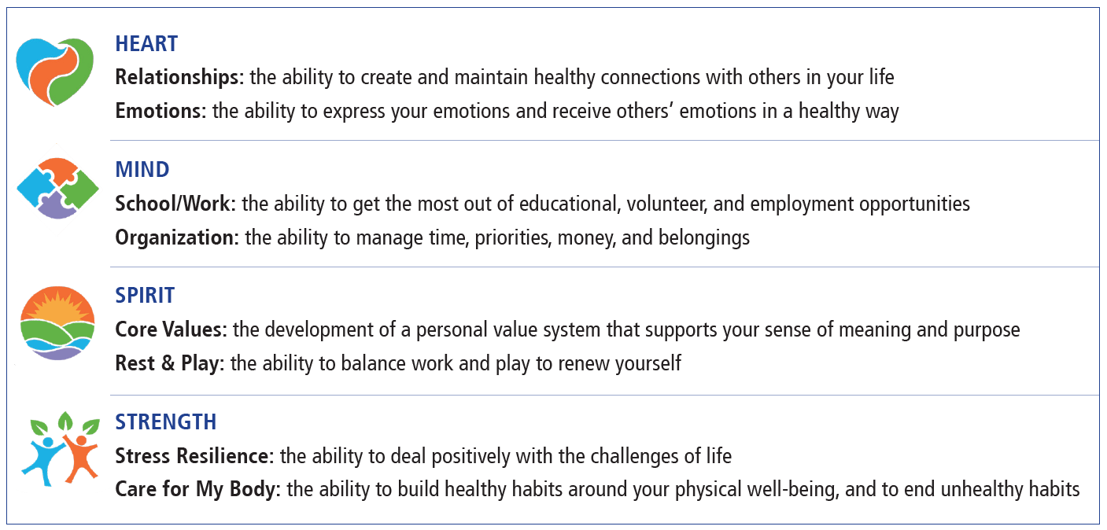
Self Care Plan- Wellness Compass
https://compassionresiliencetoolkit.org/
COMPASSION, APPRECIATION, RESILIENCE & EMPOWERMENT

Slide 37
Self Care Plan- Wellness Compass Activity
Why is self care important in each of these areas?
Heart
Mind
Spirit
Strength
What are you currently doing?
What would you like to try?
COMPASSION, APPRECIATION, RESILIENCE & EMPOWERMENT

Slide 38
Closing
I came in today feeling ______ …and I am leaving feeling ______
COMPASSION, APPRECIATION, RESILIENCE & EMPOWERMENT

