Slide 1
Adverse Childhood Experiences
Presented by
Joe Neigel & Erin Wood
Thank You for your participation and partnership!

Slide 2
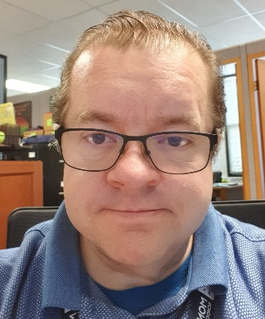
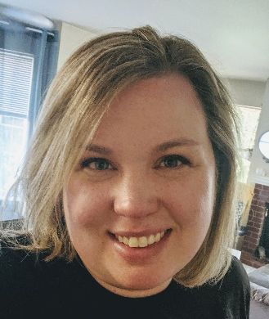
Joe Neigel, BA, CPP
Joe Neigel is Monroe School District's Prevention Services Manager, where he supervises the Behavioral Health Team and the implementation of tiered, evidence-based strategies to address substance use, mental health and suicide. Joe also coordinates the Monroe Community Coalition and is recognized across Washington State as an expert speaker on the topics of substance abuse prevention, Adverse Childhood Experiences and evidence-based prevention kernels. His print and video community guide, "Prevention Tools: What Works, What Doesn't," is distributed statewide and nationally by the Washington State Health Care Authority. Most importantly, Joe is a daddy to five quirky, sweet and hilarious children aged 8-21.
Erin Wood is a licensed mental health counselor and the Behavioral Health Specialist for Monroe School District. She specializes in the prevention and intervention of youth suicide, and supports students and staff in raising awareness and understanding of mental health across the lifespan. Erin organizes the district’s Crisis Recovery Team and student-focused prevention efforts including Sources of Strength and the Signs of Suicide Prevention Program. Erin loves working with students K-12, and is especially passionate about supporting the mental, emotional, and behavioral needs of every young person in our community.
Erin Wood, MA, LMHC

Slide 3
ACES 101: The Hidden Risk Factor
Understanding Adverse Childhood Experiences, Complex Trauma and What We Can Do About It!

Slide 4
Start with the End in Mind
A different kind of data set
Our Learning Goals
Enhance our Understanding
The Adverse Childhood Experiences Study (ACES)
Look Across Disciplines
Evidence-based Kernels
Notes:
Notes: We start with the data to ensure a common understanding for our why. Even if the ACES study and outcomes are not new to the listener, this will ensure a common lens with which to participate in the training.

Slide 5
CLIENT OF CONCERN – 10 Minute Breakout Session
Think about a client for whom you have concern. Discuss the following:
What worries do you have for this client?
What challenging behaviors does this client exhibit?
6-8
Notes:
Notes: Our goal is to immediately make this training personal by inviting participants to consider how they are impacted by client/student behavior in their places of work. We will expand on these questions as we move through the presentation. Ultimately, we will ask participants to consider what role trauma may have in influencing these behaviors, whether or not these behaviors bring benefits to the client, and why they would stop engaging in these behaviors without a replacement behavior.

Slide 6
Adverse Childhood Experiences Study (ACES)
ACES began as study in the late 1980’s and 1990’s at a diet and nutrition center managed by Kaiser-Permanente in San Diego, California. It became the largest study ever to examine social determinants of health.
Over 17,000 people participated in the study, which ultimately a direct connection between traumatic childhood experiences and health.
Most critically, the Centers for Disease Control and Prevention (CDC) now recognize ACES as a public health crisis.
ACES Participants were mostly:
Middle class, average age of 57
80% White, 10% Black, 10% Asian
74% Some college
44% Graduated college
49.5% Men
But since the original ACE study, research indicates that ACEs are more prevalent for those belonging to non-dominant cultures and living in poverty...
Notes:
Notes: This is a brief summary of the ACE Study origins and demographics. The text on this slide is all you need; however, I find that adding salient details about Felitti or Anda’s experience increasing engagement. Check out these video interviews, or just google ACES origins to find what resonates with you:
Politics and Profit Interview: https://vimeo.com/349164603/b152fa1e61
Indian Congress Lecture: https://www.youtube.com/watch?v=-ns8ko9-ljU

Slide 7
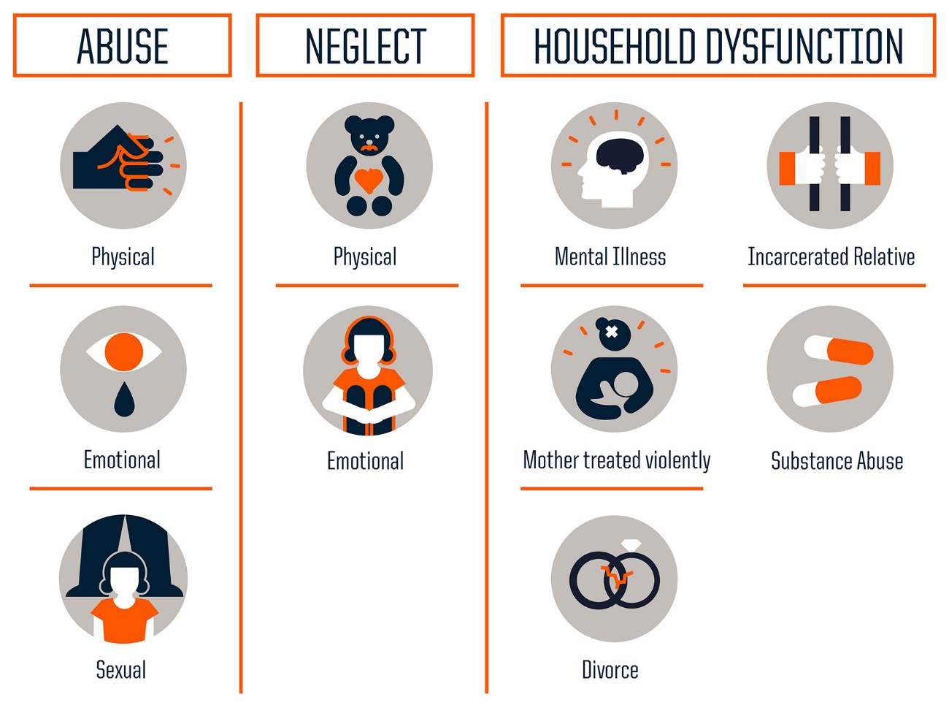
THREE
TYPES OF ACEs
MEASURED
The original ACE study measured three types of ACEs through a 10 question assessment:
But, there’s actually more than just these…
Notes:
Adverse Childhood Experiences are any exposure to one of 10 forms of household abuse and dysfunction prior to your 18th birthday. There are now more known domains of exposure, but for today, we will focus on the 10 original ACES.
Source: Centers for Disease Control and Prevention
Credit: Robert Wood Johnson Foundation
https://www.npr.org/sections/health-shots/2015/03/02/387007941/take-the-ace-quiz-and-learn-what-it-does-and-doesnt-mean

Slide 8
ACEs interact with stressors commonly faced by racial and sexual minorities—such as discrimination, stigma, and rejection—to contribute to behavior, health and opportunity disparities.
Notes:
Children’s Hospital of Philadelphia Research Institute: https://injury.research.chop.edu/blog/posts/role-race-and-ethnicity-aces-and-developmental-disabilities#.XyheBvnYrIU
http://www.fact.virginia.gov/wp-content/uploads/2019/05/Racial-Trauma-Issue-Brief.pdf
Racial disparities in Childhood Trauma: https://scholar.harvard.edu/files/davidrwilliams/files/child_adversity.pdf

Slide 9
ACEs and Intersectionality
Ethnic and sexual minority children are significantly underrepresented in the ACEs research.
When cultural minorities are included in the data, Black, Hispanic and LGBT children are consistently shown to be exposed to more adversities than white children.
Similarly, those living in economically stressed communities are more likely to experience ACEs.
This has led to a reexamination of the ACEs that predict long-term negative health and opportunity outcomes.
Racial disparities in Childhood Trauma: https://scholar.harvard.edu/files/davidrwilliams/files/child_adversity.pdf

Slide 10
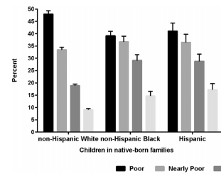
RACE, ETHNICITY AND INCOME INFLUENCE EXPOSURE
ACE Exposure by Race/Ethnicity and Income Level
N=84,837
https://scholar.harvard.edu/files/davidrwilliams/files/child_adversity.pdf
Notes:
https://www.ncbi.nlm.nih.gov/pmc/articles/PMC4815563/
https://scholar.harvard.edu/files/davidrwilliams/files/child_adversity.pdf

Slide 11
Since the original ACE study, exposure to additional early life stressors are being studied.
Passing of a loved one or pet
End of a relationship
Acute Trauma: is caused by a single traumatic event that triggers extreme emotional or physical stress.
Natural Disaster
Homelessness, Foster Care
Poverty
Complex Trauma: is caused by exposure to multiple traumatic events. The long-term impact of this exposure is severe and pervasive.
Community Violence
Deportation or Migration
Historical Trauma: is a complex and collective trauma experienced over time and across generations by a group of people who share an identity, affiliation, or circumstance.
Bullying
Discrimination, Racism
Medical Trauma
Notes:
Note: Additional known trauma domains with links to long-term negative health and opportunity outcomes.

Slide 12
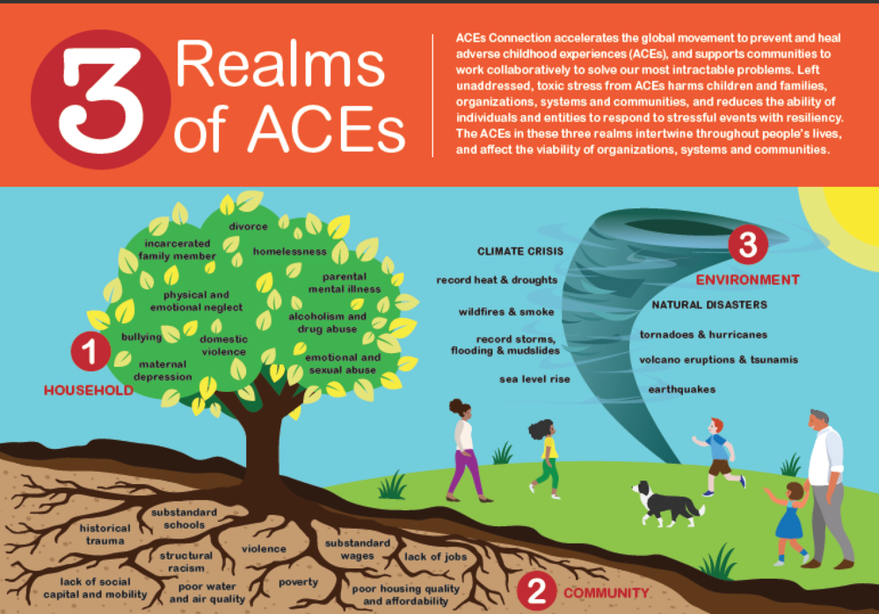

Slide 13
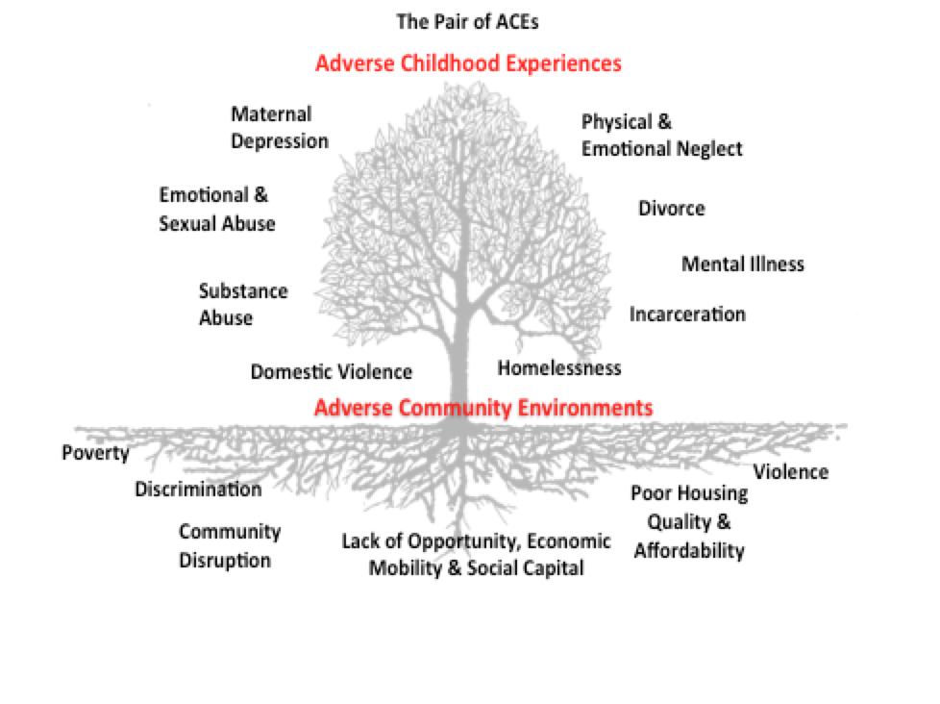

Slide 14
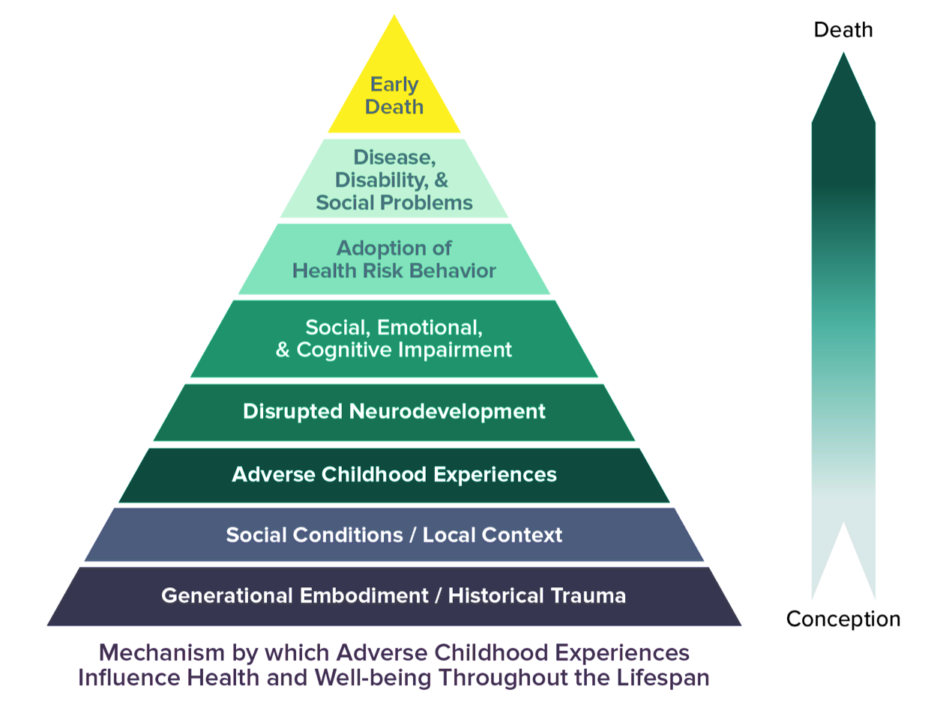
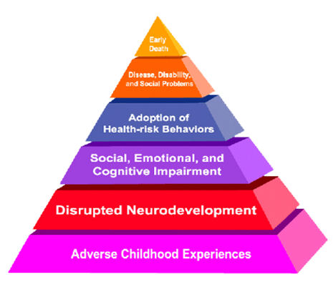
The Model has Expanded Since the Original Study
“Personal Solution”

Slide 15
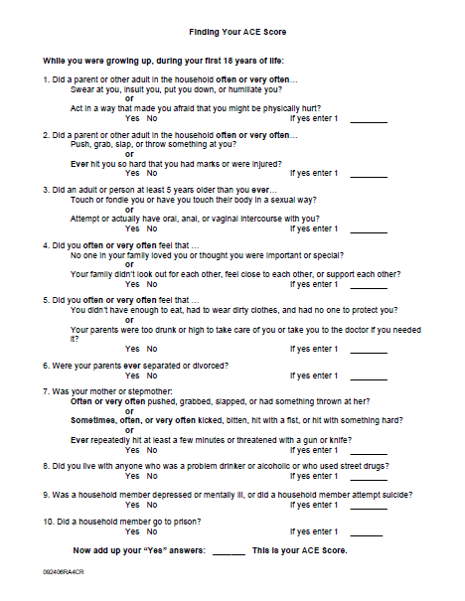
ACE SCORE CALCULATOR
Did a parent or other adult in the household often: Swear at you, insult you, put you down, or humiliate you? OR Act in a way that made you afraid that you might be physically hurt?
Yes No If yes enter 1 ________
Notes:
Notes: Although there are ongoing discussions about whether or not the ACE survey should be administered to presentation participants, and I understand concerns about retraumatization, this is the most important component of personalizing the presentation.
The survey is private and totally voluntary. I ask people to keep track of their score on their fingers or in their minds. I acknowledge up front that I will not ask for people to disclose their ACE score, except for one group, and only if they feel comfortable: Those with an ACE score of Zero.
Please do read the ACE questions aloud.
Directions: Keep track of your total number of yes answers. This is your ace score.

Slide 16
CALCULATING YOUR ACE SCORE
Did a parent or other adult in the household often: push, grab, slap, or throw something at you? OR Ever hit you so hard that you had marks or were injured?
Yes No If yes enter 1 ________
Notes:
Notes: After reading the second question aloud and pausing for a moment, I remind people that their ACE score is the total number of yes answers they have so far.

Slide 17
CALCULATING YOUR ACE SCORE
Did an adult or person at least 5 years older than you ever touch or fondle you or have you touch their body in a sexual way? OR Try to or actually have oral, anal, or vaginal sex with you?
Yes No If yes enter 1 ________
Did you often feel that no one in your family loved you or thought you were important or special? OR Your family didn’t look out for each other, feel close to each other, or support each other?
Yes No If yes enter 1 ________

Slide 18
CALCULATING YOUR ACE SCORE
Did you often feel that you didn’t have enough to eat, had to wear dirty clothes, and had no one to protect you? OR Your parents were too drunk or high to take care of you or take you to the doctor if you needed it?
Yes No If yes enter 1 _______
Were your parents ever separated or divorced?
Yes No If yes enter 1 _______

Slide 19
CALCULATING YOUR ACE SCORE
Was your mother or stepmother often pushed, grabbed, slapped, or had something thrown at her? OR Sometimes or often kicked, bitten, hit with a fist, or hit with something hard? OR Ever repeatedly hit over at least a few minutes or threatened with a gun or knife?
Yes No If yes enter 1 _______
Did you live with anyone who was a problem drinker or alcoholic or who used street drugs?
Yes No If yes enter 1 _______

Slide 20
CALCULATING YOUR ACE SCORE
Was a household member depressed or mentally ill or did a household member attempt suicide?
Yes No If yes enter 1 ______
Was a household member ever incarcerated?
Yes No If yes enter 1 ______
Notes:
Notes: Please read your audience to determine if supportive words, tissue or other needs should be addressed. At this point, I disclose my own ACE score to normalize the experience. YOU DO NOT NEED TO DISCLOSE YOUR ACE SCORE.

Slide 21
Did Anyone Score Zero
Notes:
Notes: Ask your participants, “If you feel comfortable, would you raise your hand if you have an ACE score of zero?” Then encourage all participants to look around. In most cases, the majority of your audience will not raise their hands. Do say, “So if you’re like me and have an ACE score, you’re not alone.”

Slide 22
POLL: What is Your
ACE SCORE?
?
Notes:
Notes: If presenting virtually you may poll your participants anonymously.

Slide 23
ACES IN SNOHOMISH COUNTY
Notes:
Notes: In Snohomish County and Washington State, the majority of adults have at least an ACE score of 1, with approximately 1 in 3 adults reporting 3 categories of trauma exposure or more. This is where we will focus much of our energy in the next 45 minutes.
Source: Snohomish Health District, Washington State Department of Health Behavioral Risk Factor Surveillance System, an annual land-line adult health survey.

Slide 24
Five Minute Break
Notes:
Notes: Return from break: any thoughts or questions before we move on?

Slide 25
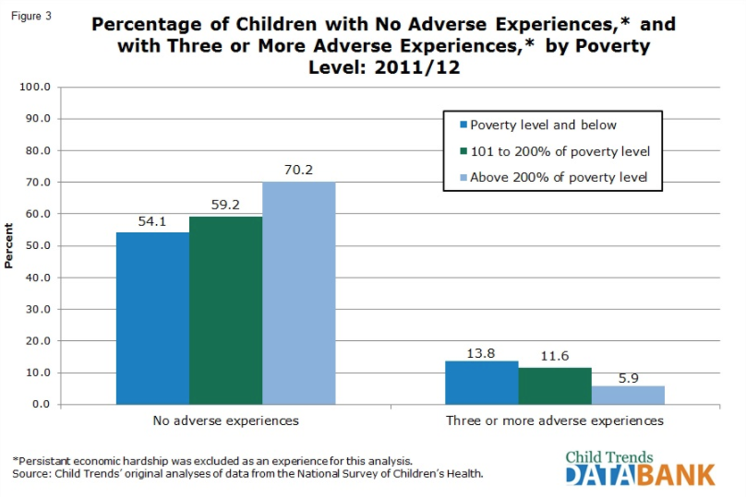
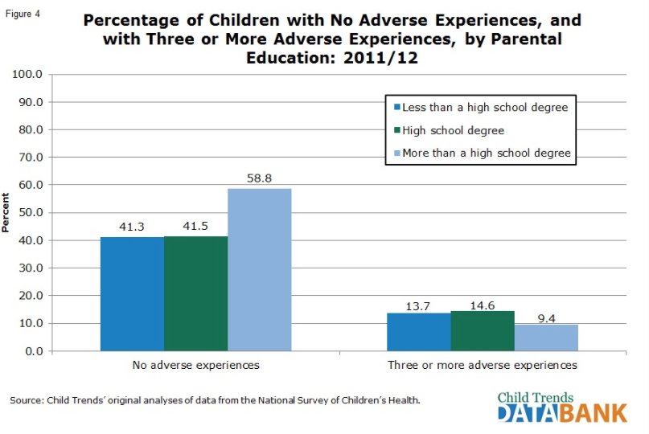
ACES & Poverty are Linked
If you serve youth, know that poor and near poor children are more likely to be exposed to ACES if their parents lack a high school education.
They are also more than twice as likely to have three or more categories of trauma exposure compared to children not impacted by poverty.
Notes:
Notes: This slide is optional. Most audiences will ask if poverty is an ACE. Here is the link between poverty and ACES.

Slide 26
Do You Really Know Maja?
https://www.youtube.com/watch?v=E_zaoQFWeLs
Notes:
Notes: This is a trailer for an online film about a person’s experience with the foster care system. It is a poignant portrayal of domains of ACE exposure. Ask the audience to count the number of ACEs to which Maja has been exposed. At the conclusion of the video, ask about how we might perceive and respond to Maja’s misbehavior before and after we learn about the details of her experience at home.
Is she just acting out to get on our nerves, or are these behaviors the result of trauma exposure and Maslow deficiencies?

Slide 27
Annotate: What is Maja’s
ACE SCORE?
0
1-3
4+
Notes:
Notes: The point here is that we can’t fully know our client’s trauma history. So, what’s the safer perspective? That they’re behaving badly to annoy you, or that there may be some underlying issue that would benefit from a trauma-informed approach?

Slide 28
Annotate: Client of Concern
Do you suspect your client of concern has been exposed to ACEs?
No
Yes
Notes:
Notes: The point here is that we can’t fully know our client’s trauma history. So, what’s the safer perspective? That they’re behaving badly to annoy you, or that there may be some underlying issue that would benefit from a trauma-informed approach?

Slide 29
ACE STUDY FINDINGS
COMMON
Category exposure determines outcomes
ACEs are strong indicators of what happens in school and later in life.
WELL CONCEALED
Notes:
Notes: So what did we learn from the initial ACEs Study? That trauma exposure is common across society, but what is not common is the recognition of their impact on individuals and communities. In fact, ACEs are very well concealed by time, shame secrecy and social taboo. We may not even have disclosed the details of our trauma to the people who are closest to us.
However, we know that ACEs are strong indicators of what happens in school and later in life. In fact, the most controversial aspect of the study findings were that it wasn’t the frequency or severity of abuse that determined life-long outcomes, but rather the category exposure itself!

Slide 30
How
Common
are ACEs?
Chronic Health Epidemic
Unfortunately, ACEs are so common the CDC has deemed them the #1 chronic health epidemic
#1
45%
The 2016 National Survey of Children’s Health (NSCH) revealed that 45% of U.S. children have experienced at least one ACE
The most common ACEs nationally reported in this 2016 study were:
Almost two-thirds of participants of the original ACE study reported being exposed to at least one ACE
Women were more likely to report:
64%
13.1%
24.7%
23.3%
Emotional Abuse
Sexual Abuse
Mental Illness
Economic Hardship
Divorce or Separation of a Parent or Guardian
Notes:
Notes: This slide is optional. The point is: The CDC has deemed ACEs to be the nation’s #1 chronic health epidemic.

Slide 31
The Brain Science
A person’s environment and experience shapes their behavior and health.
Our brain is designed to prioritize survival.
Hormones like Cortisol are released when our “Fight, Flight, or Freeze” response is triggered.
Notes:
Notes: There are many local expert presenters and presentations that can unpack the neurology of ACES. This is not that presentation. In fact, all I want to acknowledge here is that audiences already possess enough intuitive understanding of how the brain works that we only need to review what we already know. You may read the brain science slides as-is, or supplement with any salient details you wish to include, as long as they are based in evidence.

Slide 32
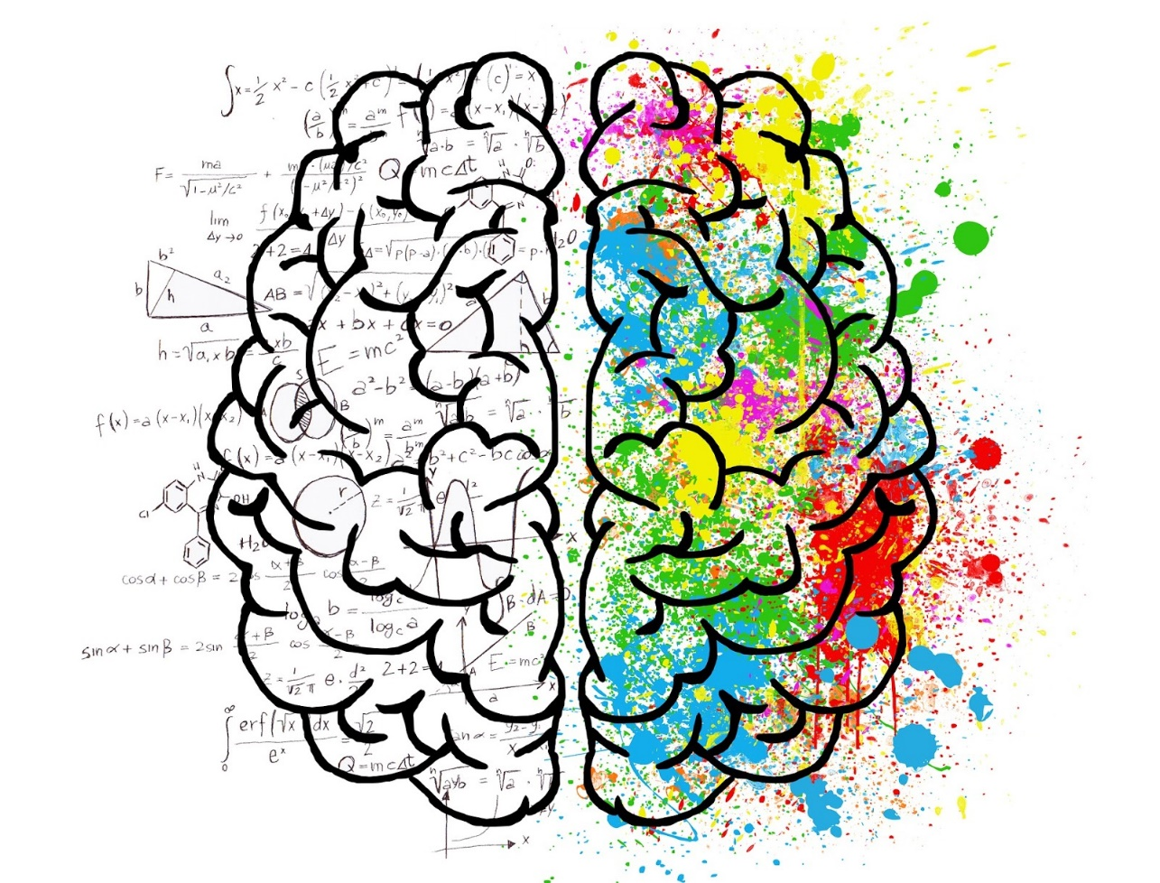
Toxic Stress
Prolonged exposure to Cortisol and other stress hormones is toxic, and makes permanent changes to the brain.
This means you may encounter clients who are perfectly adapted to survive in their home environment, but who cannot turn-off their behavioral and stress response adaptations in your organization, community or other “normal” situations.

Slide 33
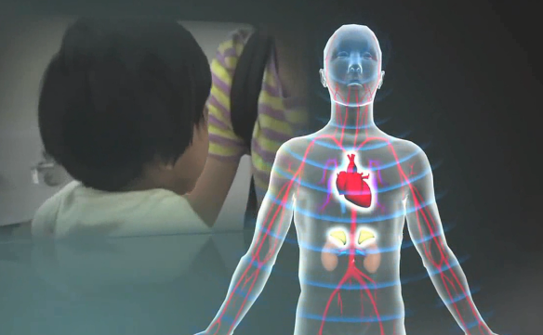
Our Stress Response System
https://www.youtube.com/watch?v=rVwFkcOZHJw&t=2s
Notes:
Notes: This video from the Harvard Center for the Developing Child is all the brain science we need for this presentation. Although the focus here is early learning, these processes are in play for as long as the brain is developing.

Slide 34
Not All Stress is Bad
Positive Stress
Common stressful events that produce a mild stress response within the context of supportive families, schools and communities.
Tolerable Stress
Living in a high stress environment, but buffered by a supportive family and community system.
Toxic Stress
Continuous activation of the stress response system without a protective buffer, causing lasting damage and impairing parts of the brain responsible for learning, concentration and self-control.
Notes:
Notes: Not all stress is bad. It is a myth that all stress should be avoided at any cost. Positive stress – for example, the stress of a failing grade, or the frustration of learning to ride a bicycle – can be developmentally positive if it leads to growth or mastery. What makes it positive is that the stressful event occurs within the context of stable and nurturing relationship.
Similarly, persistently stressful environments – such as a neighborhood impacted by violence or poverty – are not likely to create long-term negative health impacts if those growing up in that environment have a consistent, nurturing relationship to serve as a buffer against the stress.
Toxic stress occurs when ACEs or other persistent stresses occur without the protective buffer of relationship.

Slide 35
Do You Recognize Signs of Traumatic Brain Development?
Hypervigilance – On edge, always scanning for threats.
Display of ADHD-like symptoms, including an inability to stay on task or follow directions, but meds don’t work.
Difficulty identifying feelings or communicating needs.
Early onset of sexualized behaviors and activity.
More impulsive, aggressive and disruptive behaviors, including those leading to suspension, expulsion and arrest.
Difficulty with transitions.
Notes:
Notes: Ask your participants if they have noticed any of these symptoms of traumatic brain development in the client population they serve. While these symptoms alone don’t prove trauma-exposure, it may change how we understand our client’s behavior and we support them through it. Simply expecting “good behavior” or punishing through bad behavior will not work.

Slide 36
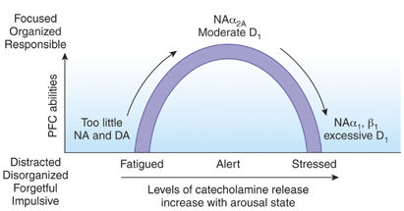
CATECHOLAMINE
PRODUCTION IMPACTS ADHD SYMPTOMS
Low catecholamine production results in distracted and impulsive behaviors.
Pain
Fright
Anxiety
Somatic
High catecholamine production impact somatic symptoms
Neuropsychopharmacology (2010) 36, 207-226; doi:10.1038/npp.2010.160
Notes:
Notes: This slide is optional. It’s a diagram showing the relationship between Catecholamine production (adrenaline and dopamine) and alertness or engagement as it relates to biological adhd and trauma-induced symptoms that resemble adhd.
Too little Catecholamine production and we experience a lack of focused, organized and responsible behavior. Biological ADHD can be treated with stimulant medications that increase Catecholamine production and move us back into focus and alertness.
For those exposed to trauma, the body may already be overproducing Catecholamine as part of the stress response. These symptoms mirror ADHD, but are not biological in origin. When physicians unaware of the impact of trauma prescribe stimulants in this case, it exacerbates the ADHD symptoms and pushes the client into symptoms of pain, fright and anxiety, in addition to forgetful, distracted and impulsive behaviors.

Slide 37
MORE TRAUMA SYMPTOMS
Bullying & Teasing
School Avoidance
Sadness & Crying
Anger & Aggression
Trauma
Physical Complaints
Risk Taking – Substance Abuse
Withdrawal
Irritability
Self-Harm
Running
Concentration Problems
Notes:
Notes: Slide may be read as is.

Slide 38
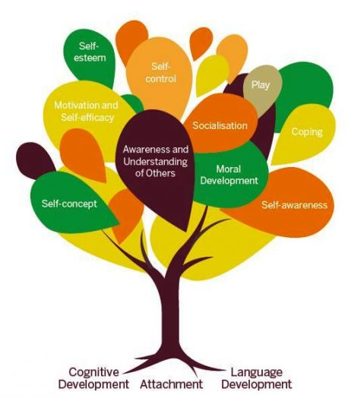
Trauma Impacts Self-Concept
Hopelessness
Body image
Shame, guilt, self-blame
Do not feel safe in this world
Difficulty developing healthy relationships
Dissociation
Hard time with boundaries
Hesitant to trust people for support or attention
Notes:
Notes: This slide may be read as is, but supplemented with your salient details about serving clients experiencing negative self-concept issues.

Slide 39
Physiological Impacts
Trauma Induced Physiological Outcomes
Difficulty concentrating and negative thoughts | Headaches, muscle tension, stomach aches and other somatic symptoms
Impaired memory | Weakened immune system
Higher blood pressure | Decreased bone density and muscle tissue
Hyperglycemia (fatigue, excessive thirst/urination) | Slower healing
Coordination problems | Development of health risk behaviors
Notes:
Notes: This slide may be presented as-is, but do link weakened immune system, decreased bone density and slower healing for your audience. These clients are more likely to become sick or injured (contributing to more frequent absences from school, work, or treatment) and take longer to recover (so those absences tend to be of a longer duration).

Slide 40
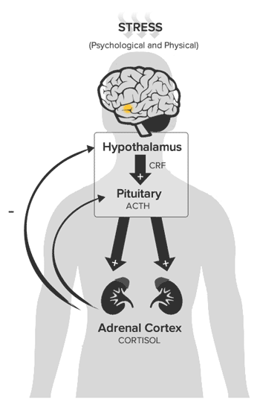
CORTISOL AWAKENING RESPONSE
People exposed to high levels of conflict, abuse or other dysfunction may develop dysregulated HPA Axis reactivity, leading to increases in health and social, emotional and behavioral problems.
Cortisol Awakening Response (CAR) – A burst of the stress hormone Cortisol at each morning wakeup that orients us to our place in space and time in order to prepare us for our day.
Our CAR brings us to full alertness, activates our immune system, helps us to recall memories that help us to anticipate our day (like a project being due or an upcoming test), and increases energy availability for coping with demands.
Source: Zhang, Jihui et al. “Family Conflict and Lower Morning Cortisol in Adolescents and Adults: Modulation of Puberty.” Scientific Reports 6 (2016): 22531. PMC. Web. 27 Mar. 2018.
.
Notes:
Notes: This slide is optional. People exposed to high rates of conflict or persistently stressful environments may experience a blunted stress response. This specifically diminishes how our brain jumpstarts orientation to the day, our immune system and memory.
The CAR does not activate at each wake-up (for example, if we wake up from a nap or in the middle of the night) but only at our start of day wake-up. During this process the body is flooded with Cortisol and maintains elevated stress hormone levels for approximately 45 minutes.
In clients experiencing a dysregulated CAR, their reaction to the cortisol burst is diminished because of persistently high cortisol rates resulting from a toxic stress environment.

Slide 41
BLUNTED STRESS RESPONSE
Blunted Stress Response – Occurs when constant activation of the stress response system creates a homeostatic reaction in the HPA Axis – a forced dampening of stress hormone production.
A dysregulated CAR system diminishes executive function and is related to these issues in your classroom:
Researchers have linked advanced stress management skills to improvements CAR functioning.
McGinnis, Ellen W et al. “Cortisol Awakening Response and Internalizing Symptoms Across Childhood: Exploring the Role of Age and Externalizing Symptoms.” International journal of behavioral development 40.4 (2016): 289–295. PMC. Web. 29 Mar. 2018.
.
Notes:
Notes: This slide is optional and may be read as presented. It describes the symptoms of a diminished cortisol awakening response.

Slide 42
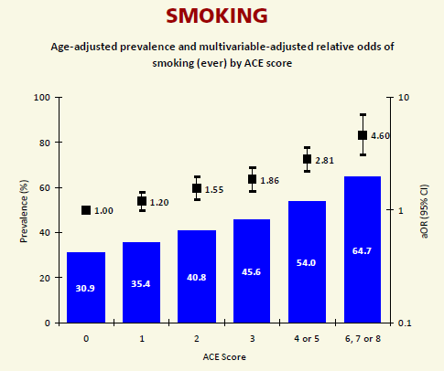
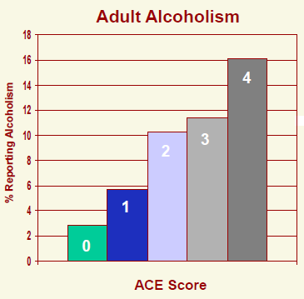
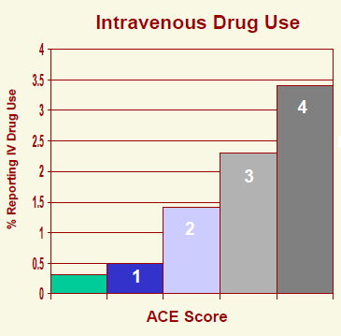
ACES IMPACT BEHAVIORAL HEALTH
46% increase from baseline.
440% increase from baseline.
820% increase from baseline.
Notes:
Notes: To increase understanding of ACE impacts, its important to review the original study findings. These graphs measure cause and effect (dose/response). The more ACES to which a person is exposed, the more likely they were to report engaging in substance use. In all ACE slides, participants should pay attention to the “stair steps” to increased risk.
Please mention that the Study measured risk across populations, but that individuals are protected from these outcomes based their own innate resilience and exposure to protective and nurturing relationships. SO – while this data is absolutely predictive for populations, it is not predictive for individuals.
ACEs are not a prescription for engaging in this behavior.

Slide 43
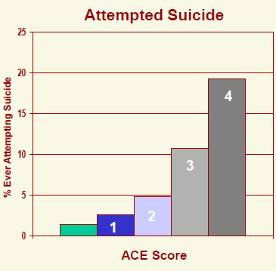
ACES IMPACT MENTAL HEALTH
220% increase from baseline.
2,275% increase from baseline.

Slide 44
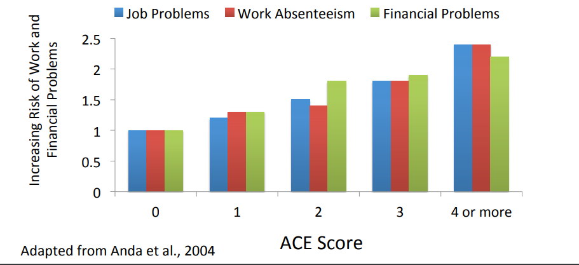
ACES IMPACT EMPLOYMENT
Notes:
Notes: Compared to individuals with no ACEs, those with an ACE Score of 4 or higher are twice as likely to report ongoing job problems, missing work for up to 14 days in a row or more, and having significant financial problems related to job instability.

Slide 45
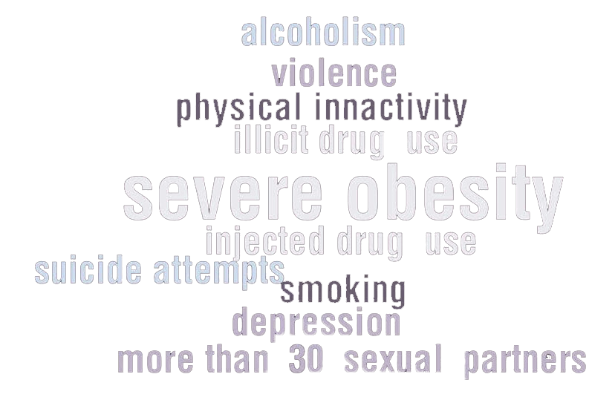
ACES LEAD TO THE 10 MOST COMMON CAUSES OF EARLY DEATH
Notes:
Notes: Read this slide as is. Again, these are the findings from the original ACES study which is our focus today.

Slide 46
REFRAMING OUR POINT OF VIEW
With an ACE score of 0, the majority of adults have few, if any, risk factors for the most common diseases leading to early death.
With an ACE score of 4 or more, the majority of adults have multiple risk factors for these diseases or the diseases themselves.
Much of what we see as problem behaviors should actually be viewed as a
personal solution to an unrecognized prior adversity.
Notes:
Notes: This is a critical slide. It is the paradigm shift we are asking all participants to embrace. If the behaviors our clients are experiencing bring them benefit – if they are solutions to an unrecognized prior adversity – how does that shift the nature of our work and approach?

Slide 47
ACES IMPACT SNOHOMISH COUNTY SCHOOLS
Special education needs
Grade repetition
Problems at school
Educator burnout
Notes:
Notes: All of the following school-based slides are optional, but may be relevant to communicating the needs and challenges of your school-aged clients.

Slide 48
Meet Malory
Mallory is in 8th grade at Centennial Middle School.
Her counselor knows Mallory’s mother physically abused her in the past. As a result, Mallory’s known ACE Score is “1.”
Keep in mind - ACEs travel in clusters: Among people exposed to physical abuse, 84% report exposure to at least 2 additional ACEs.
Notes:
Notes: Trauma disorders may result in significant school disruption. The example here, Malory (French for “Unfortunate One.”) is fictional, but her path is not. These slides may be read as presented.

Slide 49
MALLORY’S AGGRESSION
Mallory is frequently sent to the office for aggressive and defiant behavior. Three months ago, she was suspended again for fighting in the cafeteria.
Students like Mallory are nearly twice as likely (1.9x) to report getting into a physical fight within the past 12 months.
They are 4.2x more likely to be in six or more physical fights.
Washington State Healthy Youth Survey 2018 Results retrieved from www.askhys.net
Notes:
Notes: The text in orange at the top of the page is the symptom we may recognize in our client. The bullet points on this and following slides describe the increased risk young people with a known ACE score of 1 (physical abuse) experience according to the health you survey.
The Healthy Youth Survey is our most important and reliable resource for understanding the risk and protective factors impacting young people in Washington State. It is administered every other year in 6th, 8th, 10th and 12th grade.
Epidemiologists estimate that HYS results are accurate and for 95% of the entire student population. Individual surveys have control questions that screen for false answers.

Slide 50
BULLYING & SAFETY AT SCHOOL
Mallory has trouble making lasting friendships and is frequently the target of bullying behavior.
8th graders like Mallory are:
Twice as likely (2.0x) to report being the victims of bullying.
3.0x as likely to report missing days of school because they feel unsafe.
Washington State Healthy Youth Survey 2018 Results retrieved from www.askhys.net

Slide 51
BEYOND ACES - BULLYING
Emerging evidence suggests the negative impacts of childhood bullying on long-term adult health and wellness outcomes are more severe than the impacts of child abuse and neglect.
2.2x 1.7x 2.7x 3.1x
The Lancet Psychiatry, Vol. 2, No. 6, p524–531, April 28, 2015
Notes:
Notes: This is an optional slide for youth serving agencies including schools. Please note the elevated risk rates in red. The bottom line: Adults cannot be bystanders when bullying is known to be occurring. The experience of bullying should result in an immediate referral for follow-up support services in school.

Slide 52
MALLORY’S MENTAL HEALTH
Mallory seems pretty disengaged in class and always looks tired. She can’t remember facts or directions from 10 minutes ago.
Students who report being physically abused by an adult are more than twice as likely (2.2x) to report being depressed on the most recent HYS.
They are also nearly three times as likely (2.8x) to report contemplating suicide.
They are more than three times as likely (3.3x) to have made an actual attempt to die by suicide within the last year.
Washington State Healthy Youth Survey 2018 Results retrieved from www.askhys.net

Slide 53
MALLORY’S PERSONAL SOULTIONS
Mallory was caught bringing a flask of alcohol to school in 7th grade. She was suspended and hasn’t really engaged with any helping adults since then.
8th Graders like Mallory are 3.4x more likely to report current alcohol or marijuana use.
They are 8.6x more likely to indicate current prescription pain killer use.
Washington State Healthy Youth Survey 2018 Results retrieved from www.askhys.net

Slide 54
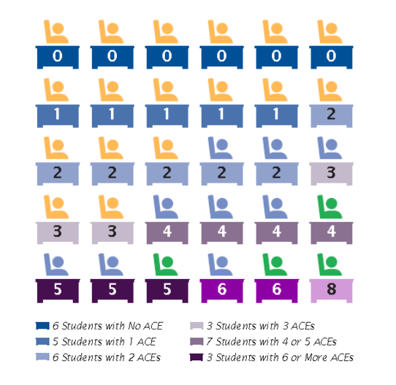
ACES in Every Classroom
More than 1 in 5 8th graders in Snohomish County Schools indicate they have been intentionally hurt by an adult on the most recent Healthy Youth Survey.

Slide 55
ACE IMPACTS RISK
FACTORS FOR DROP OUT
Low School Engagement
Contacted Home Due to Problems
National Survey of Children’s Health, Johns Hopkins University (2012)
Highly Externalizing Behavior
Does Not Finish Tasks Started
Notes:
Notes: Compared to students with an ACE Score of Zero, students with just 3 categories of trauma exposure or more are at twice the risk for experience the risk-factors that lead to school-dropout.

Slide 56
ACES IMPACTS RISK FACTORS FOR DROP OUT
Grade Repetition
Source: National Survey of Children’s Health, Johns Hopkins University (2012)
Notes:
Notes: With an ACEs score of zero, about 1 in 20 students are at risk for being held back. With an score of 3 or higher, 1 in 5 are at risk.

Slide 57
ACES IMPACT SCHOOL COSTS
NEED FOR ACADEMIC & BEHAVIORAL INTERVENTIONS
Burke, Nadine J. et al. “The Impact of Adverse Childhood Experiences on an Urban Pediatric Population.” Child abuse & neglect 35.6 (2011): 408–413.
Notes:
Notes: Only 3% of the student population experience no adverse childhood experiences will require academic or behavioral intervention. With an ACEs score of 4 or more, every other student requires intervention to be successful.

Slide 58
CLIENT OF CONCERN – 10 Minute Breakout Session
Think about a client for whom you have concern. Write down the following:
What worries do you have for this client?
What challenging behaviors does this client exhibit, if any?
Do you suspect this client has exposure to ACES?
All behavior has a function. If we consider this client’s behavior as a personal solution instead of a problem, what purpose might the behavior serve? How does the behavior help them to get their needs met?
6-8
Notes:
Notes: Now we are back to turn and talk. In dyads or triads, participants should discuss the “benefits” that engaging in the noted problem behavior brings to their client. What is the function of the behavior. Encourage speculation based on what they’ve learned today. This will be a challenging exercise for some participants transitioning from understanding their client’s behavior as “bad.”
We want participants to understand that all behavior has a purpose. Generally to gain something or escape something. This understanding is key to finding a prosocial replacement behavior.

Slide 59
The link between Trauma
& Health
Partial List of ACE Dose/Response Outcomes
Alcoholism & alcohol abuse | School Drop-Out
Chronic obstructive pulmonary disease & ischemic heart disease | Significant Financial Problems
Depression and other MH issues | Sexually transmitted disease
Chronic Unemployment | Obesity
High risk sexual activity | Suicide attempts
Illicit drug use | Unintended pregnancy
Intimate partner violence | Early Death
Three or more marriages | Increased Emergency Room Use
Increased Pharmacy Use | Many more…
Notes:
Notes: The researchers found ACEs cause (not correlate) this partial list of long-term negative health and opportunity outcomes. More than that, these issues are significantly more likely to occur in clusters rather than individually. So for example, a trauma-impacted client is more likely to experience depression, substance use and unintended pregnancy rather than just depression alone.

Slide 60
Why Trauma Awareness Matters
To put it simply, childhood experiences are the most powerful determinants of who we become as adults.

Slide 61
POPULATION ATTRIBUTABLE RISK
PAR = The difference in rate of a condition between an exposed population and an unexposed population.
In this case, it is a calculation used by the CDC to estimate the proportion of a health outcome caused by ACE.
Takes into account:
The increased risk due to each level of ACE
The prevalence of the number of ACE categories
Notes:
Notes: The following slides are a visual depiction of the increased risk caused by ACE exposure.

Slide 62
POPULATION ATTRIBUTABLE RISK
21.7%
78.3%
Risk data from Felitti, et. al: PAR analysis: RE Voorhees
Notes:
According to the CDC, 21.7% of all smoking is directly caused by the experience of trauma during childhood. What that means is if I used a magic wand to eliminate all trauma in the nation, we would see smoking rate decline by about 22% because the causal factor never occurred.

Slide 63
POPULATION ATTRIBUTABLE RISK
21.7%
54.2%
45.8%
78.3%
Risk data from Felitti, et. al: PAR analysis: RE Voorhees
Notes:
Notes: The CDC estimates that more than half of all depression is directly attributable to the experience of trauma during childhood.

Slide 64
POPULATION ATTRIBUTABLE RISK
21.7%
54.2%
32.1%
67.9%
45.8%
78.3%
Risk data from Felitti, et. al: PAR analysis: RE Voorhees
Notes:
Notes: The CDC estimates that 68% of all illicit drug use is caused by the experience of childhood trauma. If I waved my magic wand now, we would see illicit drug use decline by two thirds. We just won the war on drugs. All of the funding put into enforcement, deconfliction, and criminal justice dedicated to the war on drugs now gets to go to Health and Human Services, Department of Education, or back into taxpayers pockets.

Slide 65
POPULATION ATTRIBUTABLE RISK
3.2%
32.1%
21.7%
54.2%
67.9%
45.8%
78.3%
96.8%
Risk data from Felitti, et. al: PAR analysis: RE Voorhees
Notes:
Notes: The CDC estimates that virtually all alcoholism is the result of childhood trauma.

Slide 66
POPULATION ATTRIBUTABLE RISK
32.1%
21.7%
54.2%
100%
67.9%
45.8%
78.3%
Risk data from Felitti, et. al: PAR analysis: RE Voorhees
Notes:
Notes: And that nearly all attempted suicide is attributable to the experience of trauma in childhood. This is an important time to remind participants that ACEs are not a prescription for engaging in these behaviors, but that as we look across the population of those exposed to trauma in the initial ACEs study, this is what was found.

Slide 67
The ACE Pyramid
Without accounting for individual levels of resiliency, this pyramid depicts how impacts to health and well-being can occur over a lifetime as a result of exposure to Adverse Childhood Experiences.
“Personal Solution”
what is predictable, is preventable
The ACE study found links between ACEs and adult health risks, often leading to chronic health conditions.
Those with 4 or more ACEs were found to be:
12.2x as likely to have attempted suicide
7.4x as likely to consider themselves to be an alcoholic
4.7x as likely to have ever used illicit drugs
4.6x as likely to have had 2 or more weeks of depressed mood in the past year
3.2x as likely to have had 50 or more intercourse partners, and
2.3x as likely to smoke
Notes:
Notes: So this is the framework by which we understand the progression of trauma into risk. If we start with a foundation of adversity, we expect brain development to be disrupted just as we saw in the Harvard video. That disruption leads to social, emotional or processing impairment and to compensate, the adoption of health risk behaviors as a personal solution to the challenge we are experiencing (after all, we’re all wired to want to feel better). But we know those personal solutions lead to disease, disability and social problems, and ultimately to early death. That is not hyperbole.
Fortunately, the model also allows for intervention points that allow us to interrupt the ACES trajectory. This is where your work is so important.

Slide 68
ACEs IMPACT MORTALITY
Notes:
Notes: So what do the researchers mean by early death? In the initial ACE Study, the population over 50 was most strongly represented among those with Zero aces. As ACEs exposure increased, the over 50 population decreases in the data. With an ACE score of 6 or higher, the over 50 population was virtually no longer represented. Researchers found that life expectancy decreased by 19.5 years with an ACE score of 6 or higher.

Slide 69
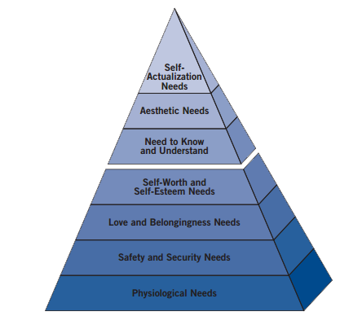
MASLOW MATTERS!
Maslow identified a hierarchy of needs to explain individual motivation.
Your clients must meet needs at the lower levels of the pyramid before tackling higher levels.
How do you intentionally address the Deficiency Needs of your clients to unlock your organization’s mission?
Desire to become all that one can become
Self-expressions of creativity
Growth Unlocked
Respect, achievement, mastery
Friendship, belonging to group
Stability, freedom from fear
Food, shelter, sleep, warmth
Notes:
Notes: We are informed by another framework that helps us to determine appropriate goals for our clients: Maslow’s Hierarchy of Needs. While we MUST maintain high expectations for our clients, we should recognize that their capacity and motivation for meeting those expectations are unlocked by first meeting their deficiency needs.

Slide 70
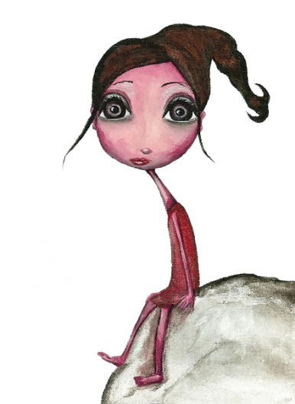
You Matter!
Whether you like it or not, most of you are on the ACEs frontline. Without proper boundaries and self-care, you are likely to experience the emotional residue of working with trauma impacted clients.
Physical – loss of sleep, not eating well, low energy
Emotional – anxiety, sadness, numbness
Behavioral – absent minded, losing things
Cognitive – diminished concentration, loss of focus, hypervigilance
Interpersonal – mistrust, withdrawal
Spiritual – workplace frustration, feeling lack of support, not satisfied
Among social workers with only indirect exposure to trauma, the rate of PTSD is twice as high compared to the general population.
Notes:
Notes: These impact/self-care slides are optional and may be read as presented. Do add salient details based on your experience and expertise. We want participants to understand that their important work with their clients may have negative wellness impacts in their own life if they aren’t vigilantly taking care of themselves. These slides are not accusation, but rather an attempt to help participants recognize where they or a colleague may be in need. The goal is to normalize this experience, not shame.

Slide 71
Personal Impact – Compassion Fatigue
We experience compassion fatigue – a profound emotional and physical erosion – when we are unable to refuel and regenerate ourselves. This is when our empathy shuts down.
Wishing a client would just get over it (“Suck it up.”).
Blaming clients for their problems.
Using anger or sarcasm when trauma symptoms manifest.
Lacking Empathy or fearing what the client will start to talk about next.
Ignoring clear signs of trauma or avoiding the client altogether.
Notes:
Notes: Know your audience. This slide is optional and may feel accusatory to some.

Slide 72
Self-Care is Client Care!
Taking care of yourself should be enjoyable. If it feels like a chore, try something else!
2 minutes
Breathe
Stretch
Daydream
Take your stress temperature
Acknowledge an accomplishment
Say no
Compliment yourself
Share a favorite joke
5 minutes
Listen to music
Have a cleansing cry
Chat with a colleague
Sing out loud
Jot down dreams
Step outside for fresh air
Enjoy a snack or coffee
10 minutes
Evaluate your day
Write in a journal
Call a friend
Meditate
Tidy your work area
Assess your self-care
Draw a picture
Dance
Listen to soothing sounds
Surf the web (but avoid media)
Read a magazine
30 minutes
Get a massage
Exercise
Eat lunch with a colleague
Take a bubble bath
Read non-work related literature
Spend time in nature
Go shopping
Practice yoga
Watch your favorite TV show.

Slide 73
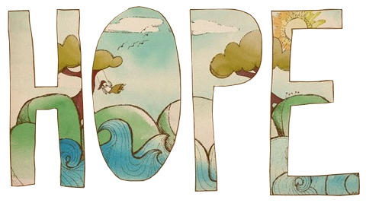
There’s Hope!
Trauma-informed organizations create environments where injured brains have the best opportunity to thrive.
Research on resiliency and neuroplasticity teach us that every person can bounce back from adversity.
Evidence-based Kernels can lead us from intuitive responses to intentional action.
Notes:
Notes: This is the closing slide for ACES and set-up slide for Kernels.

Slide 74
Five Minute Break
Notes:
Notes: Return from break: any thoughts or questions before we move on?

Slide 75
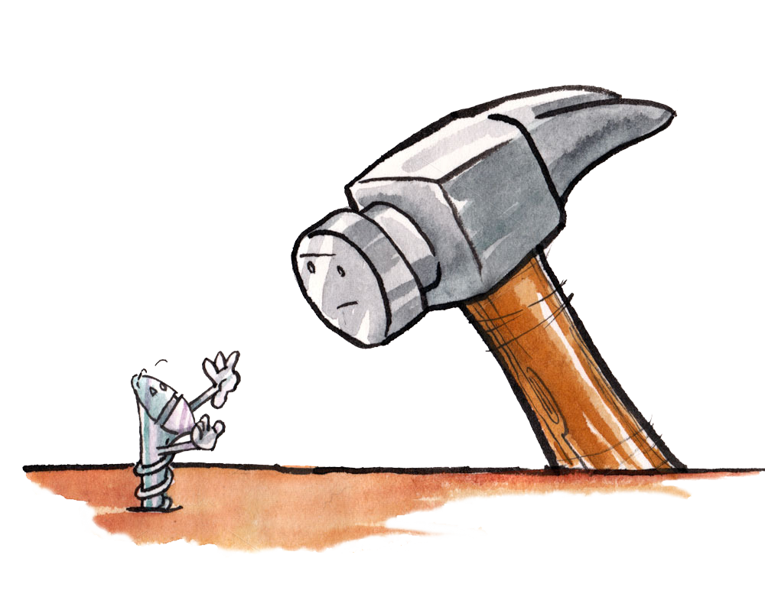
Looking Across Disciplines
“If all you have is a hammer,
everything looks like a nail."
- Abraham Maslow
Notes:
Notes: I want to emphasize cross-discipline collaboration. As we move forward in the presentation, we will draw from strategies used across disciplines to mitigate the trauma trajectory of our clients and increase positive outcomes. Its time to expand our tool box.

Slide 76
How Wolves Change the Behavior of Rivers
https://www.youtube.com/watch?v=ysa5OBhXz-Q
Notes:
Notes: This video is a perfect introduction to systems level work. It demonstrates how small intentional acts can grow into significant measurable and positive change over time. I conclude the video by inviting the participants to be the ecosystem engineers of their environments.

Slide 77
How Wolves Change the Behavior of Rivers

Slide 78
Let’s Talk about Kernels
Kernels are low or no-cost to evidence-based strategies recognized as fundamental units of behavioral influence.
This means we can unleash access to strategies that support safety, relationship and skill building essential to our client’s readiness to grow and learn.
Kernels give us a way to implement simple but effective practices that interrupt the ACES trajectory, move us from intuition to intention, and improve outcomes.
Notes:
Notes: The following slides may be read as presented. Kernels were first identified in a metastudy conducted by Dennis Embry and Tony Biglan: “Evidence-based Kernels: Fundamental Units of Behavioral Influence.”
https://www.ncbi.nlm.nih.gov/pmc/articles/PMC2526125/

Slide 79
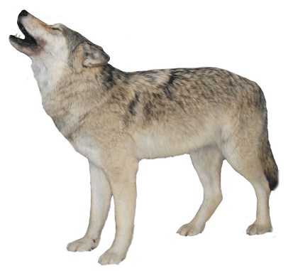
What is a Kernel?
A kernel is the smallest unit of scientifically proven behavioral influence.
Kernels produce quick easily measured change that can grow into much bigger change over time.
They can be used alone OR combined with other kernels to create new programs, strategies or policies.
Combinations of Kernels are considered “behavioral vaccines.”
“Planted” Kernels create a culture.

Slide 80
Managing Affect
Mood is your internal emotional state.
Affect is how you externalize your emotions through verbal and non-verbal cues.
Research shows that trauma-impacted people are particularly aware of changes in affect, which triggers the survival brain, decreasing their capacity to think and learn.
Notes:
Notes: This slide introduces participants to Affect management. It is okay to read as presented. We’ll circle back to this slide in a bit.
Attachment, Self-Regulation & Competency
Kinniburgh, Blaustein, Spinazzola & van der Kolk, 2005, Psychiatric Annals, pp. 424-430.

Slide 81
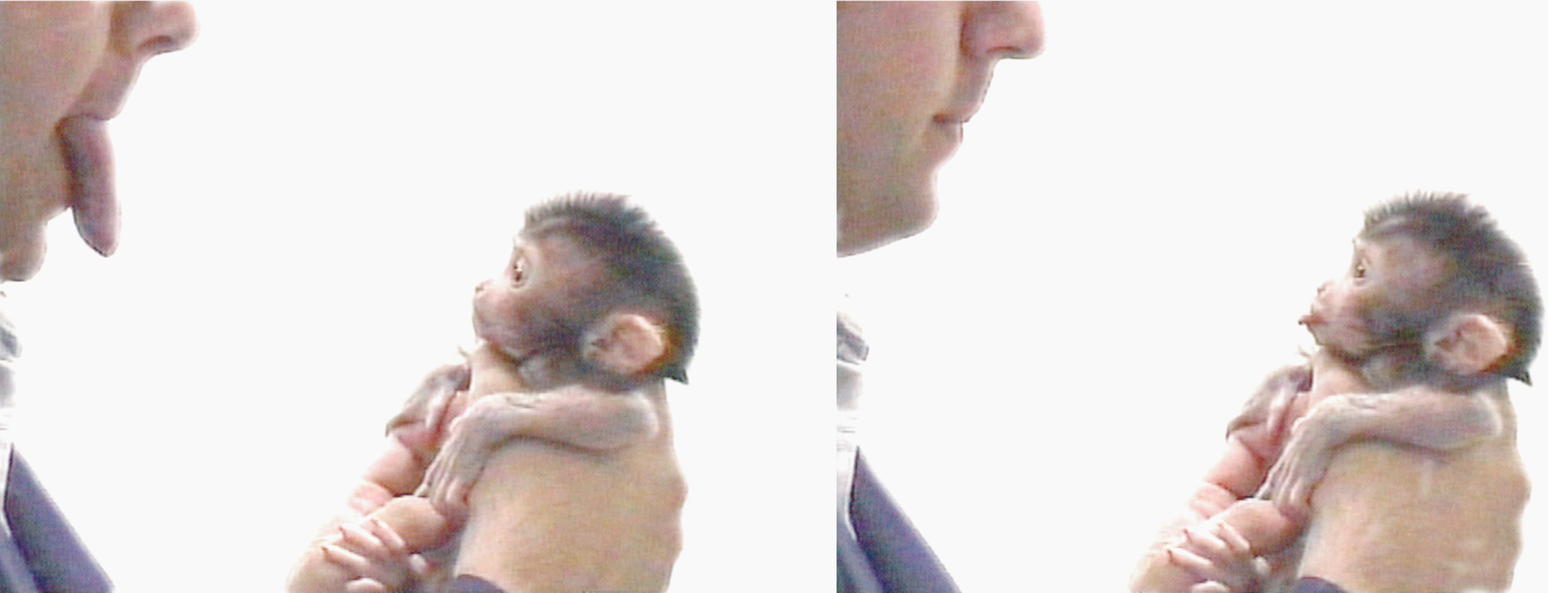
Your Pain is My Pain
Mirror Neurons help us to instinctively understand the actions of others and prime us to imitate what we see.
This neural mechanism is involuntary and automatic.
Notes:
Notes: This slide introduces participants to the concept of mirror neurons, an involuntary social learning mechanism. Mirror Neuron research in humans is young, primarily beginning in 2012; however, mirror neuron existence in animals began about 60 years ago.

Slide 82
Rubber Hand Illusion
https://www.youtube.com/watch?v=iPFSgLDCvAs
Notes:
Notes: This video comes from the National Geographic television program called “Brain Games.” Introduce it as, “I want to show you how mirror neurons work.”
When the video concludes, I repeat the last lines for emphasis, that approximately 30% of the brain is dedicated to processing our sense of sight, and that when faced with choosing what we’re seeing vs. what our other senses are telling us, we often trust our eyes and make the wrong choice.
This video does not actually demonstrate Mirror Neurons in action, it actually demonstrates the brain’s capacity for neuroplasticity – the ability to recover from trauma by creating new neural connections.
What we see as the host conditions each participants hands is their brain – in real-time – creating new neural connections telling participants that the false hand is their real hand. That’s why when it is struck, particpants express feeling pain, being able to move their fingers, and so on.
Neuroplasticity gives us hope that forever changed by trauma doesn’t mean forever damaged by trauma.

Slide 83
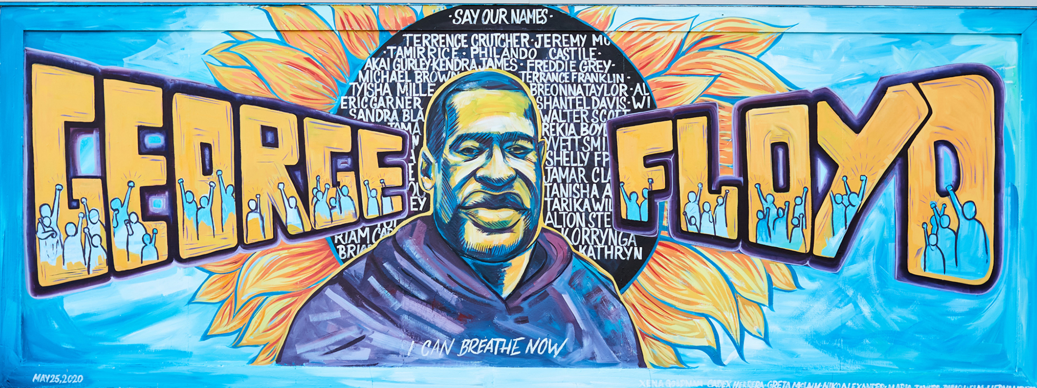
Your Pain is My Pain
Mirror Neurons help us to instinctively understand the actions of others and prime us to imitate what we see. It is an involuntary and automatic neural mechanism.
Consider that in our current context, Mirror Neurons comprise the biology of witness.
Notes:
Notes: Circling back to the Mirror Neuron slide, say: “The actual demonstration of how Mirror Neurons work was this room. You were a living demonstration.” Explain that although presentation participants were just observers of a two-dimensional tv program, most of them still mirrored the expressions they saw on screen. Point out the gasps that accompanied the first demonstration, the matched facial expressions of surprise, that most of the room was silent during the second demonstration until the participant begins to laugh and then the whole room chuckled with him, and even the final demonstration in which (even though they new it was coming) the majority of the room matches the participant’s surprise and shock.

Slide 85
Managing Affect
Mood is your internal emotional state.
Affect is how you externalize your emotions through verbal and non-verbal cues.
Research shows that trauma-impacted people are particularly aware of changes in affect, which triggers the survival brain, decreasing their capacity to think and learn.
Notes:
Notes: This brings us back to the importance of the evidence-based practice of managing affect. Our goal should be a consistent neutral or positive affect when interacting with clients in order to facilitate trust and rapport building while keeping them at ease around us. Think about maintaining at least a McDonald’s level of customer service in every interaction.
Attachment, Self-Regulation & Competency
Kinniburgh, Blaustein, Spinazzola & van der Kolk, 2005, Psychiatric Annals, pp. 424-430.

Slide 86
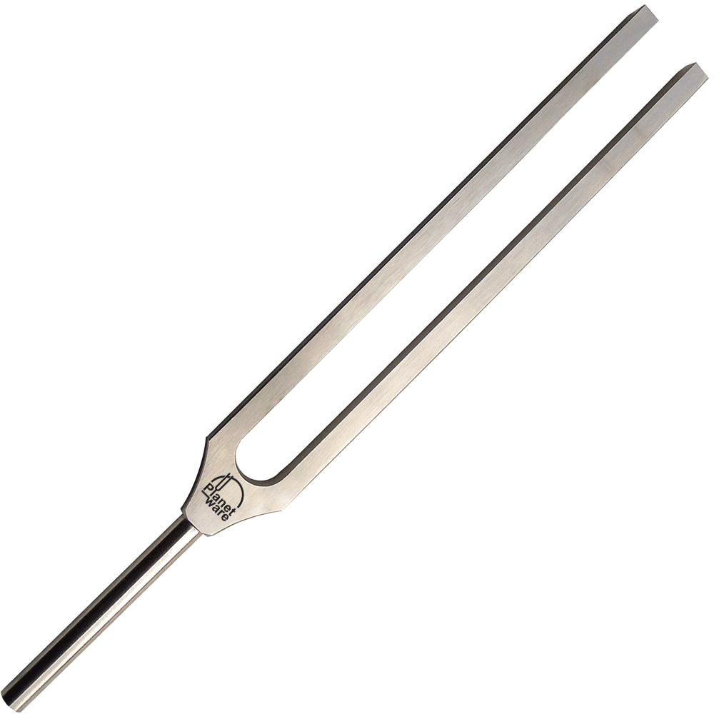
Attunement
Traumatized people, especially youth, often have difficulty communicating, so their behaviors may become a front for conveying unmet needs or dysregulated affect.
We may respond to the most distressing symptom, rather than the client’s underlying emotion or need.
Ask - “What’s happening here?” rather than, “What’s wrong with this person?”
Notes:
Notes: This is the second paradigm shift we are asking participants to embrace: to ask what’s happening rather than what’s wrong. We want participants to embrace a thought process that encourages considering if a client’s immediate behavior may be the result of an activated stress response system rather than rudeness.

Slide 87
Consistency
Being predictable by having consistent responses to client behavior is vital to establishing safety and reducing your client’s need to exert control.
An intentional focus on building success, rather than establishing limits – which may be associated with powerlessness or vulnerability – should be your priority.
Know that your most challenging clients may initially react with both negative or positive responses.
Notes:
Notes: In this case, building success means promoting the prosocial behaviors you want to see rather than the anti-social behaviors you don’t want to see. This is also a time to remind participants that any change to predictability may negatively impact behavior until the change becomes routine.
This is also an opportunity to remind participants about extinction behaviors. Our clients may subconsciously and more intensely regress into the behavior we’re trying to change if our efforts are being successful because any change may be considered a threat. Stick with it. Research shows that we must practice new strategies for at least 12 weeks before achieving sustainable behavior change. Encourage participants to stick with a new strategy for at least a month before concluding it is ineffective. In my experience, well-meaning individuals paint themselves into the corner of “Nothing will work with this client” because they abandon evidence-based strategies when they do not produce immediate or magical effects.

Slide 88
Routines and Rituals
Building routines and rituals, particularly around trouble areas, can make meeting with you fun, safe and predictable.
Research shows that establishing routines enhances client:
Feelings of safety;
Ability to build trust and feelings of reliability within a relationship; and
Anticipation of an event, which reduces stress.
Notes:
Notes: This slide may be presented as written, and validated by your personal experience or salient detail about establishing a routine.
Attachment, Self-Regulation & Competency
Kinniburgh, Blaustein, Spinazzola & van der Kolk, 2005, Psychiatric Annals, pp. 424-430.

Slide 89
From Concept to Application – 10 Minute Breakout Session
Consider the following evidence-based kernels:
Affect Management
Attunement
Consistency
Establishing Routines and Rituals
Discussion:
How is your organization intentionally promoting or using these strategies among staff and with clients?
Are there any situations you can recall where the use of one of these strategies would have helped a client to be successful?
Brainstorm ideas about how these strategies can be incorporated into your work.
6-8

Slide 90
Why Haven’t We Heard this Before?
Notes:
Notes: This slide is optional. The point is: It’s a long and very expensive road to becoming recognized as a evidence-based practice. Program developers must recoup their investment, or these effectiveness studies would essentially stop.
Kernels, on the other hand, comprise non-proprietary evidence-based practices shared by many world class programs. They are indivisible and fundamental units of behavioral influence. They are also intuitive and require no special curriculum, materials or supplies to implement. There is simply no money to be made from promoting kernels.
So we turn to the audience. They are our wolves (as in the opening systems video for this half of our presentation)

Slide 91
Play
Caretaker/child play – is associated with lower rates of delinquency, substance abuse problems and psychiatric disorders such as depression and anxiety problems.
Physical play – increases a child’s ability to have healthy relationships by teaching basic skills for making and playing with friends.
Non-Directive Play – improves the relationship with the parent, increases the happiness and contentment of the child, and results in greater attention span, improved creativity and resourcefulness.
Notes:
Notes: Physical play is exactly what it sounds like.
Non-directive play has a recipe: The adult does not lead play, but rather follows the child’s play by imitating and narrating what the child is doing. Essentially, the adult becomes the sports announcer of play while they participate with the child. Two 15 minute play session a week result in the listed outcomes over time.

Slide 92
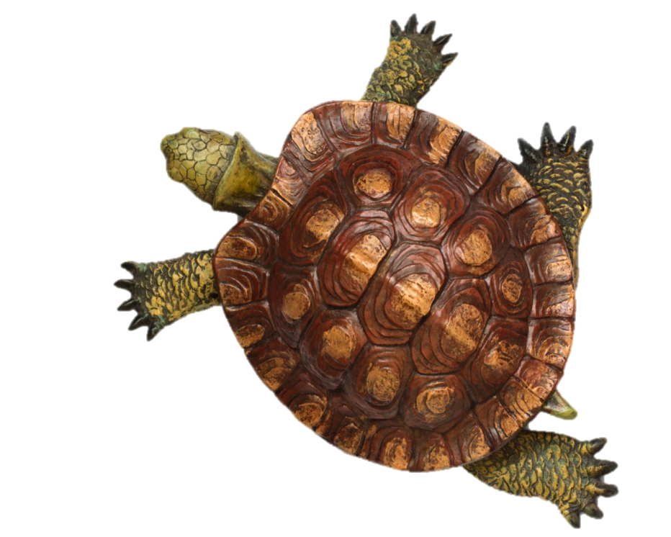
Turtle Breathing
“Turtle Breathing” is a technique for helping children with controlling anger.
Trusted adults use this technique in conjunction with the scripted story, “Tucker Turtle Takes Time to Tuck and Think.”
This technique:
Reduces anxiety
Reduces temper tantrums
Increases resiliency
Increases self-control
Notes:
Notes: Reading and practicing the steps in the story book is the intervention. All materials are available online for free. The strategy was developed and researched by Vanderbilt University.

Slide 93
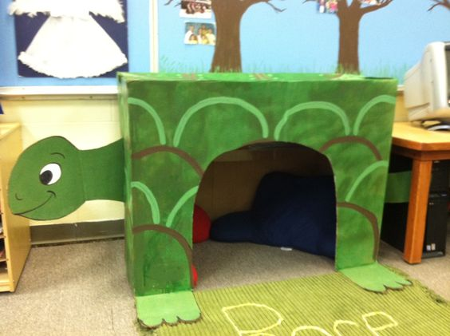
Turtle Breathing - Recipe
Model remaining calm
Teach the child the steps of how to control feelings and calm down
Step 1: Recognize your feeling(s)
Step 2: Think “stop”
Step 3: Go inside your “shell” and
take 3 deep breaths
Step 4: Come out when calm and think of a “solution”
Practice steps frequently
Recognize and comment when the child stays calm
Involve families: teach them the “Turtle Technique”
Be clear, consistent, predictable, and follow through
Maintain high expectations and assume positive intent, build on success rather than establishing limits
Provide guided opportunities to participate through voice and choice
Focus on the feeling of safety, building trust, and reliability of relationships

Slide 94
Notes:
Notes: One example of many, many free online resources available to support Turtle Breathing

Slide 95
Verbal Praise
When any person receives specific, spoken recognition for engagement in a target act or behavior, it is widely demonstrated to:
Improve school and work performance
Improve prosocial interactions
Improve organizational functioning
Increase engagement in the noticed behavior
Notes:
Notes: This slide may be presented as written, but emphasize that verbal praise and recognition is the single most powerful behavior change strategy on earth. No other strategy comes close to the impact of praise.
Research is clear that the more we notice a behavior, the more likely its frequency will increase. Consider the next slide…

Slide 96
Verbal Praise as a Social Reinforcer
What are the social reinforcers in your organization for this behavior?
Paying attention.
Notes:
Notes: How does your agency or program recognize participants for doing “what is expected?” Chances are expected behavior is ignored.

Slide 97
Verbal Praise as a Social Reinforcer
How about for this behavior?
Attention Seeking or Distracting
Notes:
Notes: Now consider how often acting out behavior is noticed. Likely at a much higher rate. Research is very clear: We increase the frequency of behaviors that we notice. Is your agency accidently installing the very behaviors you’re struggling with, or trying to prevent?

Slide 98
I – FEED – V
Use the I-Feed-V mnemonic to guide your use of praise (Loveless, 1997): I = immediate F = frequent E = enthusiastic E = eye contact D = describe the behavior V = variety
Ratio of praise to criticism = 4:1 (Watson, 2004)
Notes:
Notes: Researchers offer this pneumonic for engaging in praise. Remember, be specific and immediate. The ratio of 4:1 for offering praise to criticism is the lowest research-supported ratio I could find. I present the minimum to make this practice more attainable, but more is better.
If you work with a client who does not receive direct praise well, try indirect praise: speaking a praise loud enough for the client to overhear, but not directly to her.
Positive outcomes for both social and academic behaviors (e.g., Broden et al., 1970; Craft et al., 1998; Ferguson, & Houghton, 1992; Gable & Shores, 1980; Sutherland, 2000; Sutherland et al., 2000).

Slide 99
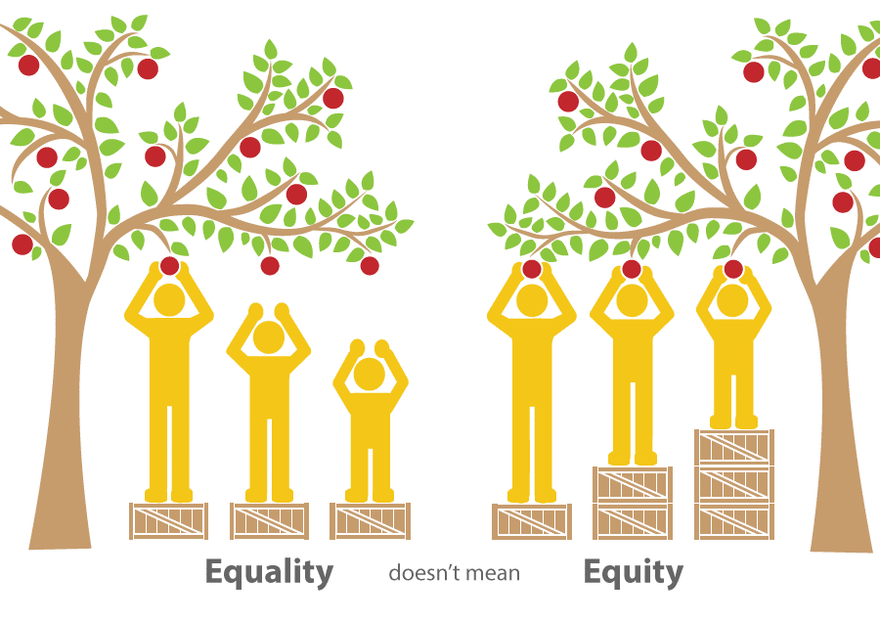
Equity or Equality
Notes:
Notes: Praise is a matter of equity, not equality. Equity means we provide additional support where we need to in order to ensure each of our clients can meet their goals. In my experience, you may encounter more public resistance to the use of praise than any other strategy presented here. “Undeserved” praise seems to challenge many people’s sense of fairness.
Do emphasize that we need to notice the expected more than the exceptional. For many of our clients, doing what is expected IS exceptional.

Slide 100
Written Praise
Notes from recognizing clients and coworkers for a specific action or behavior is demonstrated to help across the span of life:
Do better at school or work
Be more socially competent
Reduce symptoms of ADHD, aggression and problem behaviors
Increase engagement in the noticed behavior
Notes:
Notes: There are more ways to share praise than by verbalizing it. Research shows written praise is just as effective.

Slide 101
Positive Note for Inhibiting a Challenging Behavior
If you work with children, a positive note sent home with a child for inhibiting an otherwise disruptive behavior is show to:
Reduce disruptive and aggressive behavior
Reduce problems at home
Increase engagement at school
Notes:
Notes: Although noticing the inhibition of a behavior seems counterintuitive, this practice is recognized to prevent domestic violence and child abuse, especially where a child’s disruptive behavior is suspected of being the trigger for violence.
Example: Dear Mrs. Smith. Its clear you’ve been working with Johnny. He didn’t bark like a dog during silent reading and was a joy to have in class!
Please note for all praise strategies: Concluding a praise statement with “Why can’t you do this all the time?” or some other variant is not praise at all.

Slide 102
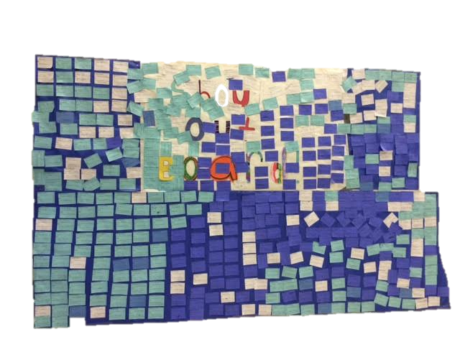
Peer to Peer Notes
Notes of praise written from one peer to another, then read aloud or posted on a public display is widely shown to:
Increase positive friendships
Reduce neighborhood disorganization and crime
Increase sense of safety
Increase volunteerism
Increase engagement in the noticed behavior
Notes:
This is a span of life kernel. The active ingredient is reading it aloud and/or posting it to a public display.

Slide 103
From Concept to Application – 10 Minute Breakout Session
Consider the following evidence-based kernels:
Engaging in or Teaching Non-Directive Play
Breathing Strategies
Specific Verbal, Written and Public Praise and Recognition
Discussion:
How is your organization intentionally promoting or using these strategies among staff and with clients?
Are there any situations you can recall where the use of one of these strategies would have helped a client to be successful?
Brainstorm ideas about how these strategies can be incorporated into your work.
6-8

Slide 104
Five Minute Break
Notes:
Notes: Return from break: any thoughts or questions before we move on?

Slide 105
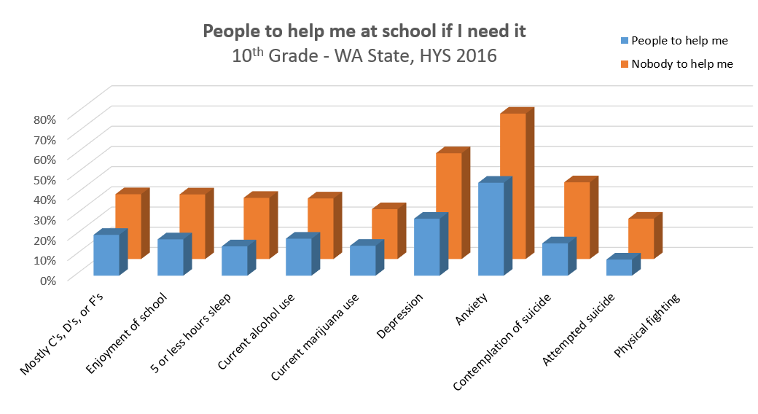
Building Relationship is Key
Connection and relationship are vital to improving outcomes for all clients.
“Relationship is the evidence-based practice.”
– Chris Blodgett, WSU
Notes:
Notes: This is the key focus of our day. Relationship is the evidence-based practice most likely to interrupt the trauma-trajectory. In the bar chart, students Washington State students are separated into two groups: Those who responded on the Healthy Youth Survey that they know an adult who can help them in school, and those who say there is no adult to help them at school. Although causation is not established, the correlation is significant: Students who believe that have access to a helping adult fare better across ALL behavioral health domains.

Slide 106
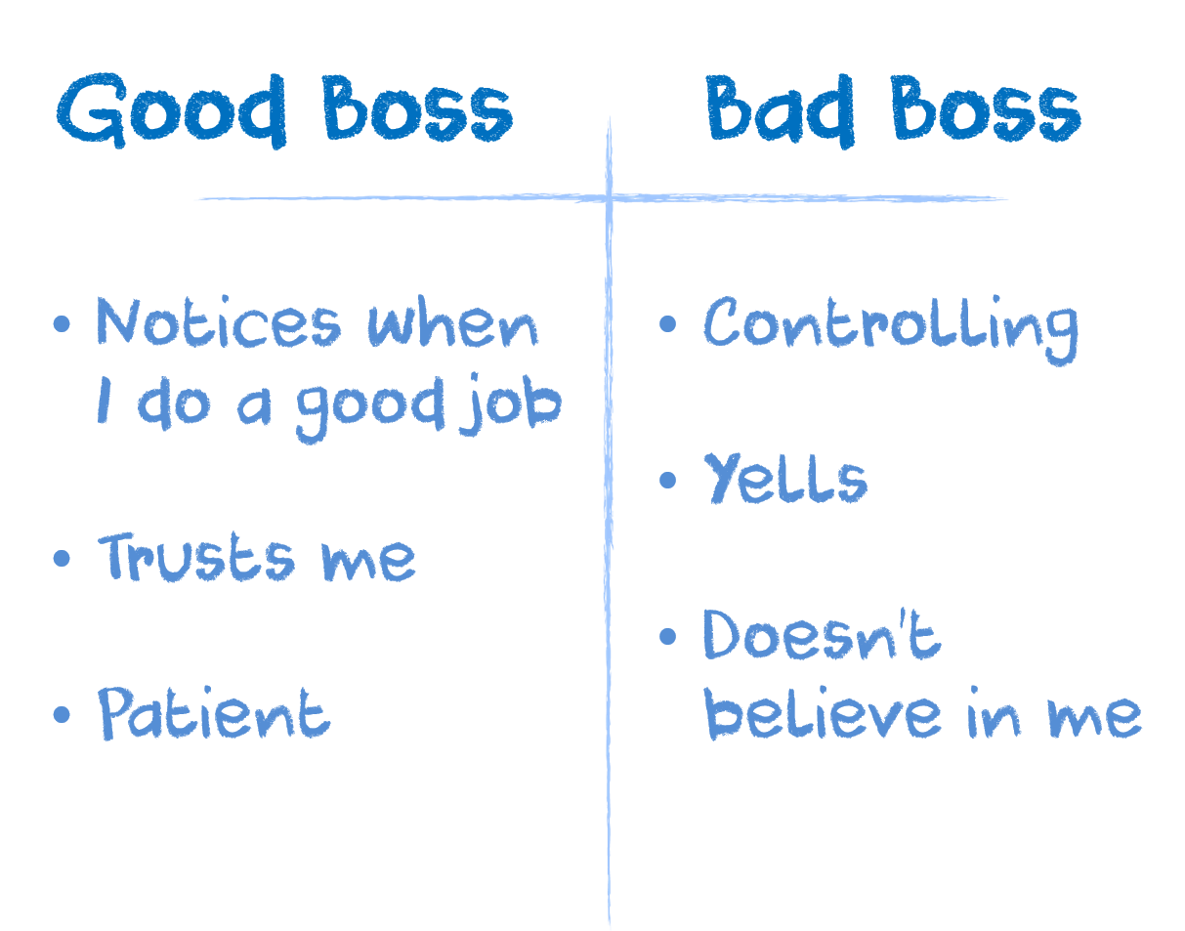
Annotation Activity: What Do You Need to Be Successful?
All
Notes:
Notes: This is a small group activity. Say, “Now I want to focus on your needs and experience.” Participants are to list the qualities of the best bosses they have ever worked for, and then list the qualities of the worst bosses they ever worked for. Prompt with questions like, “What made it the best office environment you’ve ever worked in? What made it possible for you to be successful? What made it so you couldn’t wait to escape.”
Conclude the activity by asking participants to read aloud from their lists. Reaffirm this exactly what we need to be successful, or that you couldn’t wait to get away from that toxic environment as well. Just normalize the responses.
Before moving to the next slide, ask aloud, “What if I changed the audience I was asking this question to?” Would the responses change if we asked what your clients need from you in order to be successful?”

Slide 107
Traits of Your Best Bosses
All
Notes:
Notes: This is a small group activity. Say, “Now I want to focus on your needs and experience.” Participants are to list the qualities of the best bosses they have ever worked for, and then list the qualities of the worst bosses they ever worked for. Prompt with questions like, “What made it the best office environment you’ve ever worked in? What made it possible for you to be successful? What made it so you couldn’t wait to escape.”
Conclude the activity by asking participants to read aloud from their lists. Reaffirm this exactly what we need to be successful, or that you couldn’t wait to get away from that toxic environment as well. Just normalize the responses.
Before moving to the next slide, ask aloud, “What if I changed the audience I was asking this question to?” Would the responses change if we asked what your clients need from you in order to be successful?”

Slide 108
Traits of Your Worst Bosses
All
Notes:
Notes: This is a small group activity. Say, “Now I want to focus on your needs and experience.” Participants are to list the qualities of the best bosses they have ever worked for, and then list the qualities of the worst bosses they ever worked for. Prompt with questions like, “What made it the best office environment you’ve ever worked in? What made it possible for you to be successful? What made it so you couldn’t wait to escape.”
Conclude the activity by asking participants to read aloud from their lists. Reaffirm this exactly what we need to be successful, or that you couldn’t wait to get away from that toxic environment as well. Just normalize the responses.
Before moving to the next slide, ask aloud, “What if I changed the audience I was asking this question to?” Would the responses change if we asked what your clients need from you in order to be successful?”

Slide 109
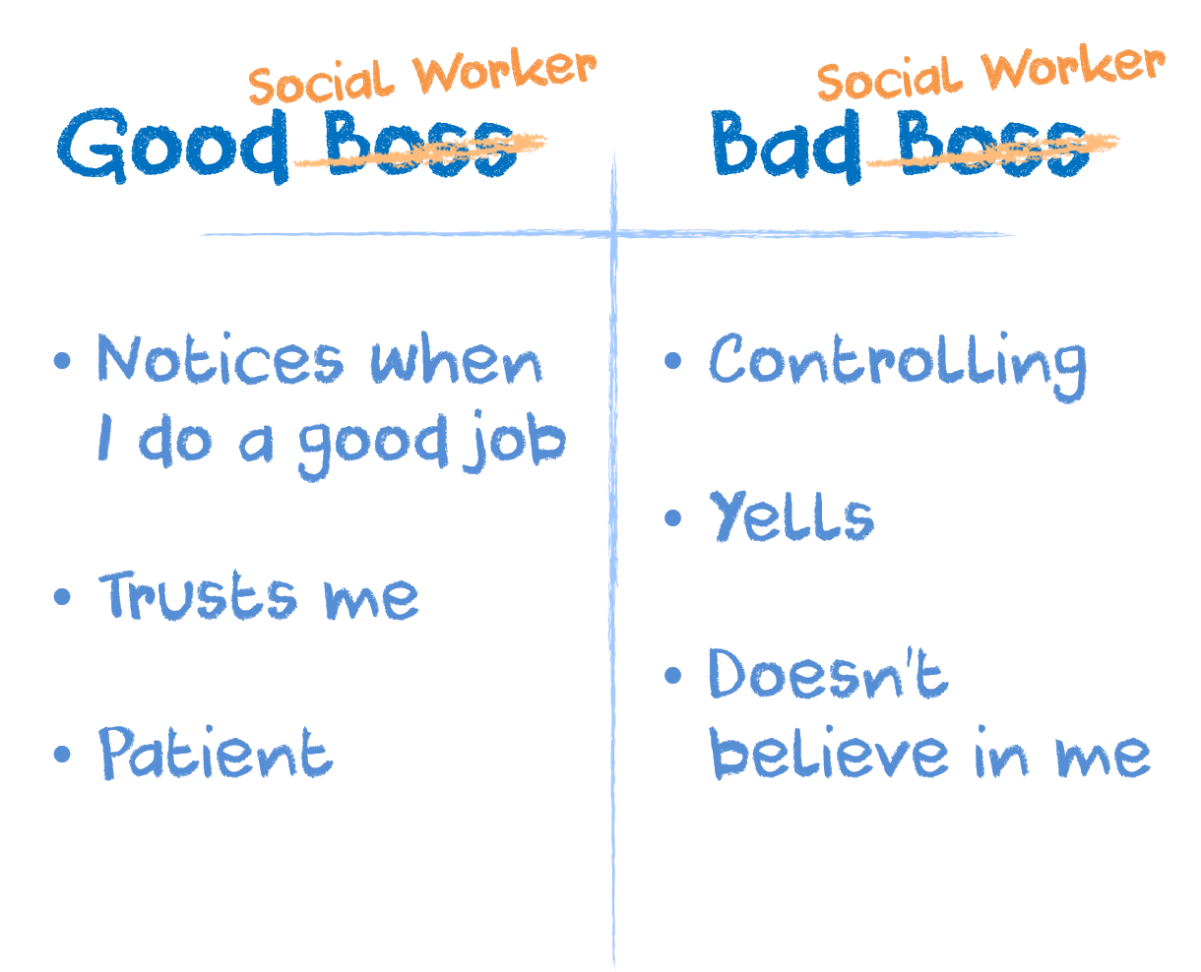
What Do Your Clients Need from You to be Successful?
Notes:
Notes: Take this opportunity to reread your participant’s lists. Instead of saying, “My best boss…” Say, “My best social worker, case manager, club leaders…”
Drive home the point that their clients need EXACTLY the same things they need in order to be successful.

Slide 110
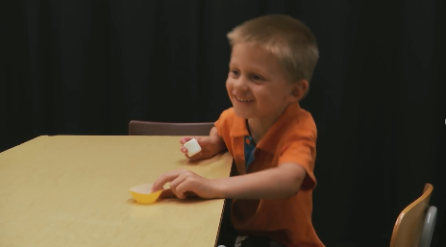
The Marshmallow Experiment
Feelings of reliability within a relationship improves self-control.
https://www.youtube.com/watch?v=JsQMdECFnUQ
Notes:
Notes: This is a video about the Marshmallow Experiment in which it was determined that feelings of reliability within a relationship have a direct bearing on a clients ability to self-regulate.
Conclude this video by reiterating the closing lines. “If our clients grew up in environments in which long-term gain is very rare, then it makes perfect sense that they would behave impulsively to maximize their opportunity for reward.”

Slide 111
Pleasant Greeting with Physical Touch
Also known as “handshakes.”
Frequent friendly physical and verbal greetings impact social status and perceptions of safety and harm.
They also affect behavior streams of aggression, hostility and politeness.
Notes:
Notes: Do acknowledge that this strategy – although evidence-based – is likely not a good idea during times of Covid. Nevertheless, I recommend presenting it as a continued example of the simplicity behind the kernels movement.
Physical contact releases a cascade of Oxytocin, the bonding, safety and attachment hormone. Demonstrations of physical contact between an authority figure and a marginalized client are shown to interrupt how that marginalized individual is perceived by their peers, especially if those peers are bonded with the authority figure.

Slide 112
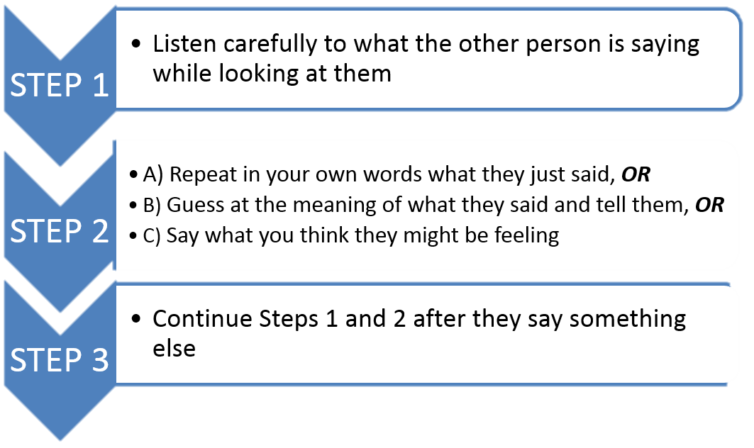
Active Listening
Active Listening is a structured form of listening and responding that focuses the attention on the speaker. Research shows this technique increases mutual understanding and respect, while building emotional support.
Notes:
Notes: This slide may be read as presented and is also an activity. Participants should break out into dyads or tryads with a listener, speaker and observer, or just a listener and speaker. Ask participants to share their stress temperature during activity. Encourage listeners to only respond using one of the options in Step 2 and refrain from adding their own experience with stress.
This is a very intentional strategy that may not come naturally to all participants. That’s okay! Practice makes progress! Each participant should have a turn as a listener and as a speaker.
Debrief and ask how it felt. Do not assume that all participants are practiced at Active Listening.

Slide 113
What’s Your Stress Temperature – 10 Minute Breakout Session
Practice your active listening skills. Instructions:
Each person takes a turn at one of three roles: Speaker, Listener, Coach
Speaker: Discuss your stress temperature from 0 degrees (life is like a Hawaiian vacation) to 100 degrees (I’m out of here and never coming back!). What’s contributing to your temperature?
Listener: Listen utilizing the active listening steps. Remember – you are listening, not sharing.
Coach: Prompt the listener with active listening steps if the listener is struggling. Share what you observed.
3

Slide 114
Private Reprimands
Public reprimands and humiliation can create a trauma response, especially in boys, that causes long lasting negative effects. Where possible, low emotion and private reprimands are a more effective strategy.
Research shows that this strategy:
Reduces aggression
Reduces disruptive behavior
Reduces emotional responding
NOT
OK
OK
Notes:
Notes: This slide may be read as presented. The graphic is a representation of the OK/Not OK card utilized in the PAX Good Behavior Game with children. R.ather than confronting and giving attention to an undesirable behavior, teachers are able to redirect it by tapping on the card without interrupting their lesson. How would this translate to a club or afterschool environment?
Remember, Praise is Public while Reprimands are Private.
Among the many insights learned from the ACEs Study, researchers determined that sexual abuse was weighted most heavily in predicting long-term negative health and opportunity outcomes for girls. For boys, the experience of humiliation was the most heavily-weighted predictor.

Slide 115
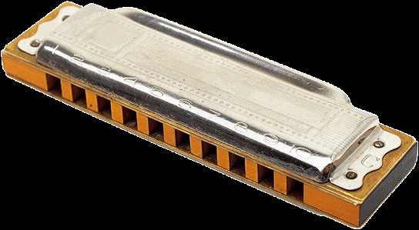
Auditory/Visual Signal for Transition
The attention kernel works for youth and adults. It results in:
Immediate reduction in transition time
Increased academic engagement
Reduced disruptive behavior
Reduced aggression and bullying
Reduced trauma response in traumatized people.
Notes:
Notes: This slide may be read as presented. Researchers found the most common auditory signal for transition that elicited a trauma-response was clapping (1-2-3, Eyes on Me!) because it simulated the sound of slapping or distant gun shots for trauma-impacted people.
The harmonica produced the lowest trauma-response during transitions.

Slide 116
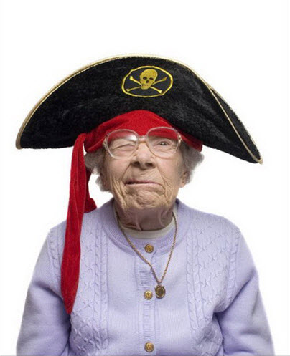
Premack’s Principle
Also known as Contingency Management, the Mystery Motivator, Granny’s Wacky Prizes, Prize Bowl and the Game of Life.
A praise strategy that uses activities as positive reinforcement instead of words. It results in:
Reduction in deviant behavior across the lifespan
Reduction in problem behaviors at school
Increases desirable behavior in all age groups
Reduces addiction.
Promotes self-regulation instead of excitement
Be clear, consistent, predictable, and follow through
Maintain high expectations and assume positive intent, build on success rather than establishing limits
Provide guided opportunities to participate through voice and choice
Focus on the feeling of safety, building trust, and reliability of relationships
Notes:
Notes: This slide may be read as presented.
Implementing a Premack’s Principal strategy can be simple. Establish a goal to be reached with your client. Each day they meet that goal, they get a cumulative entry in the prize bowl. 1st day, one entry. 2nd day in a row 2 entries. 3rd day, 3 entries and so on. On the fourth day they miss their goal and get no entry. On 5th day they meet their goal and start over at one entry.
Prizes probably should not be material with young people, and probably should not exceed on Grand Prize exceeding more than $20. Ample instructions exist online, but at its core, this is another praise and recognition strategy used to increase the frequency of a desired behavior.

Slide 117
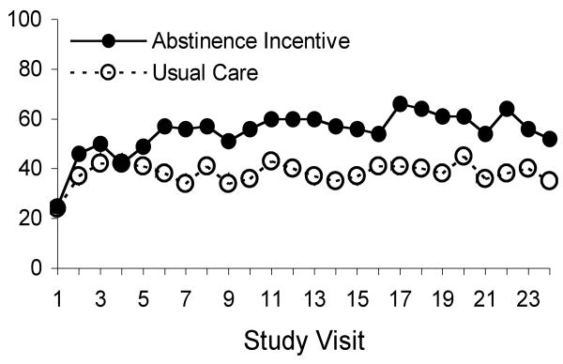
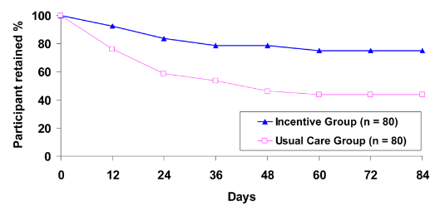
Premack’s Principle
Be clear, consistent, predictable, and follow through
Maintain high expectations and assume positive intent, build on success rather than establishing limits
Provide guided opportunities to participate through voice and choice
Focus on the feeling of safety, building trust, and reliability of relationships
Effects of a randomized contingency management intervention on opiate abstinence and retention in methadone maintenance treatment in China.
Hser YI, Li J, Jiang H, Zhang R, Du J, Zhang C, Zhang B, Evans E, Wu F, Chang YJ, Peng C, Huang D, Stitzer ML, Roll J, Zhao M.
Addiction. 2011 Oct;106(10):1801-9. doi: 10.1111/j.1360-0443.2011.03490.x. Epub 2011 Jul 27.
PMID: 21793958
Notes:
Notes: These graphs represent the effectiveness of augmenting substance use treatment with a contingency management strategy. Both retention rates and abstinence are increased by the use of this strategy. Typically, contingency management costs less than $160 per client.

Slide 118
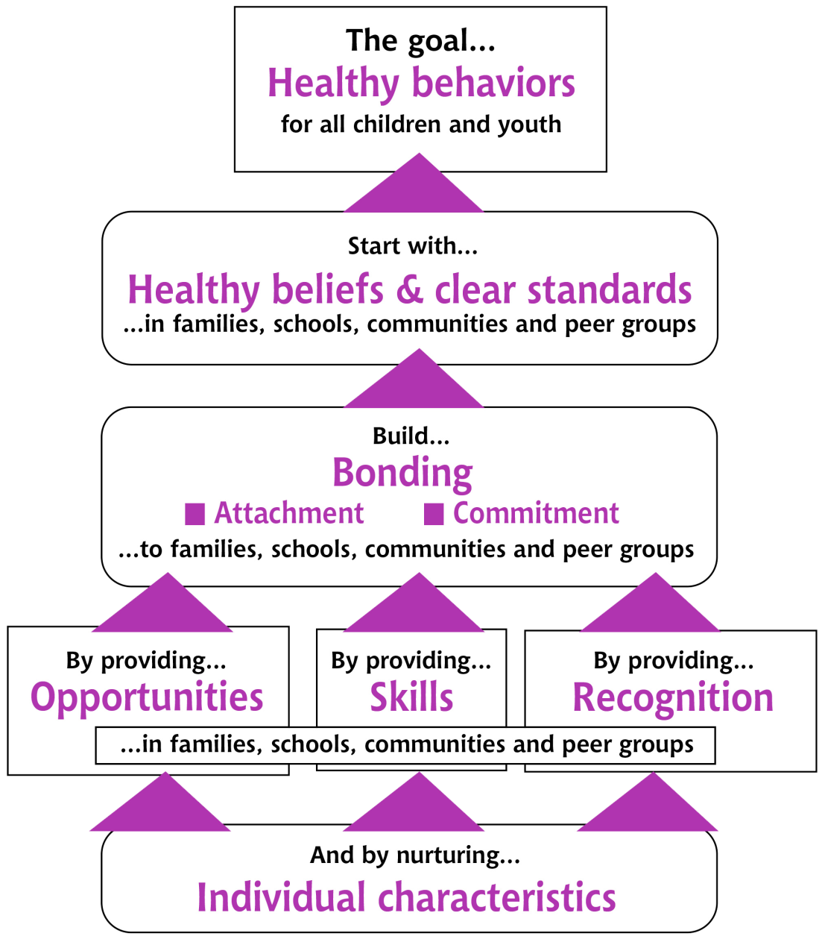
The Social
Development Strategy
Notes:
Notes: The Social Development Strategy was developed by the University of Washington School of Social and is recognized globally. It is essentially the formula for bonding and the adoption of healthy beliefs and behaviors.
We start be recognizing the individual characteristics of our clients, and then engage in a three step process:
Provide opportunity for your client to make a meaningful contribution to you, your agency, or community.
Teach the skills your client will need in order to be successful in that opportunity. Do not assume ability.
Provide consistent recognition for your client’s effort (not exceptionalism) as they work at the contribution. Private and public recognition is okay based on your knowledge of what the client will receive/respond to.
Research shows this process creates attachment and commitment between client and clinician/institution. This attachment leads the client to be more receptive to your healthy beliefs and standards, and ultimately leads to the adoption of those behaviors.

Slide 119
Detached Observer Phenomenon
Reading helps clients build resilience by introducing them to solutions that may be relevant to their needs.
Through identification with characters, the reader has a vicarious experience that facilitates insight and a release of their own emotions.
Because the reader is a detached observer, they are less defensive and more open to a new experience.
Notes:
Notes: This slide may be read as presented.

Slide 120
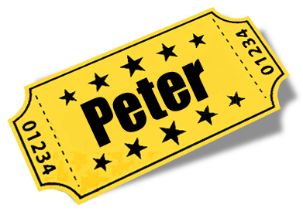
Authority Figure Lottery
When an authority figure like a club director sends a note home or calls a parent about a young person’s positive behavior, research shows that action results in:
Increases in engagement
Reductions in disruptive behavior
Reductions in aggression
Notes:
Notes: This slide may be read as presented.

Slide 121
Gratefulness Check-in
When people are asked and share what they are grateful for once per week, research shows:
Increase in happiness
Improved sleep
Notes:
Notes: This is a staff care strategy. Research shows that incorporating gratefulness practices into regular meetings measurably increases employee happiness and sleep. Imagine a more rested and happy workforce!

Slide 122
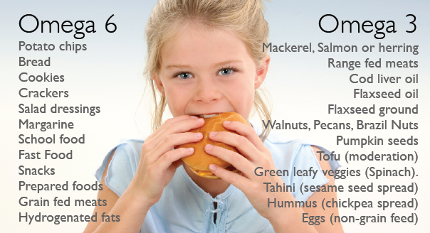
Brain Nutrient Deficiencies Impact Health Across the Globe
The alterations in brain chemistry that have resulted from our changing diet during the last 60 years contributes to trends of depression, bipolar disorder, autism, violence and academic problems.
Notes:
Notes: This is a fun one! It is both a client and clinician self-care strategy supported by research conducted by the National Institute of Health. Simply participants to identify which side of the essential fatty-acid list their clients mostly eat from.
This trend in diet in new in our history, but contributed to significant behavioral health trends. Remind participants that the body does not produce essential fatty acids, they must be consumed. Also remind them that we need to the right ratio of Omega 6: Omega 3 in order for our brains to function optimally.

Slide 123
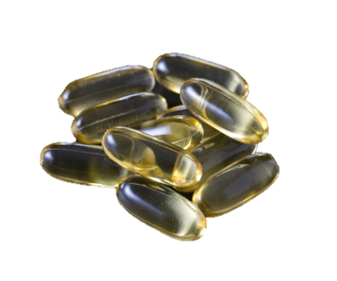
Omega-3
Supplementation
Omega 3 has no harmful effects
Well-documented evidence for Reducing aggression, depression, anxiety, bipolar disorder, post partum depression and borderline personality disorder
2002 Oxford University study and 2009 Dutch Corrections study of found Omega-3 supplementation achieved a 37% reduction in episodes of inmate aggression.
In 2006, the American Psychiatric Association recommend that all psychiatric patients receive at least 1 gram of omega-3 per day to reduce symptoms of mental illness.
Notes:
In 2002, Bernard Gesch, a physiologist at Oxford University, investigated the effects of nutritional supplements on inmates in British prisons. Working with 231 detainees for four months, Gesch gave half the group of men, ages 18 to 21, multivitamin, mineral and fatty-acid supplements with meals. The other half of the men received placebos. During the study, Gesch observed that minor infractions of prison rules fell by 26 percent among men given the supplements, while rule-breaking behavior in the placebo group barely budged. The research showed more dramatic results for aggressive behavior. Incidents of violence among the group taking supplements dropped 37 percent, while the behavior of the other prisoners did not change.
Also - Dutch National Agency of Correctional Institutions revealed a 34% decrease of violence and aggression among a 116 member group that were given multi-vitamins, minerals and omega-3 supplements. At the same time, the 105 member group that was administered the placebo had their violent behavior and incidences of rule-breaking behavior increase by 13%.

Slide 124
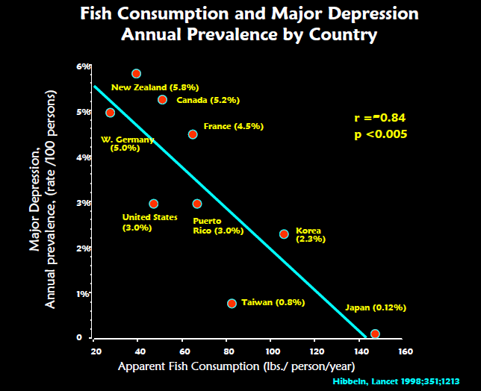
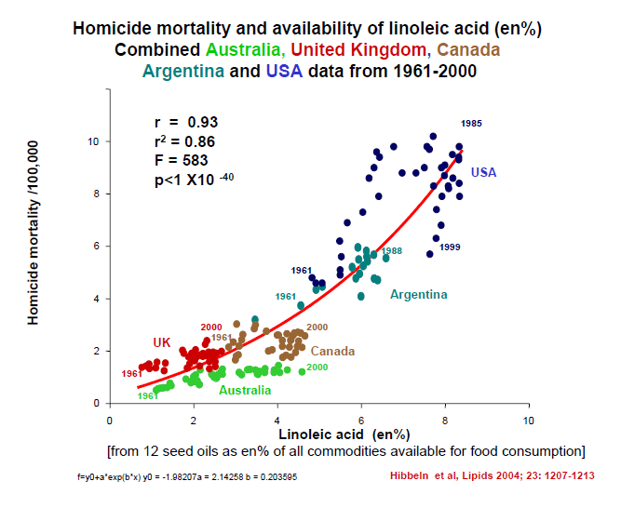
National Institute of Health
Notes:
Notes: The graph on the left depicts rates of national omega 3 consumption using fish consumption as a proxy. The more fish consumed in a nation, the lower the prevalence of major depressive disorders. Conversely, the less fish consumed by a nation the higher the rate of major depressive disorders.
On the right, NIH did a follow-up study looking at homicide mortality rates between 1961-2000. The agency found that countries consuming the most omega-6 per capita also had the highest homicide mortality rates during this time.

Slide 125
Behavioral Vaccines
1967
1971
1996
1968
If you work together to provide effective organization-wide behavioral vaccines for your clients, how will your resources and culture be impacted?
1995
1859
Notes:
Notes: As we wrap-up, lets circle back to behavioral vaccines. Behavioral vaccines work like any other vaccine. If you have an infected person in an uninoculated population, the virus broadly contaminates the population and your resources get stretched to, or over, capacity. If the same virus is introduced into a well inoculated population, contagion is limited and you can focus your resources equitably, on those who most need them.
A behavior vaccine is simply the combination of effective technologies into something even more effective. Each component of the smart phone in your pocket was a revolutionary invention in its time; however, it wasn’t until they were thoughtfully combined that it transformed the behavior of society. Who here has a smartphone in their pocket?
We can also make a behavioral vaccine by combining kernels. Pick any two or three that we’ve discussed today. Commit to implementing them. Watch as small change grows into much bigger change.

Slide 126
Seattle Social Development Strategy
Adults instructed to greet and shake hands with five kids NOT in their classroom each day. They also gave out “caught you being good” tickets every day. 10 years later, kids who received this simple strategy had:
Reduced alcohol, tobacco and other drug initiation
Reduced aggression
Had significant improvement on achievement tests
Were significantly less likely to have engaged in school misbehavior (i.e., cheating, truancy, or being removed from class for misbehavior)
Notes:
Notes: Although it predates the publication of Embry and Biglan’s foundational study on kernels, the Seattle Social Development strategy conducted in Seattle by the University of Washington is a perfect illustration of the simplicity and power of behavioral vaccines.
During this study, teachers at six Seattle elementary schools committed to shaking hands and written praise daily. At 10 year follow-up, controlling for all other factors, researchers determined that this behavioral vaccine positively and irrevocably changed the lives – and trauma trajectory – of students.

Slide 127
Timing Makes a Difference
As we age, it takes more effort for the brain to change in response to experiences.
The plasticity of our brains shrinks when our neurons struggle to form new connections (synapses) with other neurons.
Our brain’s plasticity is the strongest in the first few years after birth. It is easier to form strong brain pathways during the early years and harder to repair pathways as we age.
That’s why building resiliency through a community of CARE is so important!
Notes:
Notes: This slide is optional. Briefly reference that the earlier we act, the more effective our efforts, but that trauma-informed care practices and principles are never wasted.

Slide 128
What else can we do?
Be clear, consistent, predictable, and follow through
Maintain high expectations and assume positive intent, build on success rather than establishing limits
Provide guided opportunities to participate through voice and choice
Focus on the feeling of safety, building trust, and reliability of relationships
Notes:
As service providers we can also:
Deescalate situations
Check assumptions – observe and ask questions
Deeply listen, recognize strengths and successes

Slide 129
The Bottom Line
Understanding ACES gives you the power to significantly impact the trauma trajectory of your clients.
Remember Kaiser Permanente’s diet and nutrition program dropouts? The researchers learned that their very successful intervention wasn’t just treating nutrition problems, it was treating personal solutions!
If you take away a client’s personal solution before teaching them a better one, you’re just digging a hole for them to fall back into.

Slide 130
Your Beliefs Matter!
https://www.youtube.com/watch?v=xQ6wr6vRfGo
Notes:
Notes: The closing video brings us back to relationship and todays participants as their agency’s most significant investment in interrupting the trauma-trajectory. Their beliefs alone can change outcomes. Thank participants and reiterate their importance to their client’s healing and outcomes.

Slide 131
Five Minute Break
Notes:
Notes: Return from break: any thoughts or questions before we move on?

Slide 133
Adverse Childhood Experiences Study (ACES)
ACES began as study in the late 1980’s and 1990’s at a diet and nutrition center managed by Kaiser-Permanente in San Diego, California. It became the largest study ever to examine social determinants of health.
Over 17,000 people participated in the study, which ultimately a direct connection between traumatic childhood experiences and health.
Most critically, the Centers for Disease Control and Prevention (CDC) now recognize ACES as a public health crisis.
ACES Participants were mostly:
Middle class, average age of 57
80% White, 10% Black, 10% Asian
74% Some college
44% Graduated college
49.5% Men
But since the original ACE study, research indicates that ACEs are more prevalent for those belonging to non-dominant cultures and living in poverty...
Notes:
Notes: This is a brief summary of the ACE Study origins and demographics. The text on this slide is all you need; however, I find that adding salient details about Felitti or Anda’s experience increasing engagement. Check out these video interviews, or just google ACES origins to find what resonates with you:
Politics and Profit Interview: https://vimeo.com/349164603/b152fa1e61
Indian Congress Lecture: https://www.youtube.com/watch?v=-ns8ko9-ljU

Slide 134
THREE
TYPES OF ACEs
MEASURED
The original ACE study measured three types of ACEs through a 10 question assessment:
But, there’s actually more than just these…
Notes:
Adverse Childhood Experiences are any exposure to one of 10 forms of household abuse and dysfunction prior to your 18th birthday. There are now more known domains of exposure, but for today, we will focus on the 10 original ACES.
Source: Centers for Disease Control and Prevention
Credit: Robert Wood Johnson Foundation
https://www.npr.org/sections/health-shots/2015/03/02/387007941/take-the-ace-quiz-and-learn-what-it-does-and-doesnt-mean

Slide 135
ACEs interact with stressors commonly faced by racial and sexual minorities—such as discrimination, stigma, and rejection—to contribute to behavior, health and opportunity disparities.
Notes:
Children’s Hospital of Philadelphia Research Institute: https://injury.research.chop.edu/blog/posts/role-race-and-ethnicity-aces-and-developmental-disabilities#.XyheBvnYrIU
http://www.fact.virginia.gov/wp-content/uploads/2019/05/Racial-Trauma-Issue-Brief.pdf
Racial disparities in Childhood Trauma: https://scholar.harvard.edu/files/davidrwilliams/files/child_adversity.pdf

Slide 136
ACEs and Intersectionality
Ethnic and sexual minority children are significantly underrepresented in the ACEs research.
When cultural minorities are included in the data, Black, Hispanic and LGBT children are consistently shown to be exposed to more adversities than white children.
Similarly, those living in economically stressed communities are more likely to experience ACEs.
This has led to a reexamination of the ACEs that predict long-term negative health and opportunity outcomes.
Racial disparities in Childhood Trauma: https://scholar.harvard.edu/files/davidrwilliams/files/child_adversity.pdf

Slide 137
RACE, ETHNICITY AND INCOME INFLUENCE EXPOSURE
ACE Exposure by Race/Ethnicity and Income Level
N=84,837
https://scholar.harvard.edu/files/davidrwilliams/files/child_adversity.pdf
Notes:
https://www.ncbi.nlm.nih.gov/pmc/articles/PMC4815563/
https://scholar.harvard.edu/files/davidrwilliams/files/child_adversity.pdf

Slide 138
Since the original ACE study, exposure to additional early life stressors are being studied.
Passing of a loved one or pet
End of a relationship
Acute Trauma: is caused by a single traumatic event that triggers extreme emotional or physical stress.
Natural Disaster
Homelessness, Foster Care
Poverty
Complex Trauma: is caused by exposure to multiple traumatic events. The long-term impact of this exposure is severe and pervasive.
Community Violence
Deportation or Migration
Historical Trauma: is a complex and collective trauma experienced over time and across generations by a group of people who share an identity, affiliation, or circumstance.
Bullying
Discrimination, Racism
Medical Trauma
Notes:
Note: Additional known trauma domains with links to long-term negative health and opportunity outcomes.

Slide 140
The Brain Science
A person’s environment and experience shapes their behavior and health.
Our brain is designed to prioritize survival.
Hormones like Cortisol are released when our “Fight, Flight, or Freeze” response is triggered.
Notes:
Notes: There are many local expert presenters and presentations that can unpack the neurology of ACES. This is not that presentation. In fact, all I want to acknowledge here is that audiences already possess enough intuitive understanding of how the brain works that we only need to review what we already know. You may read the brain science slides as-is, or supplement with any salient details you wish to include, as long as they are based in evidence.

Slide 141
Toxic Stress
Prolonged exposure to Cortisol and other stress hormones is toxic, and makes permanent changes to the brain.
This means you may encounter clients who are perfectly adapted to survive in their home environment, but who cannot turn-off their behavioral and stress response adaptations in your organization, community or other “normal” situations.
Notes:
Notes: This slide may be read as presented.

Slide 142
ACES LEAD TO THE 10 MOST COMMON CAUSES OF EARLY DEATH
Notes:
Notes: Read this slide as is. Again, these are the findings from the original ACES study which is our focus today.

Slide 143
REFRAMING OUR POINT OF VIEW
With an ACE score of 0, the majority of adults have few, if any, risk factors for the most common diseases leading to early death.
With an ACE score of 4 or more, the majority of adults have multiple risk factors for these diseases or the diseases themselves.
Much of what we see as problem behaviors should actually be viewed as a
personal solution to an unrecognized prior adversity.
Notes:
Notes: This is a critical slide. It is the paradigm shift we are asking all participants to embrace. If the behaviors our clients are experiencing bring them benefit – if they are solutions to an unrecognized prior adversity – how does that shift the nature of our work and approach?

Slide 144
The ACE Pyramid
Without accounting for individual levels of resiliency, this pyramid depicts how impacts to health and well-being can occur over a lifetime as a result of exposure to Adverse Childhood Experiences.
“Personal Solution”
what is predictable, is preventable
The ACE study found links between ACEs and adult health risks, often leading to chronic health conditions.
Those with 4 or more ACEs were found to be:
12.2x as likely to have attempted suicide
7.4x as likely to consider themselves to be an alcoholic
4.7x as likely to have ever used illicit drugs
4.6x as likely to have had 2 or more weeks of depressed mood in the past year
3.2x as likely to have had 50 or more intercourse partners, and
2.3x as likely to smoke
Notes:
Notes: So this is the framework by which we understand the progression of trauma into risk. If we start with a foundation of adversity, we expect brain development to be disrupted just as we saw in the Harvard video. That disruption leads to social, emotional or processing impairment and to compensate, the adoption of health risk behaviors as a personal solution to the challenge we are experiencing (after all, we’re all wired to want to feel better). But we know those personal solutions lead to disease, disability and social problems, and ultimately to early death. That is not hyperbole.
Fortunately, the model also allows for intervention points that allow us to interrupt the ACES trajectory. This is where your work is so important.

Slide 145
Let’s Talk about Kernels
Kernels are low or no-cost to evidence-based strategies recognized as fundamental units of behavioral influence.
This means we can unleash access to strategies that support safety, relationship and skill building essential to our client’s readiness to grow and learn.
Kernels give us a way to implement simple but effective practices that interrupt the ACES trajectory, move us from intuition to intention, and improve outcomes.
Notes:
Notes: The following slides may be read as presented. Kernels were first identified in a metastudy conducted by Dennis Embry and Tony Biglan: “Evidence-based Kernels: Fundamental Units of Behavioral Influence.”
https://www.ncbi.nlm.nih.gov/pmc/articles/PMC2526125/

Slide 146
What else can we do?
Be clear, consistent, predictable, and follow through
Maintain high expectations and assume positive intent, build on success rather than establishing limits
Provide guided opportunities to participate through voice and choice
Focus on the feeling of safety, building trust, and reliability of relationships
Notes:
As service providers we can also:
Deescalate situations
Check assumptions – observe and ask questions
Deeply listen, recognize strengths and successes

Slide 147
Notes:
Neuroplasticity is the process by which the brain is shaped by experiences. There are two types of neuroplasticity:
Cellular plasticity is the number of connections between brain cells. (occurs during the first 5 years of life)
Synaptic plasticity is the strength of the connections between brain cells. (occurs simultaneously with cellular plasticity, but continues on to occur throughout our lives)
Transition: Lets talk more about the power of resiliency! But first, what exactly is resiliency?
_____________________________________
Pat Levitt (2009).
Center for Youth Wellness – An Unhealthy Dose of Stress https://drive.google.com/file/d/1RD50llP2dimEdV3zn0eGrgtCi2TWfakH/view

Slide 148
Notes:
https://www.ncbi.nlm.nih.gov/pmc/articles/PMC4815563/
https://scholar.harvard.edu/files/davidrwilliams/files/child_adversity.pdf

Slide 149
Remember the Shift!

Slide 150
Resources
CWC www.snocochildrenswellnesscoalition.com
Kernels: http://promiseneighborhoods.org/kernels/
Or
http://bit.ly/embry_kernels
ACES: http://www.cdc.gov/ace/index.htm
Or
http://www.acestudy.org/
Or
http://www.fpc.wa.gov/
Or
http://www.acestoohigh.com
ARC Training: http://www.traumacenter.org/research/ascot.php
Notes:
Attachment, Self-Regulation & Competency
Kinniburgh, Blaustein, Spinazzola & van der Kolk, 2005, Psychiatric Annals, pp. 424-430.

